Slide 1
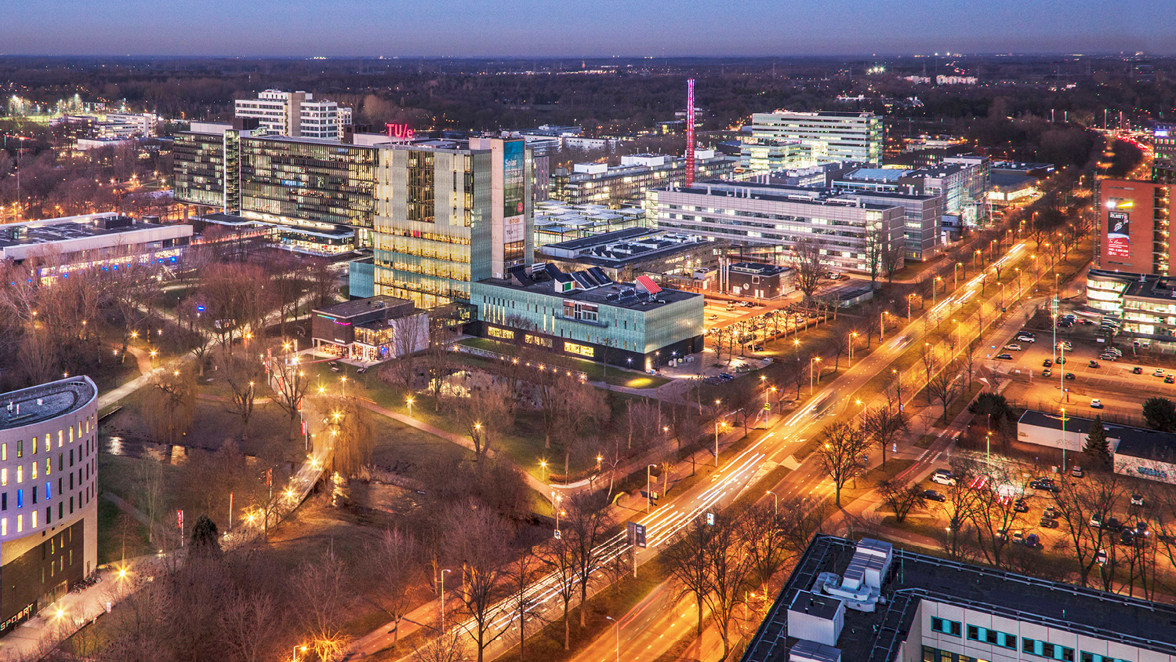
Physics of Engineering Problems
H.c.j. mulders
16 December 2023

Slide 2
Primary and secondary goals
Learn about Simulations (real world)
Learn about Professional work
So: Real World Challenge!
    But how?
JJ Koning; L Pel
Notes:
First learn how to simulate things, so practice assignment!

Slide 3
Simulations
observe
analyse
conclude (hypothesis)
test
Why simulations?
Time
Money
Notes:
Simulations:
Fast, less experiments, cheap, reduce risks
Powerful tool for engineers to answer questions

Slide 4
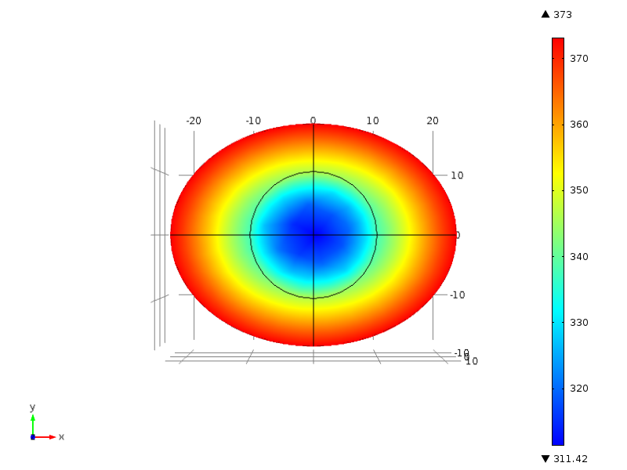
Simulations
“The Perfectly Boiled Egg”
Egg white / albumen: < 100 ˚C.
  85 ˚C tastes better
Liquid Yolk: >65 ˚C? but <70 ˚C.
  Core: 52 ˚C? Should taste well !
Perfect boiling recipe?

Slide 5
Notes:
Schattingen

Slide 6
Notes:
Solution analoog aan het waterstof atom met cn uit fourier-truc
Voor n>1 worden de termen snel Klein!
Tcooked voor Tyolk = T(r = 0:70R; t =tcooked)

Slide 7
Notes:
Voor tyolk=70

Slide 8
Notes:
Voor tyolk=70

Slide 9
Notes:
Hierna ei koken

Slide 10
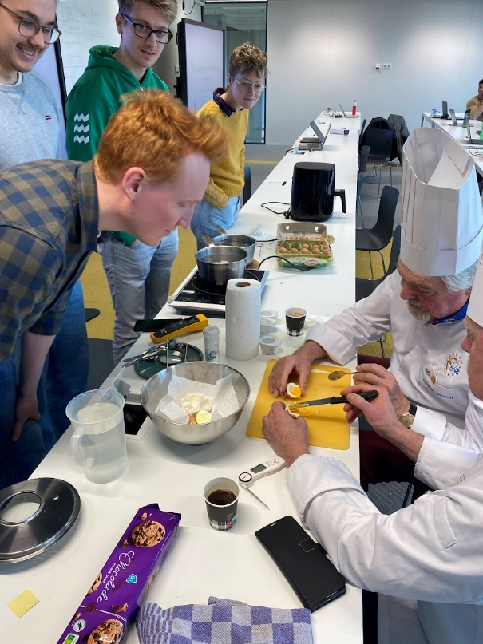
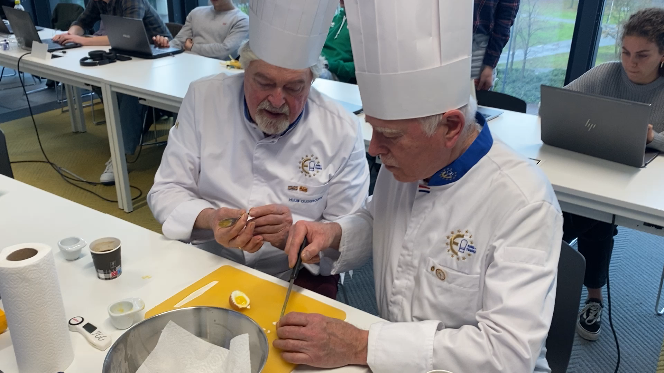
Notes:
Voor tyolk=70

Slide 11
Professional work
Real project
Too big
Unclear goals
Unscientific requirements
Empathetic requirements
Real client
Busy
Requires manners

Slide 12
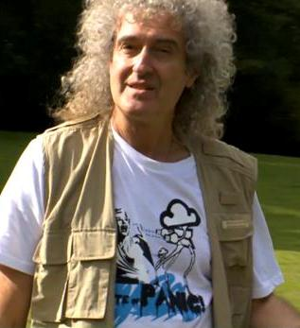

Professional work

Slide 13
Arrogance
Case owners are intelligent people
  Came to consultant because they want advice
  Obvious solutions have been tried!
Ask questions to clarify the problem
  If you see trivial solution, you don’t understand the problem
Ask for measurements/data
Ask what solutions have been tried
Ask about desired properties of solution

Slide 14
Communication
Make communication straightforward for client
  1 contact person
  Contact frequency: not too high, not too low
  Make it look neat and be clear
  Be respectful
  Send pleasant reminders if necessary
Give summaries of meetings
  List decisions
  List actions you will take
  Invite feedback
CC team members and us (Leo, Claudia and me)

Slide 15
Managing expectations
Projects are always too big in the real world
Indicate as clearly as possible what you can do in the given time
  Understand the need of the client
  Indicate what you will certainly do and why you think these are the right steps to prioritize
  Indicate what steps you will do if time permits after achieving the committed goals
  Ask the client if this will indeed satisfy him
Deliver
Be predictable

Slide 16
Client centric solution
Be aware of the client’s need
Be aware of their context
Be aware of their purpose
Understand where they make money
Make suggestions on how to proceed (in their interest)
Fill your report with information relevant to them
Give them what they want → Happy client
Notes:
VBB Advisory commercial spin off!

Slide 17
Examples
Notes:
Squall

Slide 18
Examples
Notes:
Ultimaker
Gasunie
Canon
ASML
Babyverwarming
Thales
Etc…

