Slide 1

Energie OpSLAG METHODEN
15 dec 2018

Slide 2
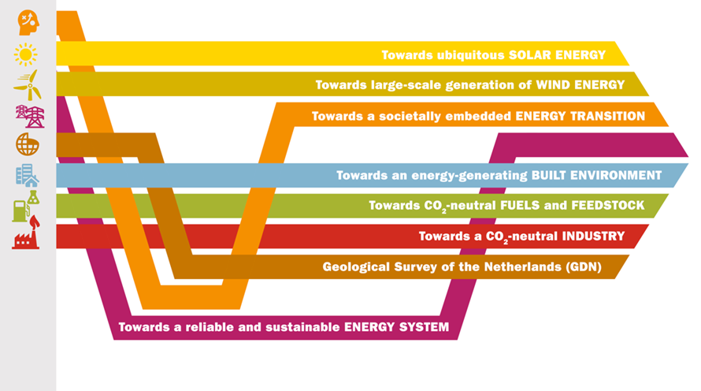
ECN part of TNO
± 700 minds working on accelerating the energy transition
8 roadmaps shaped by government, industry and research
We do:
Technology development for the benefit of society and industry
Technology transfer to the market
System analyses and (market) integration
Societal perception
Regulatory framework
Independent and applied research

Slide 3

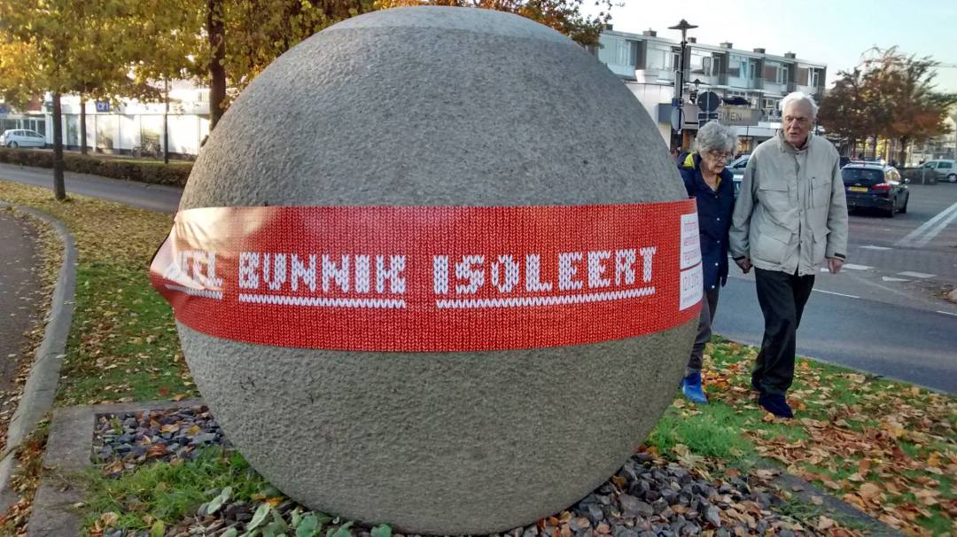
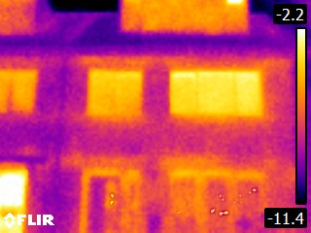
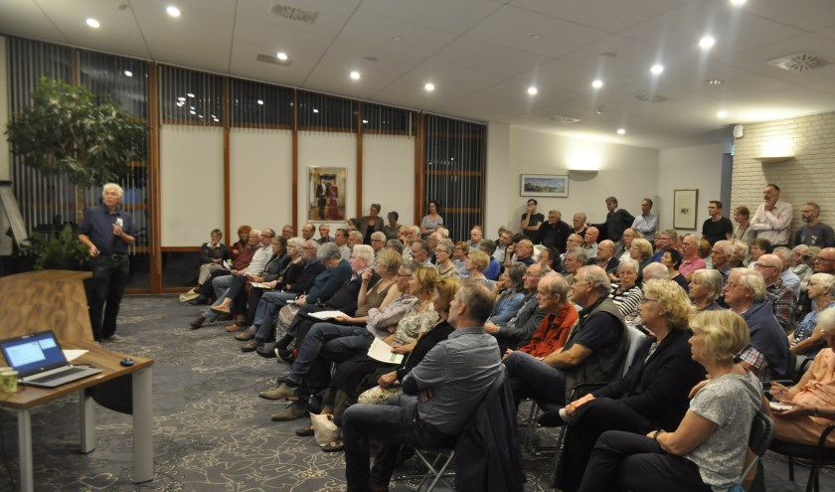

Energiegroep Bunnik
coöperatie Duurzaam Bunnik

Slide 4
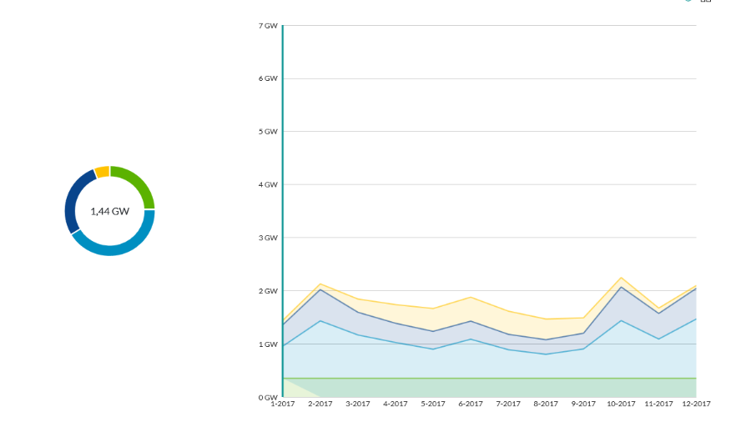
Duurzame Energie mix NL
Gedurende 2017
zon
Wind op zee
Wind op land

Slide 5
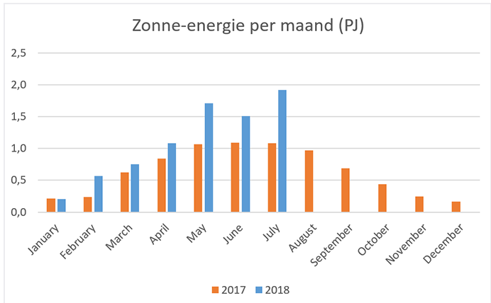
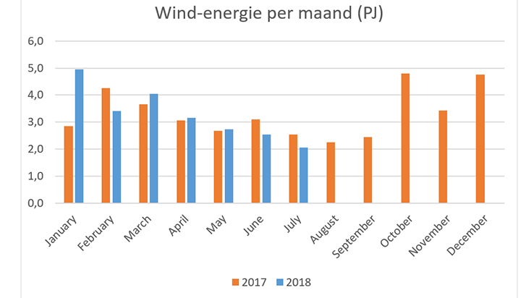
Wind/ZON

Slide 6
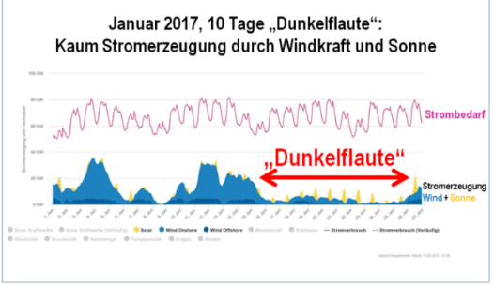

Dunkelflaute
Geen PV
Geen wind
CBS: Bruto finaal energieverbruik (2016) 2090 peta (E15) Joule

Slide 7
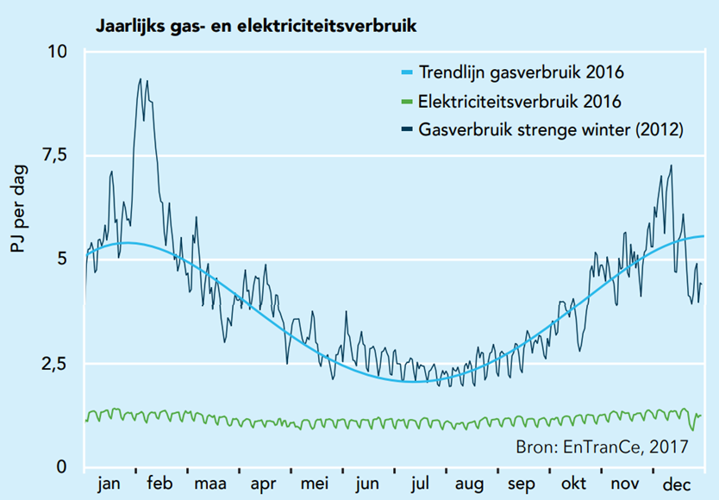
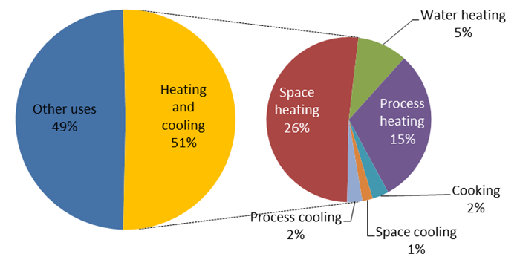
Need for storage
Dutch studies on flexibility | ESTMAP | Work programme EzK 2018 (H₂ 2050) | Work programme EzK 2018 (Heat 2050) | Flexnet (2050) | PBL 2017 (2050) | DNV GL (2030)
Required storage volume in the Netherlands [TWh] | Potential in the EU | 510 – 1 600 | 5 – 10 | 0.5 – 2 | 5– 17 | 5 – 25

Slide 8
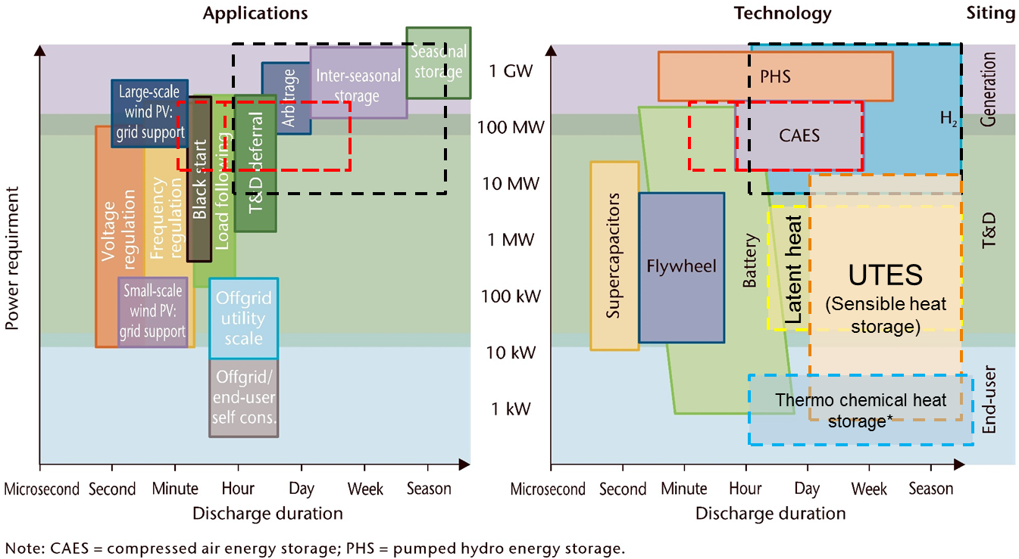
Need for large scale storage
PHS
CAES
Hydrogen
Heat
 | Largest battery | CAES in single cavern | H2 in single cavern
Volume [MWh] | 130 | 2900 | 120 000
 | Jamestown (Aus) | McIntosh (US) | Moss Bluff (US)

Slide 9
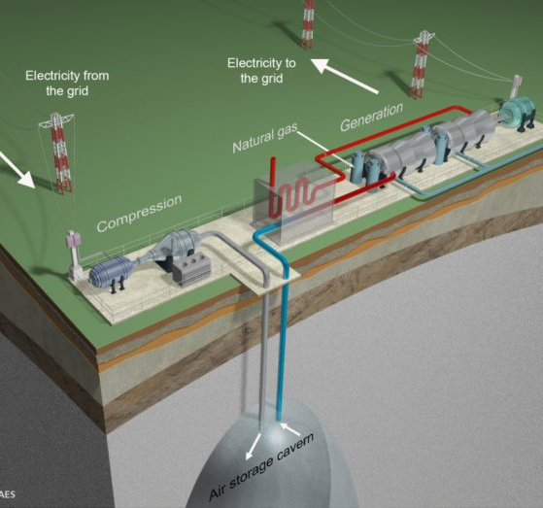
CAES
Proven technology. Research is location specific
2 plants operational (Huntorf, 321 MW, McIntosh, 110 MW)
New projects planned (Larne, 330 MW, 2GWh and Bethel Energy Center in Texas, 371 MW, 30 GWh)
Heat from natural gas
Potential
Market
Cost
TRL

Slide 10
CAES
Challenge in creating storage space
Difficult to value the technology
Geographical limitations: salt deposits between 500m (due to pressure) and 1500m (due to temperature)
0.55 TWh Northern Netherlands (306 caverns)
Fast response system (active frequency containment reserves)
Potential
Market
Cost
TRL

Slide 11
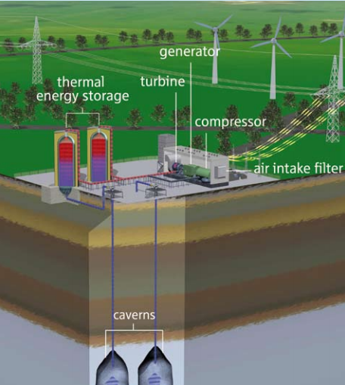
AA-CAES
Advanced Adiabatic CAES
Carbon reduction compared to conventional CAES
0.55 TWh Northern Netherlands (306 caverns)
Challenge in creating storage space (i.e. caverns)
Geographical limitations
Potential
Market
Cost
TRL
Notes:
Story:
What is AA-CAES: compressor heat is stored in storage medium. Mediums can be …
Potential: same geographical limitation as CAES, but potential for carbon reductions makes it the preferred option in a carbon free energy system, like is the aim in the Netherlands.

Slide 12
AA-CAES
Advanced Adiabatic CAES
Focus on highly efficient low cost thermal storage tech¹
No large demonstration projects in salt caverns
One 660 kW under water pilot at Toronto Island (Hydrostor)
Adele (Germany) on hold, reverted to classic CAES
Hydrostor planned projects in Canada (1.75 MW in 2018) and Australia (5MW in 2019)
Storelectric no pilot planned
Potential
Market
Cost
TRL
Source: Adele project
¹EASE-EERA roadmap
Notes:
Story TRL:
TRL: not a proven technology yet. Not het implemented on a large scale. Expected achievable efficiencies of 60 to 70% (AGE Work programme EzK 2018), even up to 75% (ESTMAP). Advancements made in European pilot was Adele project in Germany. Currently in hibernation due to financial reasons (AGE Work programme EzK 2018), in Hydrostor and what is next and what is to expect
What was special about Adele, thermal energy storage: 600C, 50 tot 70 bar in oxide ceramics and natural stones
What is special about Hydrostor & NRSTOR inc Goderich CAES facility in Canada, 1,75MW, 7 MWh, to be operational in 2018 in a salt cavern. Thermal energy storage is probably under patent filing at this moment, because there is no information available on the temperature levels and storage medium at this point in time
What is special about Hydrostor & Australia: 5 MW system, 10 MWh, in an old mine. Planned in service in 2019 (info from July 2018)
StoreElectric: some old information about a 268 MW, 1600 GWh pilot in Cheshire UK, but no present documentation on that project.
Need: according to EASE-EERA high efficient low cost thermal storage technologies
AA-CAES does not have suffient scale for national head demand balancing (AGE Work programme EzK 2018).
Adele: Recently stopped due to financial reasons (which ones?) (AGE Work programme EzK 2018. It was the first large-scale advanced

Slide 13
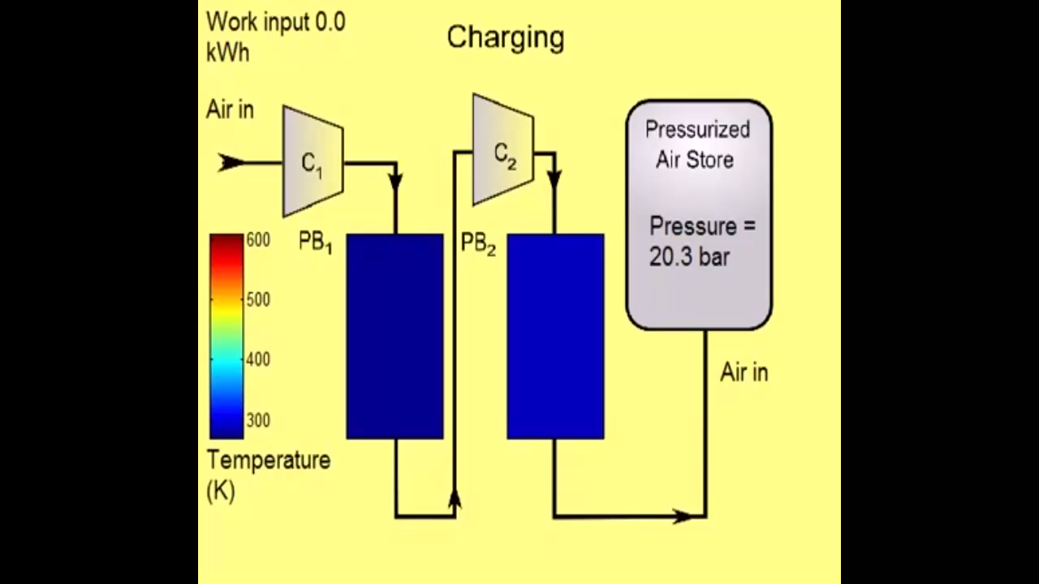

Adiabatische CAES

Slide 14
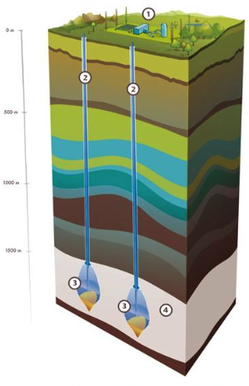
Hydrogen Storage Caverns
Mostly locations specific research questions remain,
Effect of dense clustering of salt caverns and cyclic operations on the subsurface
Pure hydrogen salt cavern storage on four locations in the world
Potential
Market
Cost
TRL
Source: Storengy
Notes:
Story:
What is hydrogen storage (i.e. production from renewable electricity through electrolysis, or blue hydrogen)
Salt caverns storage done on 4 locations, 3 in US, 1 in UK. All for feedstock purposes (OPVIS)
Considered a proven technology
Location specific research remains. mainly investigating the salt layers and if caverns can be build the way they were designed

Slide 15
Hydrogen Storage Caverns
Business case of hydrogen storage for electricity market is due to round trip efficiency not feasibile yet
Current hydrogen storages serve as feedstock storages
Potential
Market
Cost
TRL
Source: Storengy
Notes:
Story:

Slide 16
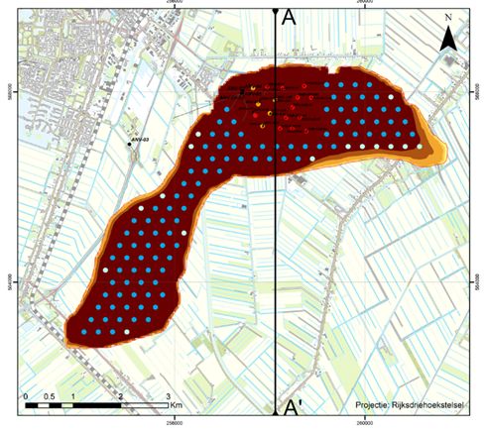
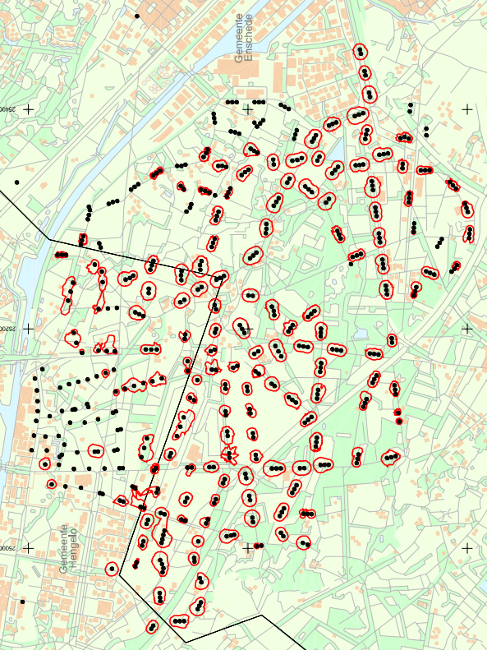
Zoutcavernes in nederland
Waterstof ook mogelijk
OPVIS study by TNO/EBN, 2018
Heiligerlee
Zuidwending
Hengelo
OPVIS study by TNO/EBN, 2018
Winningsplan Twenthe-Rhijn, Nouryon, 2003

Slide 17
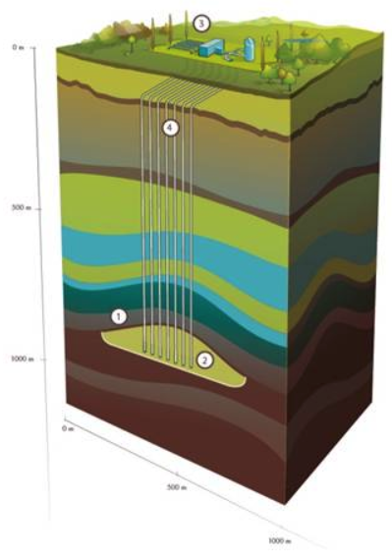
Hydrogen Storage Gas Fields
Many questions remain:
  top seal
  Quality at surface
  microbiological and chemical conversions
  mobility and mixing
  material interactions
  cushion gas specifications
Pilot in Austria (SunStore, 2015), 10% H₂
Pilot in Argentina (Diadema 2009), 10% H₂
Methanation occurs, 82% of hydrogen retrieved (SunStore)
Potential
Market
Cost
TRL

Slide 18
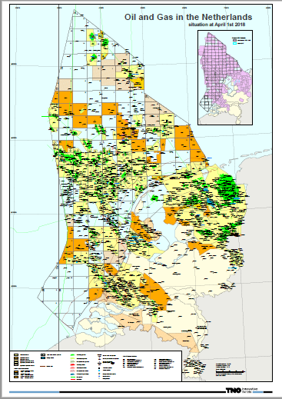
Nederland zit vol
met mogelijkheden

Slide 19
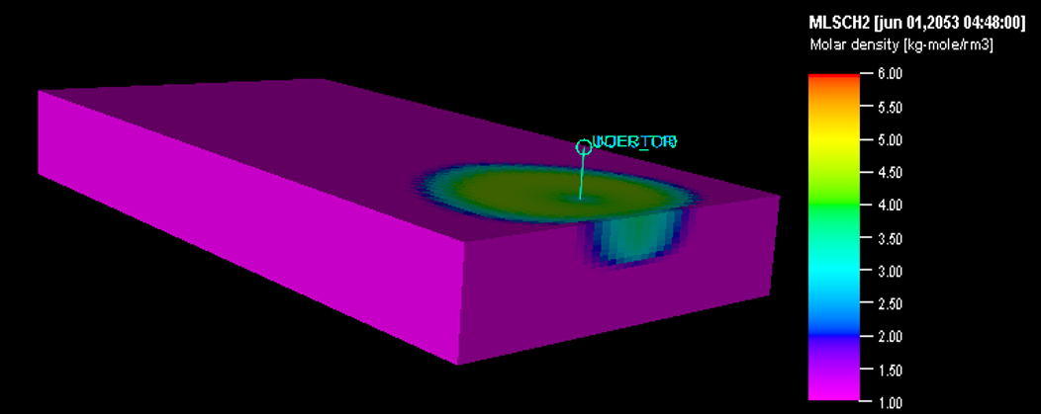
Opslag in gasvelden
Sythetische studie

Slide 20
Productie H2

Slide 21
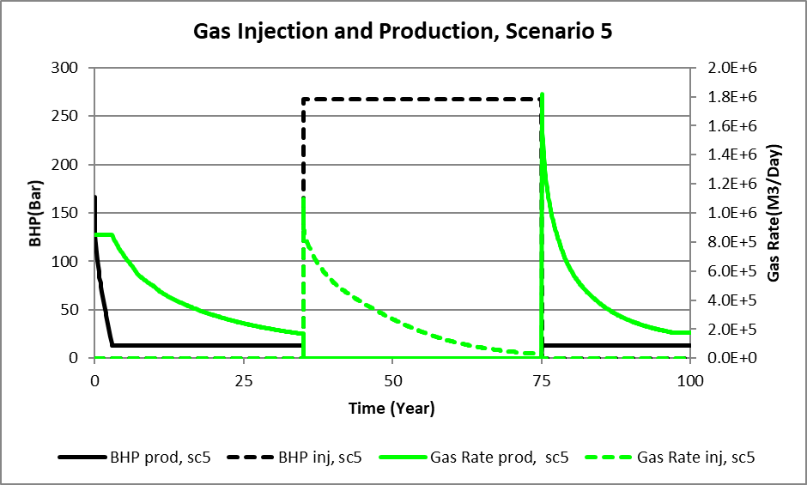
Ander scenario

Slide 22
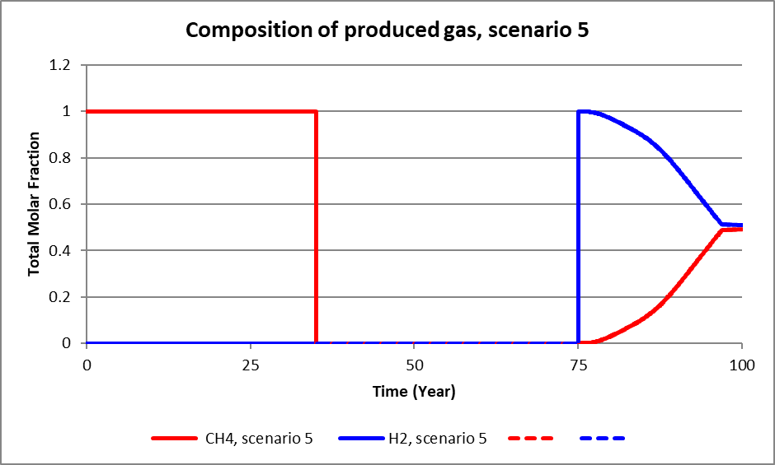
Ander scenario

Slide 23
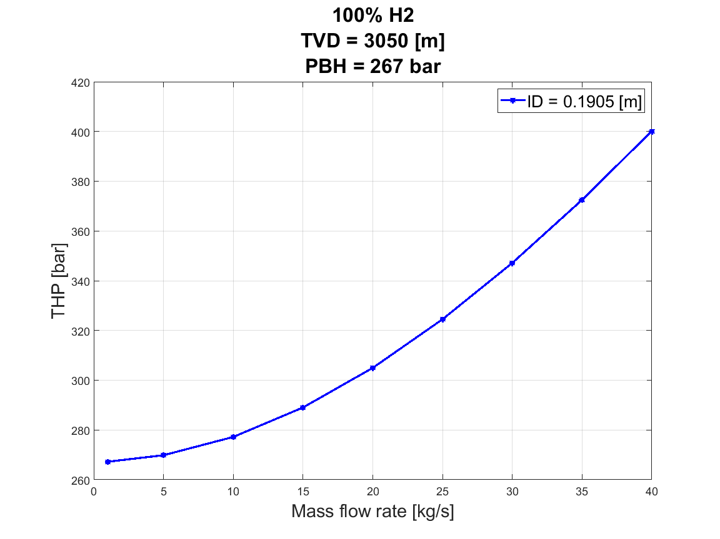
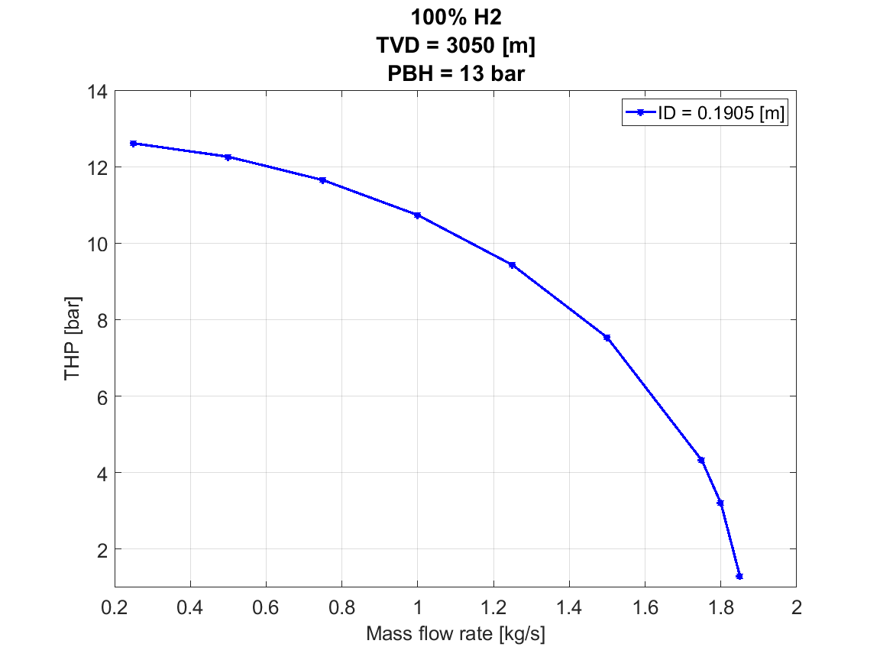
Gedrag van waterstof in put

Slide 24
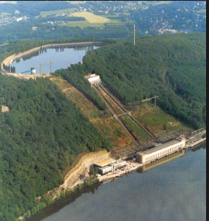
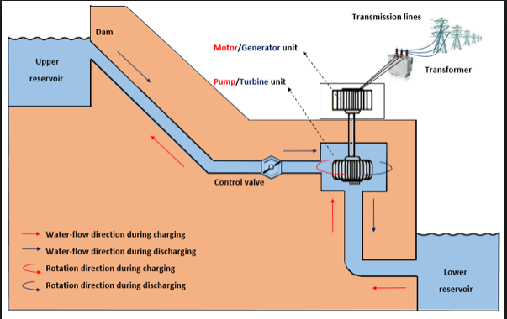
Pumped hydro

Slide 25
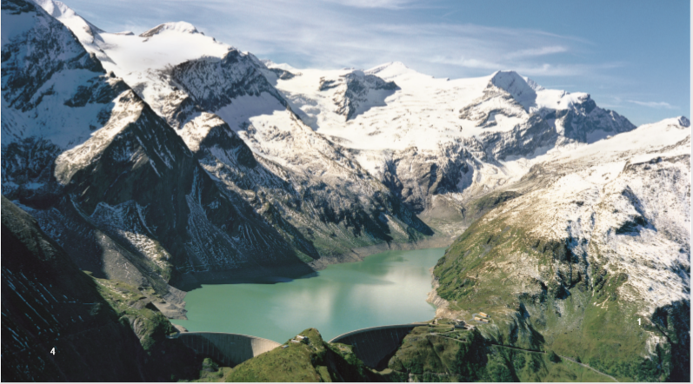
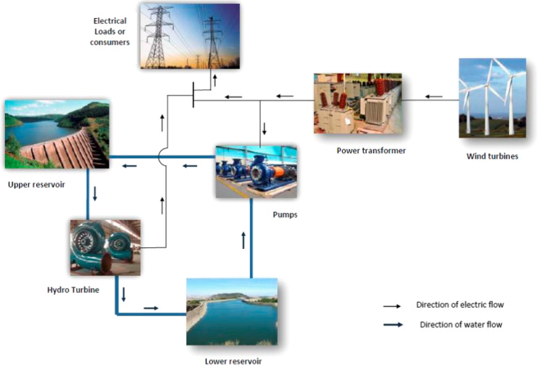
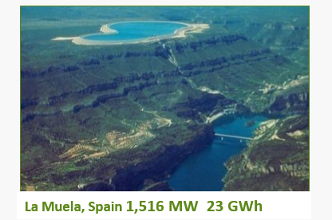
Stabilisatie Net
Iberdrola

Slide 26

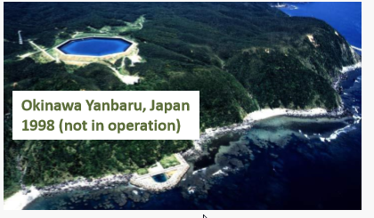
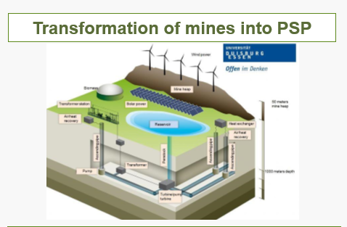
Andere mogelijkheden
Bij zee
Iberdrola
mijnen

Slide 27
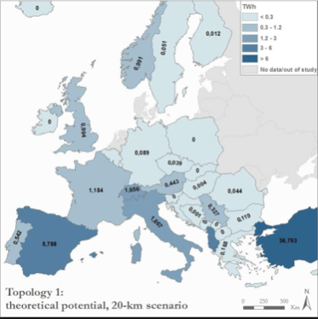
Waar in Europa ?
Electricteitskabels ?

Slide 28
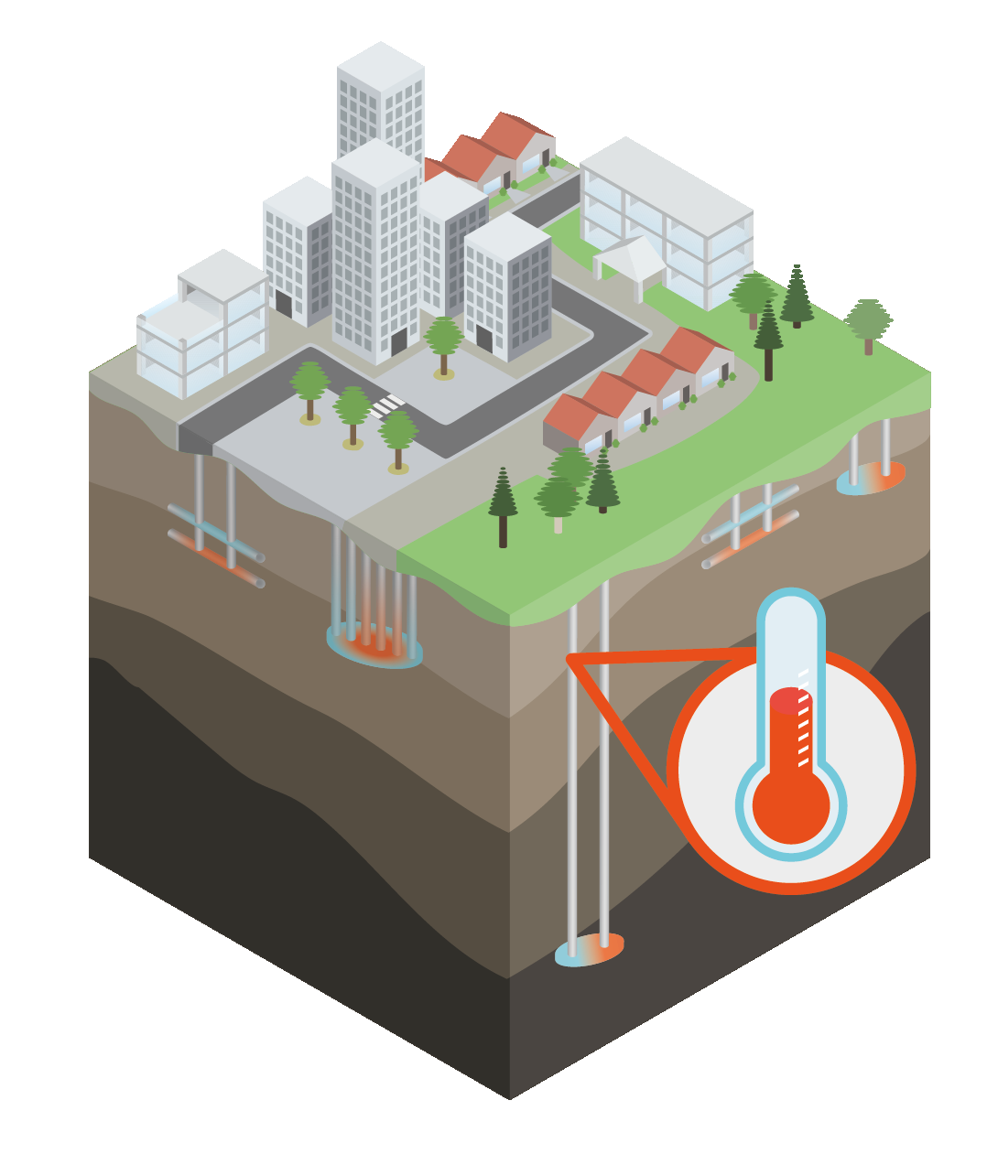
Thermal energy storage
Potential location dependent and very much technology dependent (combination)
Geology
  Mines
  Aquifers
  Groundwater
Potential
Market
Cost
TRL
Source: heatstore.eu

Slide 29
Thermal energy storage
Not proven for high temperatures
Target efficiency of 75%
Grid integration requires optimization
Potential
Market
Cost
TRL
Source: heatstore.eu

Slide 30
Thermal energy storage
Heating grids seasonal
  Less peak
  Less infra
  Power to heat
Very good combination with low marginal cost of heat
Among lowest cost of large scale storage
Potential
Market
Cost
TRL
Source: heatstore.eu

Slide 31
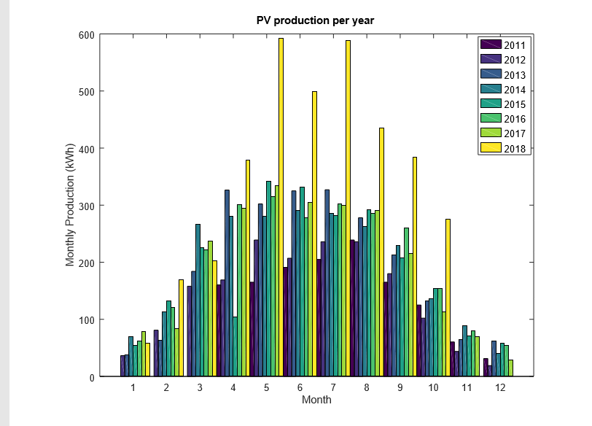
Opslag thuis
PV gedurende het jaar

Slide 32
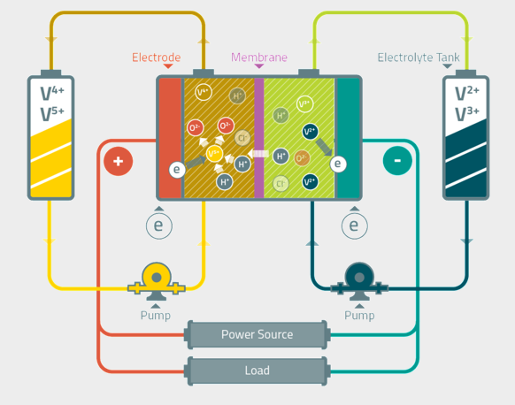

Vanadium Redox Flow
Andere voorbeelden
Zink-Broom
polysulfide-broom
Zwavelzuur
Ontladen
V²⁺->V³⁺
V⁵⁺->V⁴⁺
Laden V³⁺->V²⁺
V⁴⁺->V⁵⁺

Slide 33
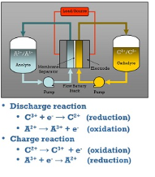
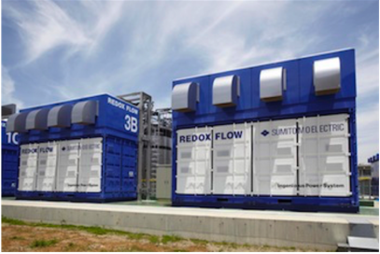
example

Slide 34
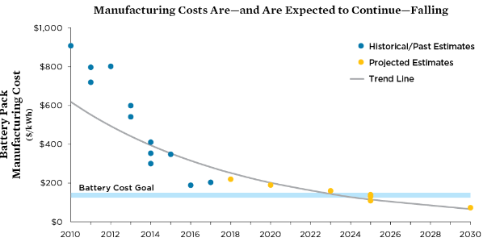
Cost prediction battery technology

Slide 35
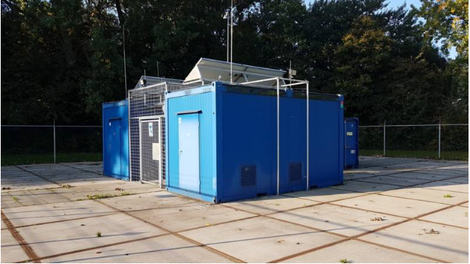
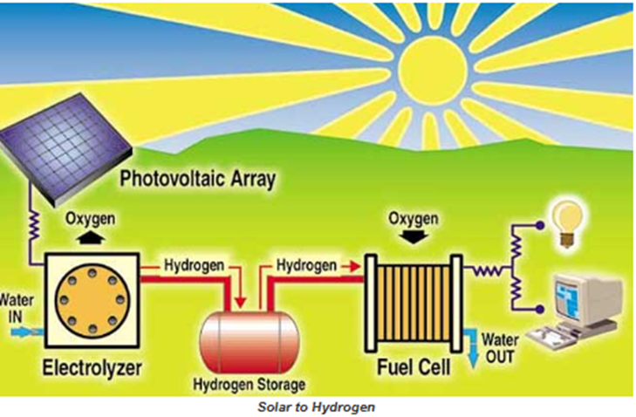
Opslag als waterstof
Electrolyse unit bij flatgebouw.

Slide 36
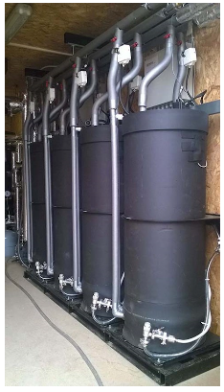
Warmte Batterij
Zomer:
Zonneboiler/warmtepomp warmte > drogen zouten
Winter:
Bevochtigen zout > warmte opwekking
Voordelen: geen verlies, seizoen opslag
Vervanging CV bij hydride systeem luchtwarmtepomp.

Slide 37
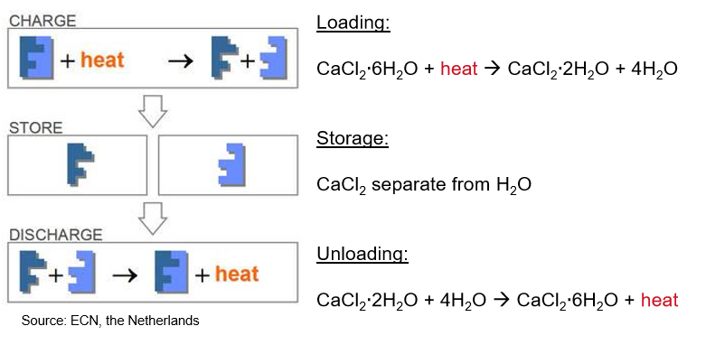
Principe warmteopslag

Slide 38
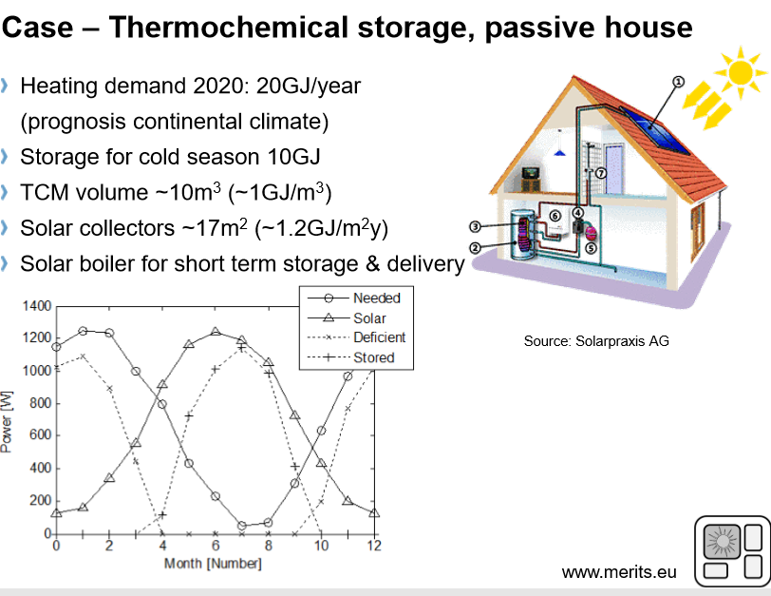
=5555 kwh

Slide 39
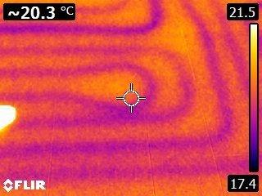
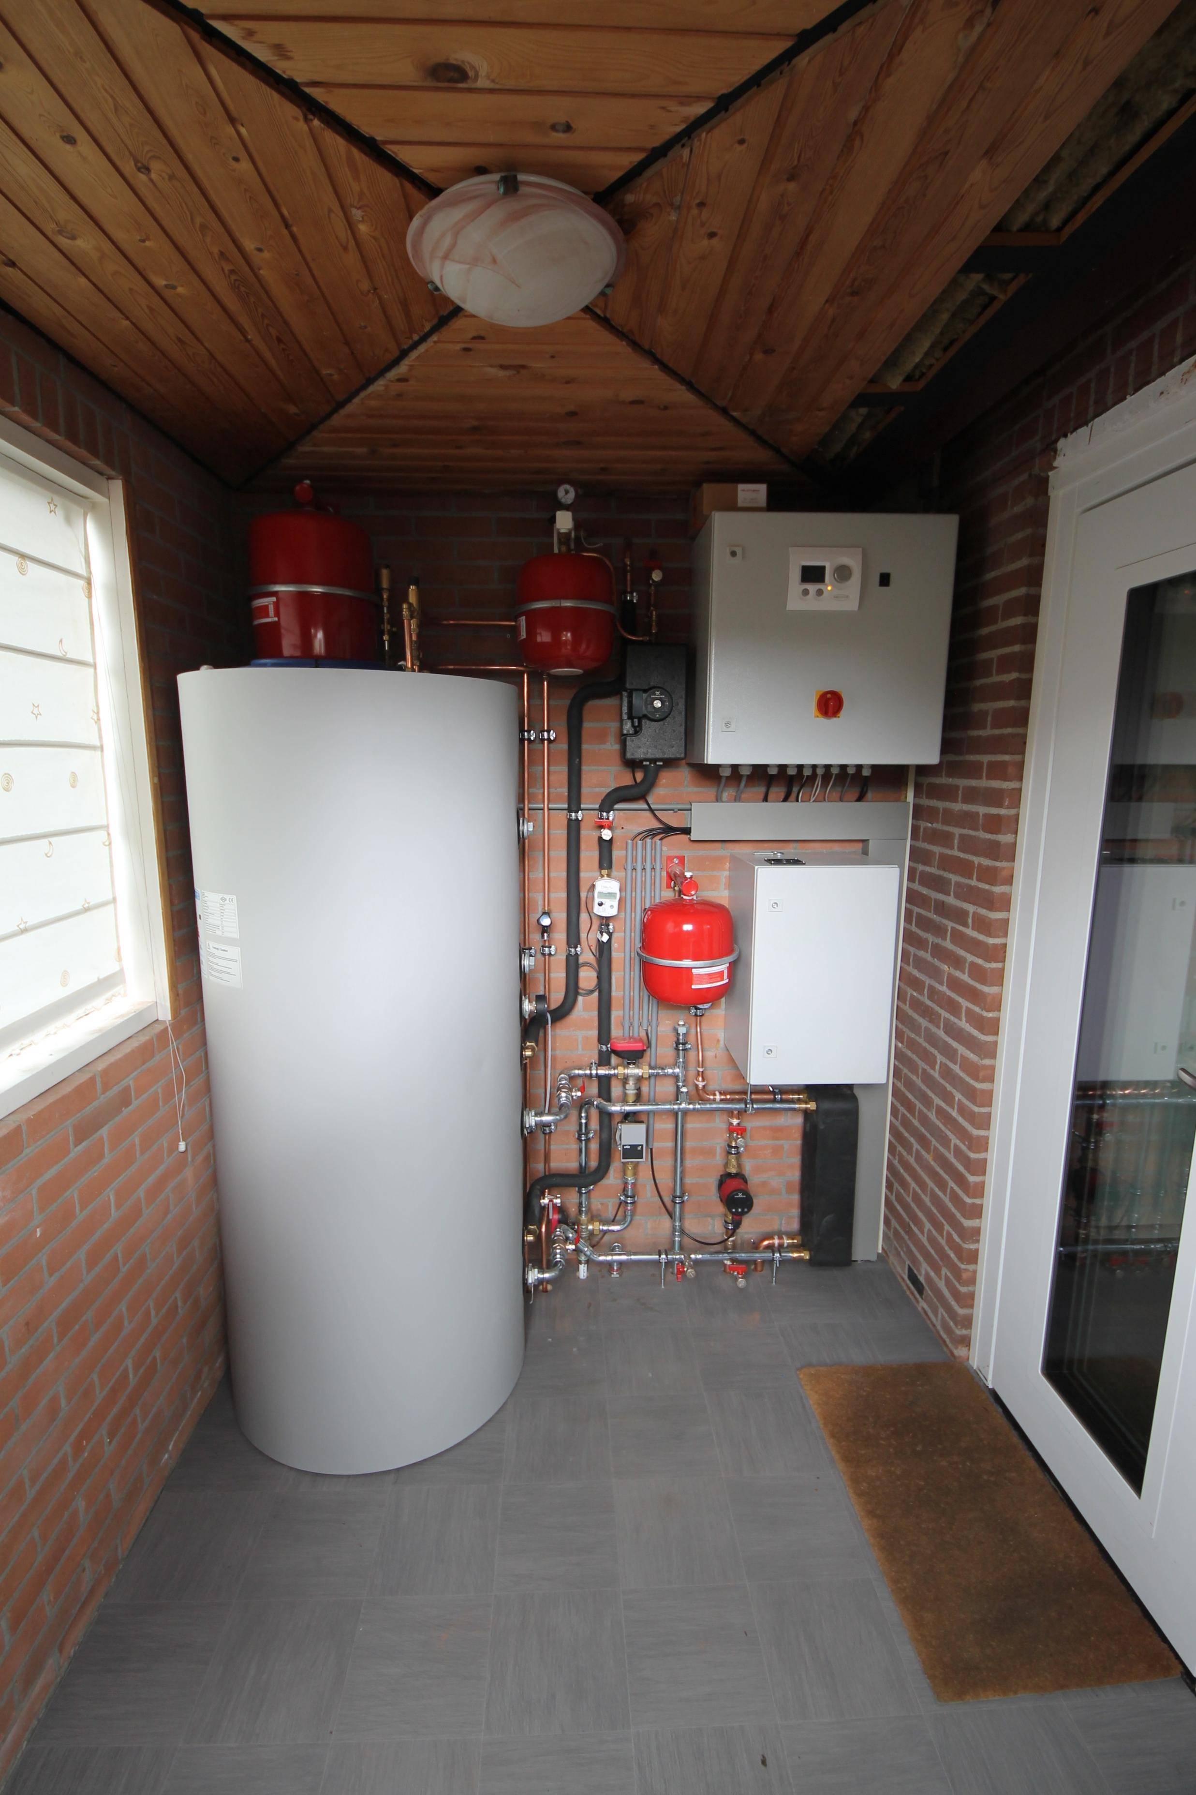
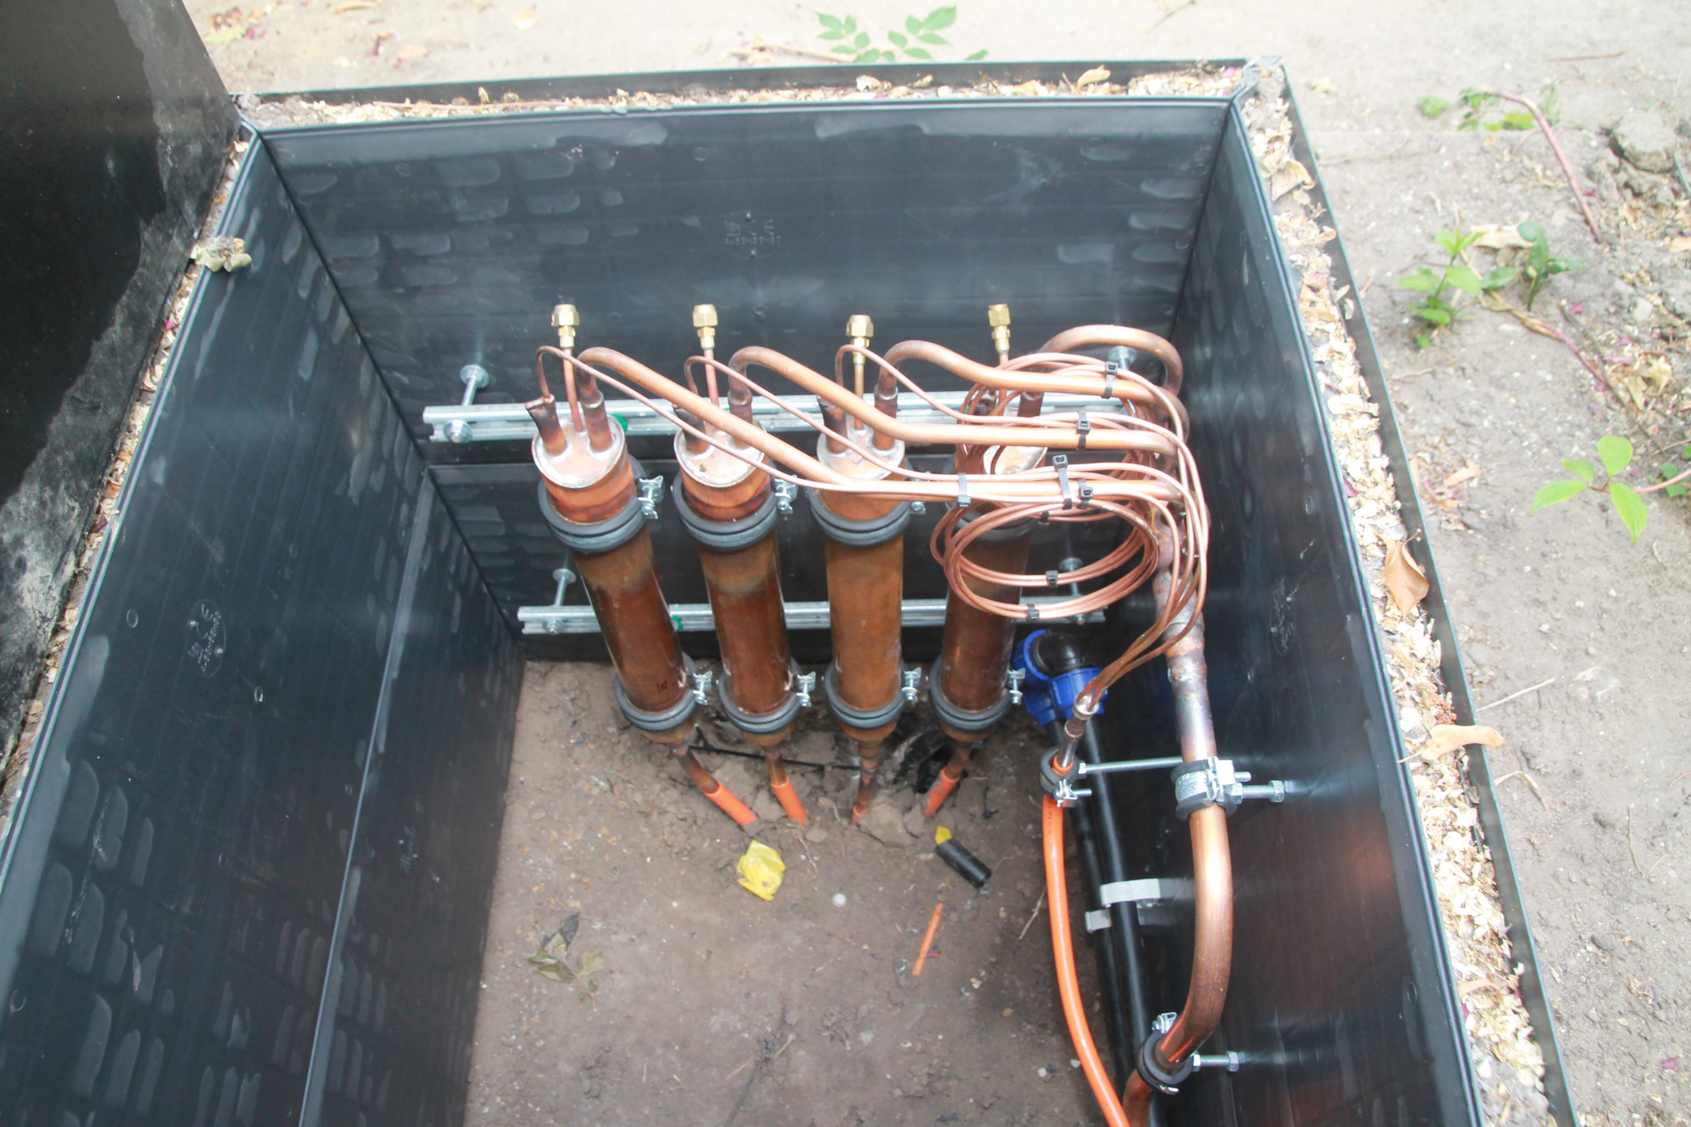
Warmteopslag in ondiepe ondergrond
Zomer 2018
Passieve koeling
Ontrekking/opslag
warmte
Warmwater opslag

Slide 40
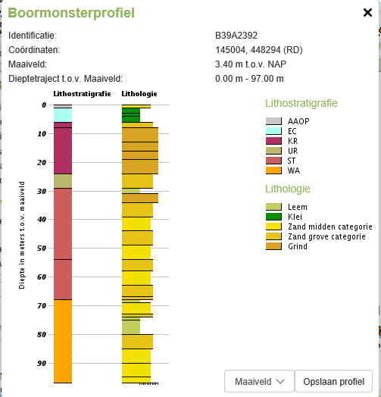
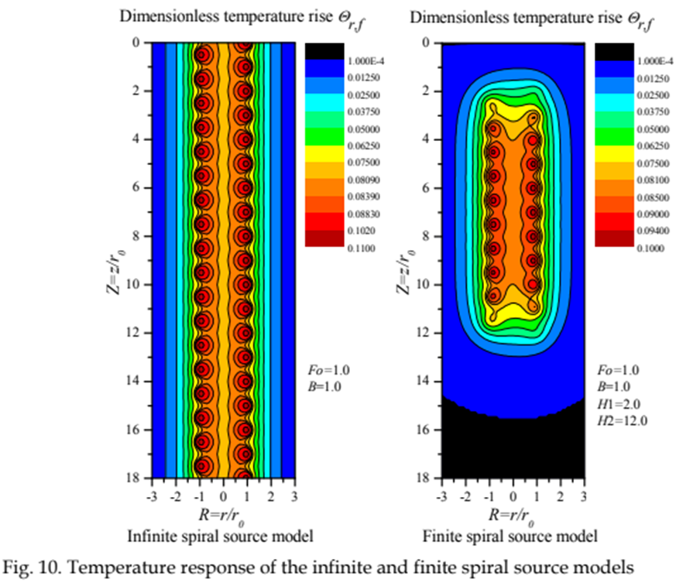

Warmteopslag bij BWW
(Y Man et all)

Slide 41
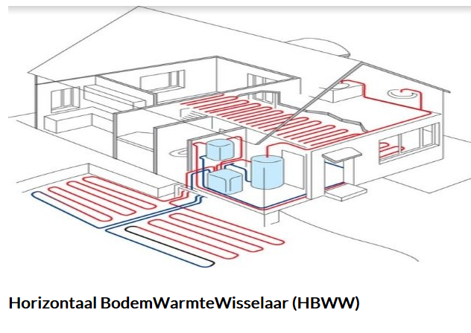
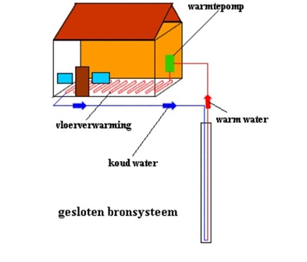
Bodem Warmte Wisselaar
Ook samen met Thermische energie uit oppervlaktewater (TEO)

Slide 42
Conclusie
Er zijn veel ontwikkelingen aan de gang rond energie opslag
Veel is nog onduidelijk, welk scenario waar zal plaatsvinden.
Er is ook zeker behoefte aan natuurkunde studenten.

