Slide 1

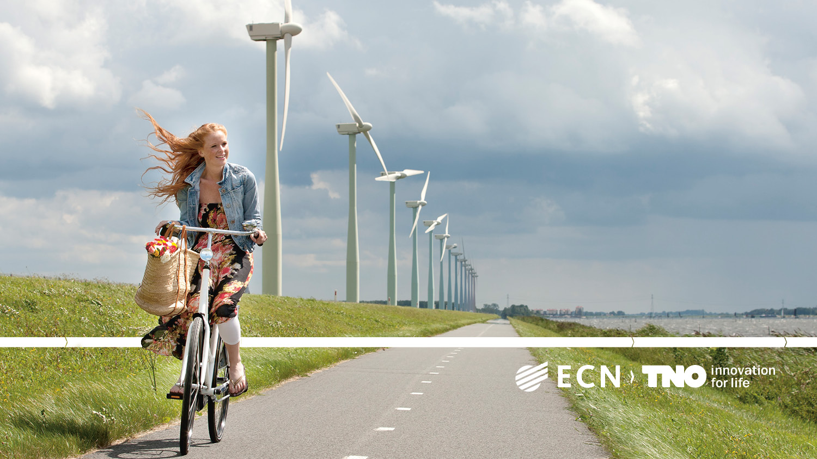

Slimme energietransitie.
WND Conferentie 2018 – Energietransitie, Noordwijkerhout
Andre Faaij
Distinguished Professor Energy system analysis, University of Groningen
Director of Science
ECN part of TNO

Slide 2
Energy demand, GHG emissions and climate change…

Slide 3
The IPCC 1,5 oC report: emission pathways

Slide 4
Energy system transformation…
[GEA/van Vuuren et al CoSust, 2012]

Slide 5
IPCC 1,5 oC report: Illustrative pathways according to different actors & modelling frameworks

Slide 6
Historical and projected global energy investments (IPCC, 1,5 oC report)

Slide 7
National level...

Slide 8
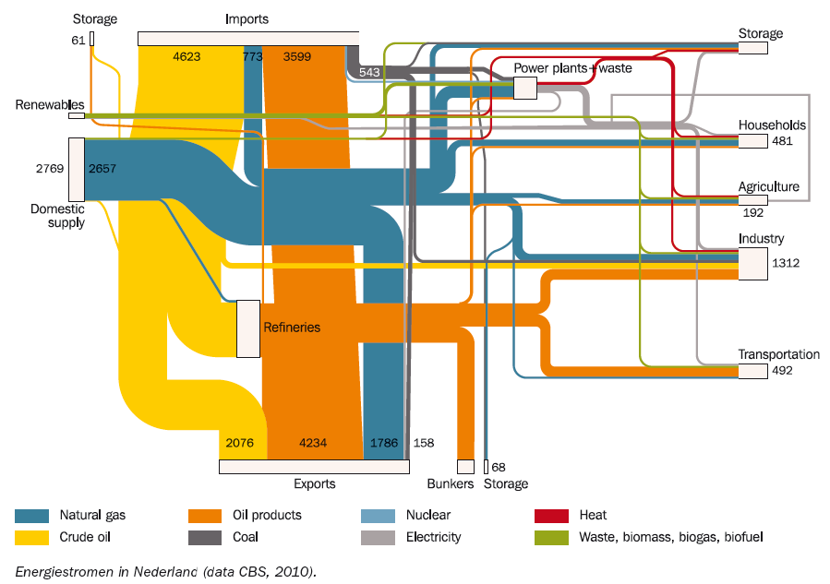
Current energy system of the Netherlands; advanced fossil energy infrastructure

Slide 9
Possible future energy supply NL (PJ/yr)

Slide 10
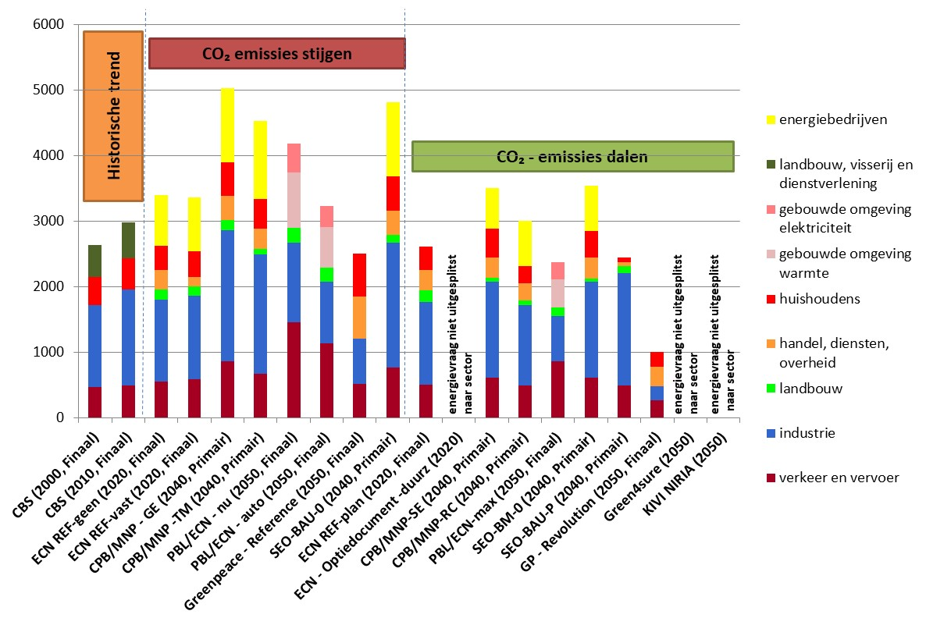
Possible future energy Demand per sector the netherlands (PJ/yr)

Slide 11
The future energy system is complex…
Decentralized, heat networks, energy cooperations, consumer preferences and behaviour, new and more comptetitive energy technologies, incentives, reliability, affordabiliy, new business vs. Current energy sector, regulation…
Possible future configuration
Of CCS infrastructure…

Slide 12
…and multidisciplinary…
  Technology
  Energy models
  Economic models
  Advanced Control Modellen
  Forecasting-, simulation- & scenario analyses
  …model collaboration!.
  Economics
  Value chains, business cases
  Regulation
  Impact of incentives
  Social
  Societal support
  Consumer behaviour and preferences.
TECHNOLOGY
REGULATORY
ECONOMY
SOCIAL
Spatial Dimensions: factory - industrial sites – city – province – country – multilateral – Europe – global.

Slide 13
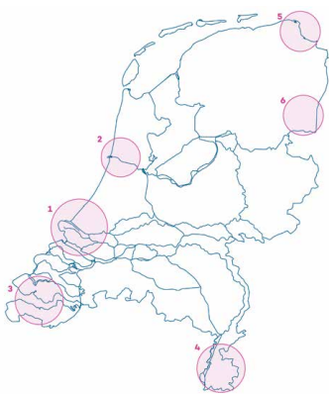
Industrial transformation -> zero carbon footprint; daunting complexity.
Industry ~50% of primary energy use.
Many options:
  Energy efficiency improvement existing processes
  New (inherently more efficient) processes
  Renewable feedstock (biobased industry
  Renewable energy carriers (green power, green hydrogen)
  Carbon Capture & Storage (with BECCS negative GHG emissions)
  Recycling/re-use/circulair value chains
  Shifts in markets and products.
All combined! Over roughly 3 decades; overall one investment cycle!!
Factory level, regional level, structural changes in economy and energy system
Figure 2 Location and size of the main industrial emission clusters.
1) Rotterdam - Moerdijk (16.9 Mt CO₂); 2) Noordzeekanaalgebied (12.0 Mt CO₂); 3) Zeeland - W-Brabant (7.9 Mt CO₂);
4) Chemelot (4.5 Mt CO₂); 5) Eemsdelta (0.7 Mt CO₂); 6) Emmen (0.5 Mt CO₂).^{[8,9]}

Slide 14
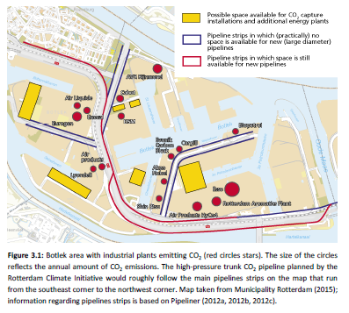
Spatial issues… example of CCS in Rijnmond
Berghout et al, 2016

Slide 15
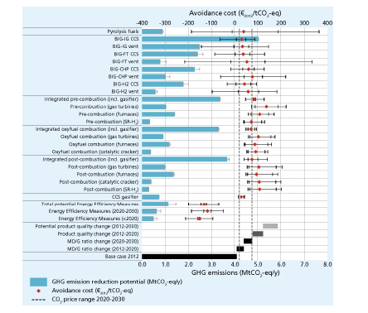
Integrated mitigation at a refinery complex
Berghout et al, 2016

Slide 16
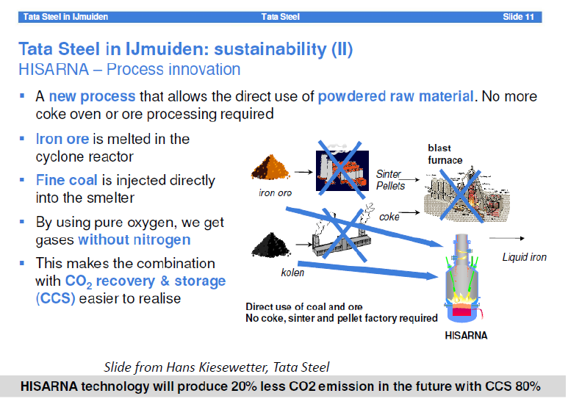

Slide 17
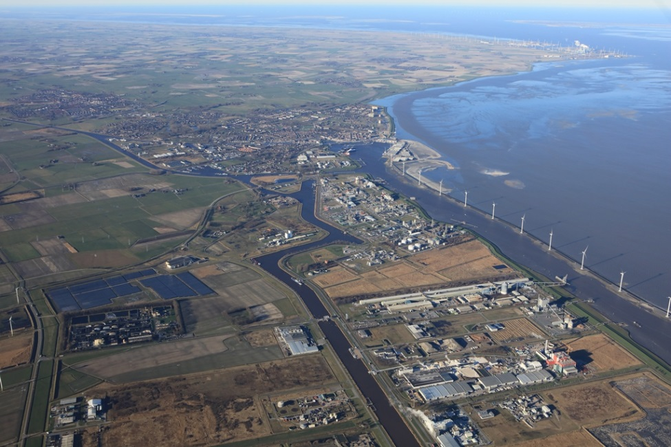
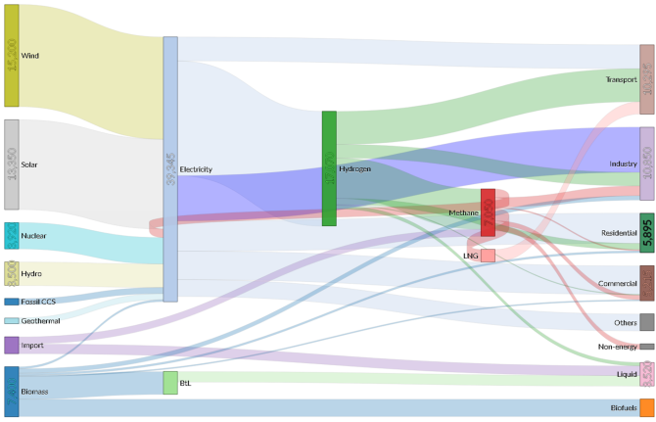
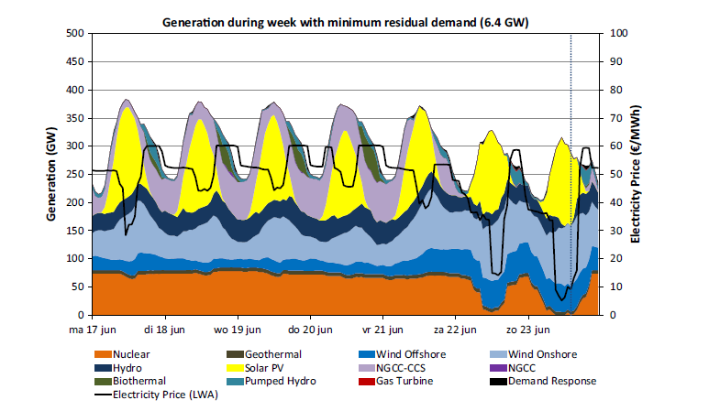
Eemsdelta/Delfzijl
(or any other industrial cluster)
Eemsdelta
Eemshaven
Delfzijl

Slide 18
North sea energy transition…

Slide 19
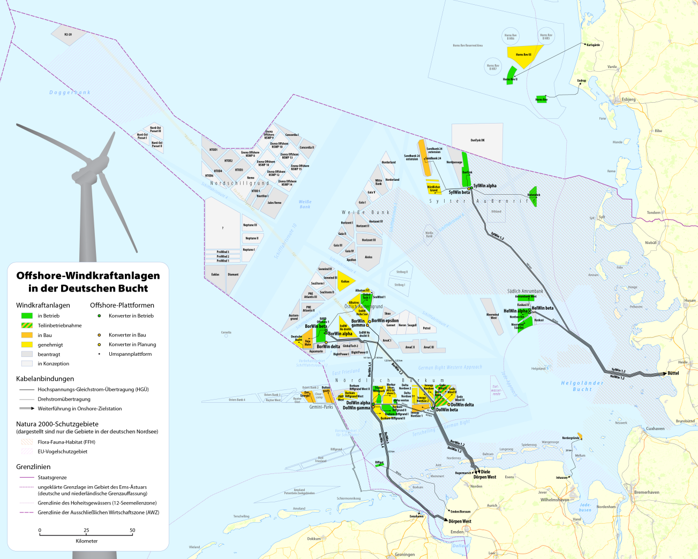
Build up wind off-shore capacity

Slide 20
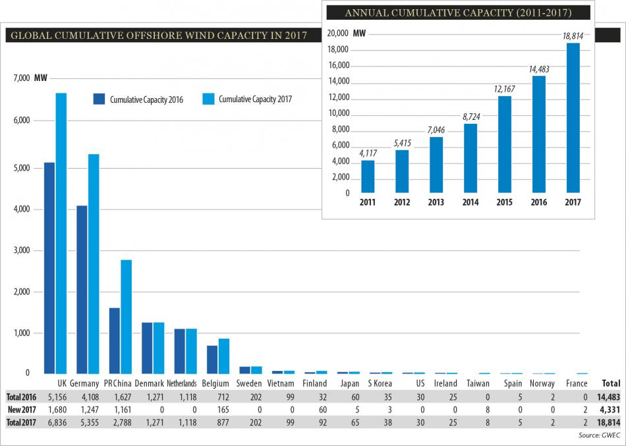
Cumulative offshore wind capacity North Sea region
[Wehrman, CLEW, 2018]

Slide 21
North Sea Energy potentials…
Annually, the Netherlands use 120 TWh electricity and emit 210 Mt CO₂
Electricity potential doubles this consumption
Dutch EEZ CO₂ capacity in depleted gas and oil fields equals 13 years
Technical potential | North Sea | Dutch EEZ
Offshore wind | 2,765 TWh/yr | 240 TWh/yr
Wave | 77 TWh/yr | 5 TWh/yr
Algae | 400 (37,000) PJ/yr | 90 (2,800)/yr
CO₂ storage capacity | 20 (125) Gt CO₂ | 1.3 (2.3) Gt CO₂
O&G extraction | 137 EJ
Notes:
For entire North Sea potential is 2x and 13x compared to annual consumption/emissions 6 countries around NS

Slide 22
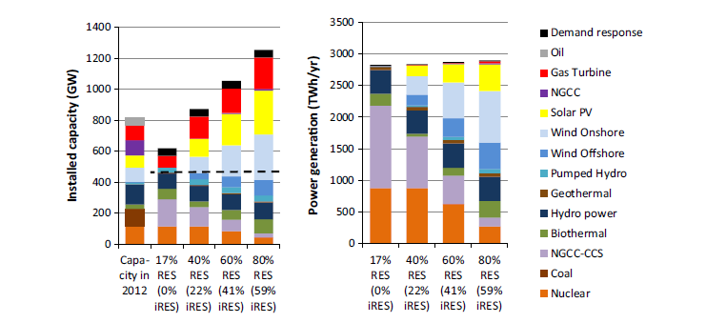
Possible RET deployment NW Europe 2050 for low GHG pathways (electricity only!).
Breakdown of installed capacities and power generation in the core scenarios
in the year 2050. The dashed line depicts the peak load in 2050.
[Brouwer et al., Applied Energy, 2016]

Slide 23
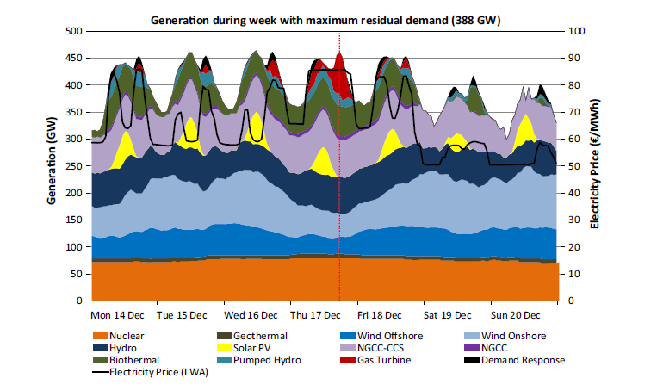
System
implications!
Electricity system simulations
NW Europe 2050 with 60% iRES
Weeks with maximum and minimum
residual loads during the year.
[Brouwer et al., Applied Energy, 2016]

Slide 24
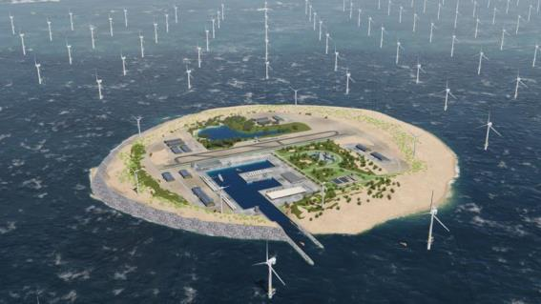
Artist impression of TenneT’s vision for a concept for large scale wind energy on the North Sea.
source: Tennet

Slide 25
Hoped economics hydrogen production (natural gas based production: 2-3 Euro/GJ)
Source: Rabobank/NIB H2 roadmap, van Wijk, 2017
However, electricity now some 50 Euro/MWh, surpluses of power minimal during
short periods, and infrastructure costs not yet included.

Slide 26
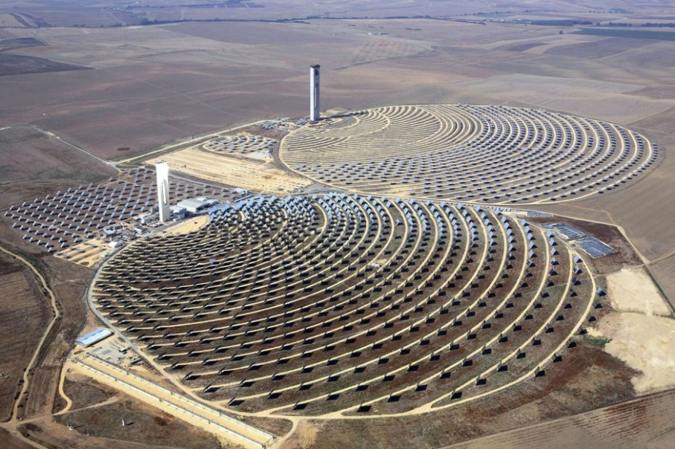
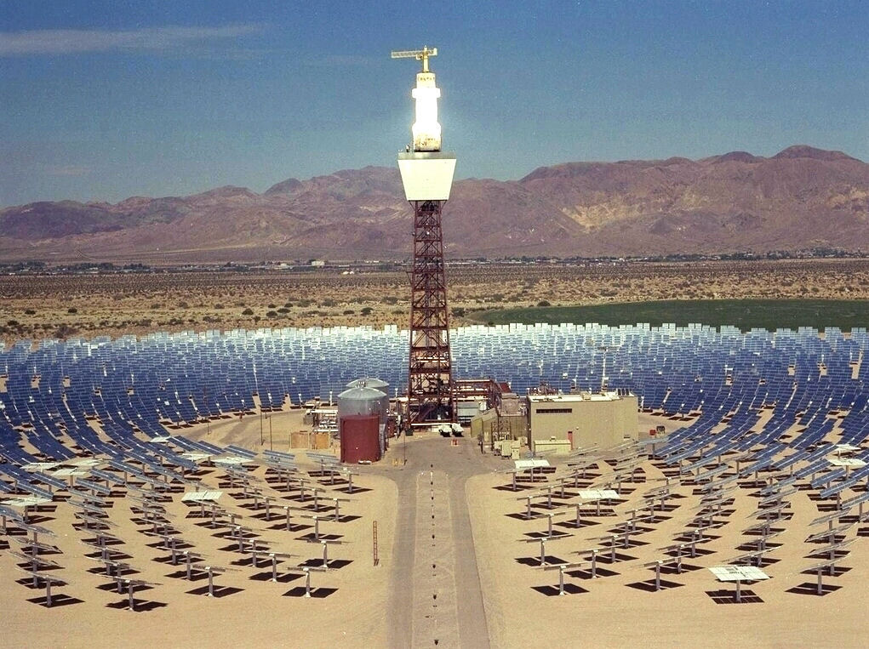
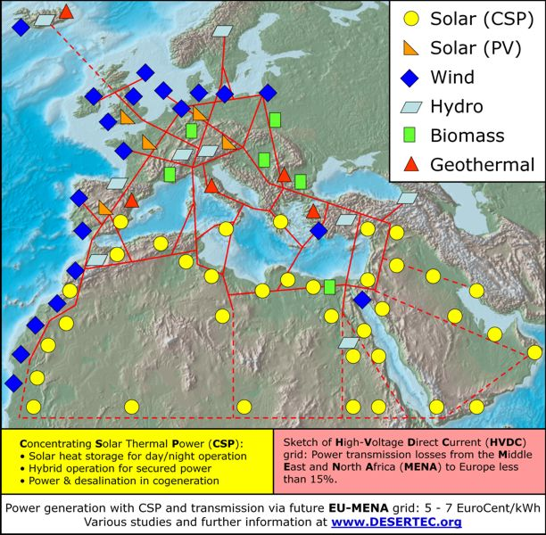
Further energy system integration…

Slide 27
Advanced energy scenario’s for Europe; competing / balancing options...

Slide 28
Drivers and barriers for PtM
914 Mton/y
450 Mton/year
228 Mton/y
CO₂ target (2050)
255 Gton
0 Gton
CO₂ storage
0%
60%
97%
VRE penetration (%)
250 €/kW
75 €/kW
PtM Capex
85 %
100%
PtM Efficiency
25 gCO₂/tnm
18-20 gCO₂/tnm
12 gCO₂/tnm
LMG efficiency in ships
25.5 EJ/y
10 EJ/y
7 EJ/y
Biomass potential
[Blanco et al., applied Energy 2018]

Slide 29

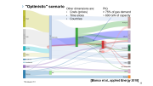

"Optimistic" scenario
Other dimensions are:
Costs (prices)
Time slices
Countries
PtG
> 75% of gas demand
~ 600 GW of capacity
[Blanco et al., applied Energy 2018]
*All values in PJ

Slide 30
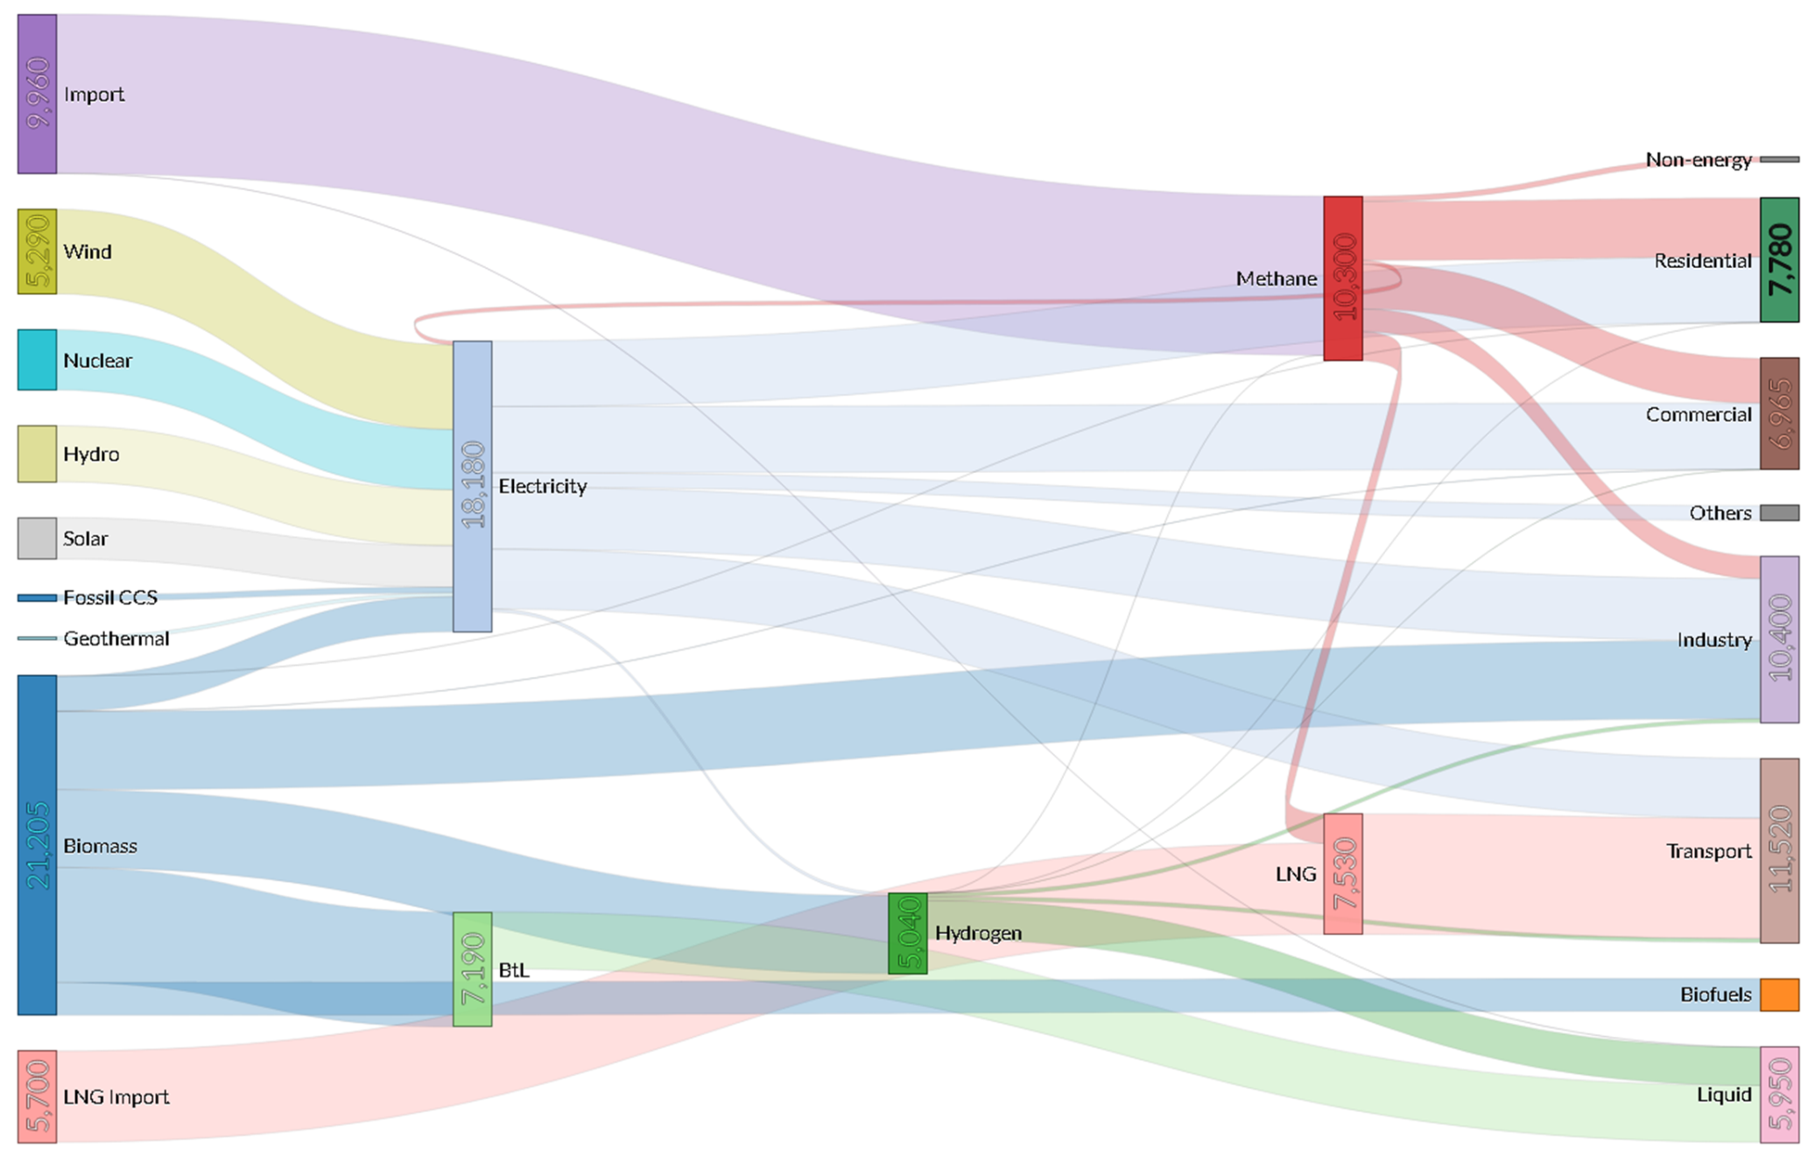
"Alternative" scenario
PtG
0% of gas demand
~ 0 GW of capacity
[Blanco et al., applied Energy 2018]
*All values in PJ

Slide 31
Energy transition = innovation race = (todays/future) business.

Slide 32

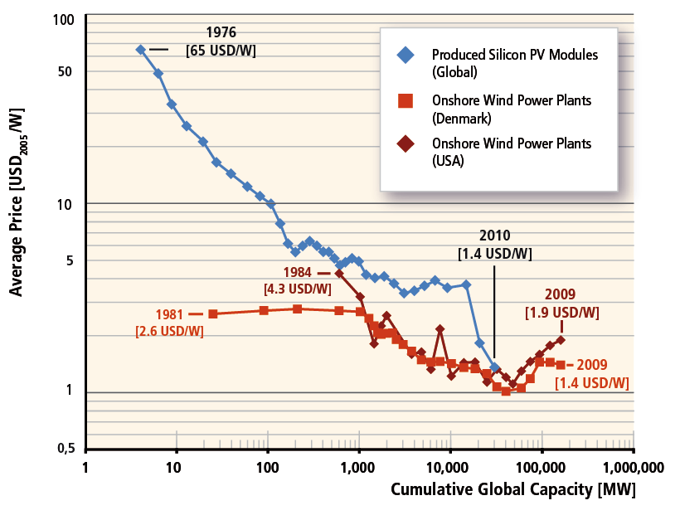
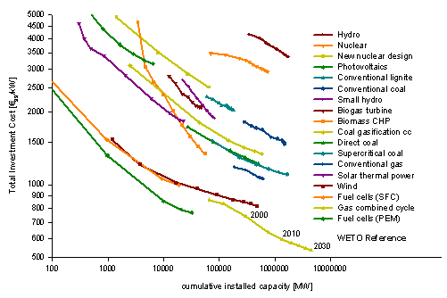
Technological learning = essential
[IPCC-SRREN, 2011]
Learning curve for power generation technologies,
historic data and POLES WETO reference projection
up to 2030.

Slide 33
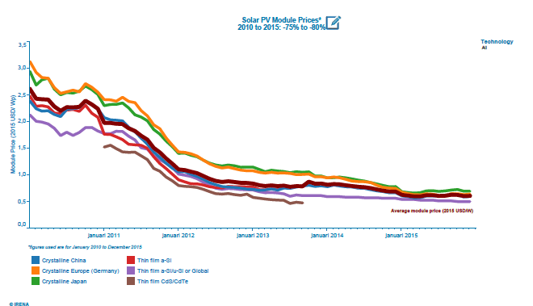
Recent solar PV module price development
[IRENA]

Slide 34
Factors influencing learning/ unit costs (example wind energy)
Improved siting of wind farms (Learning by doing)
Development of specific components (gear boxes, generators) and regulating mechanisms (stall/ pitch regulation) (R&D)
Mass production of wind turbines (economies-of-scale)
Upscaling of wind turbines (upscaling)

Slide 35
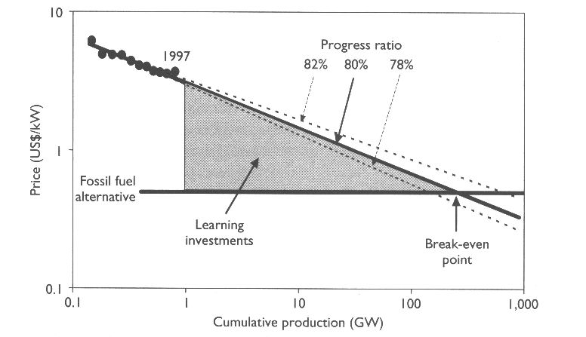
‘Learning investments’ – the cost of learning
Source: IEA, 2000

Slide 36
Mountain of death; ‘’time’’ can mean decades…

Slide 37
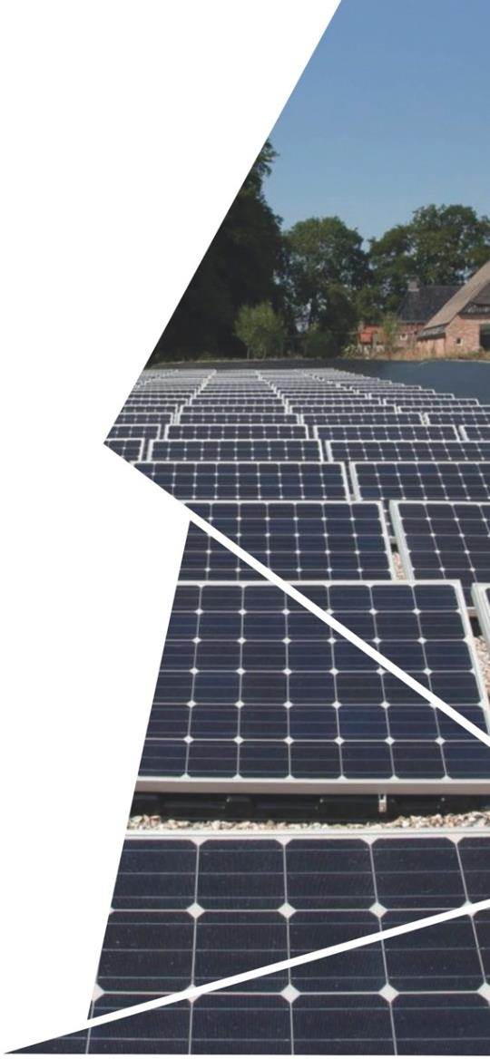

Speed up innovations; science, technology, market, policy…

Slide 38
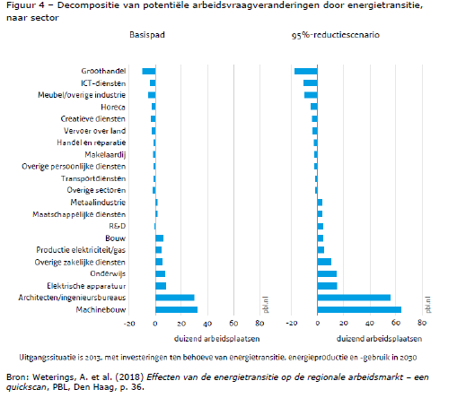
Major human capital agenda
In Europe shortage of skilled workers is a substantial barrier for realizing the ambitious energy transition goals.
At the same time there is a substantial need for equipping existing energy professionals with up to date skills.
Required skills and knowledge change fast.
Increasingly interdisciplinary.

Slide 39
Biggest no-brainer in the energy field
A.o. IEA (WEO) concluded multiple times that :
Yes, 450 ppm pathways requires massive investments…
…but will lead to rapid cost reductions of RET’s and energy efficient technologies…
…and less pressure on fossil fuel supplies…
…leading to an overall lower cost and more secure (global) energy supply!
[Vs. external costs of climate change order of magnitude of a few world wars… ]

Slide 40

Thank you very much for your attention

