Slide 1
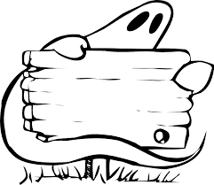
WND 2016
Nuria Muñoz Molina
Colegio la Inmaculada de Algeciras
Silvio Rademaker
Amadeus Lyceum Vleuten

Slide 2
Phantoms or Physics
Appetizers
Experiences Spain
Experiences the Netherlands
DIY experiments

