Slide 1
What types of mathematical reasoning are evaluated in school mathematics? - An analysis of Swedish high school exams

Slide 2
:
Paper I Palm, T., Boesen, J., & Lithner, J. (2005). The Requirements of Mathematical Reasoning in Upper secondary Level Assessments Research Reports in Mathematics Education (No. 5). Umeå: Mathematics.
Paper II Boesen, J., Lithner, J., & Palm, T. (2005). The relation between test task requirements and the reasoning used by students – An analysis of an authentic national test situation Research Reports in Mathematics Education (No. 4). Umeå: Mathematics.
Paper III Boesen, J. (2006). Why emphasise imitative reasoning? –
Teacher made tests Research Reports in Mathematics Education (No. 3). Umeå: Mathematics.
Paper IV Boesen, J. (2006). The National Course Tests’ Impact on Teachers’ Written Classroom Assessment Research Reports in Mathematics Education (No. 4). Umeå: Mathematics.

Slide 3
Tenets:
'Mathematically superficial aspirations towards algorithmic reasoning are common and often dominant'
‘What you test is what you get’

Slide 4
Research aims:
Expand knowledge about students' learning difficulties. What types of math skills are required to solve problems on math tests?
Expand knowledge about the national examination system. Is teacher's test construction affected?

Slide 5
Theories or conceptual frameworks:
Mathematical reasoning:
Johan Lithners
Mathematical competencies:
Palm et. al. (Niss o Jensen, NCTMs, Kilpatric et. Al. )

Slide 6
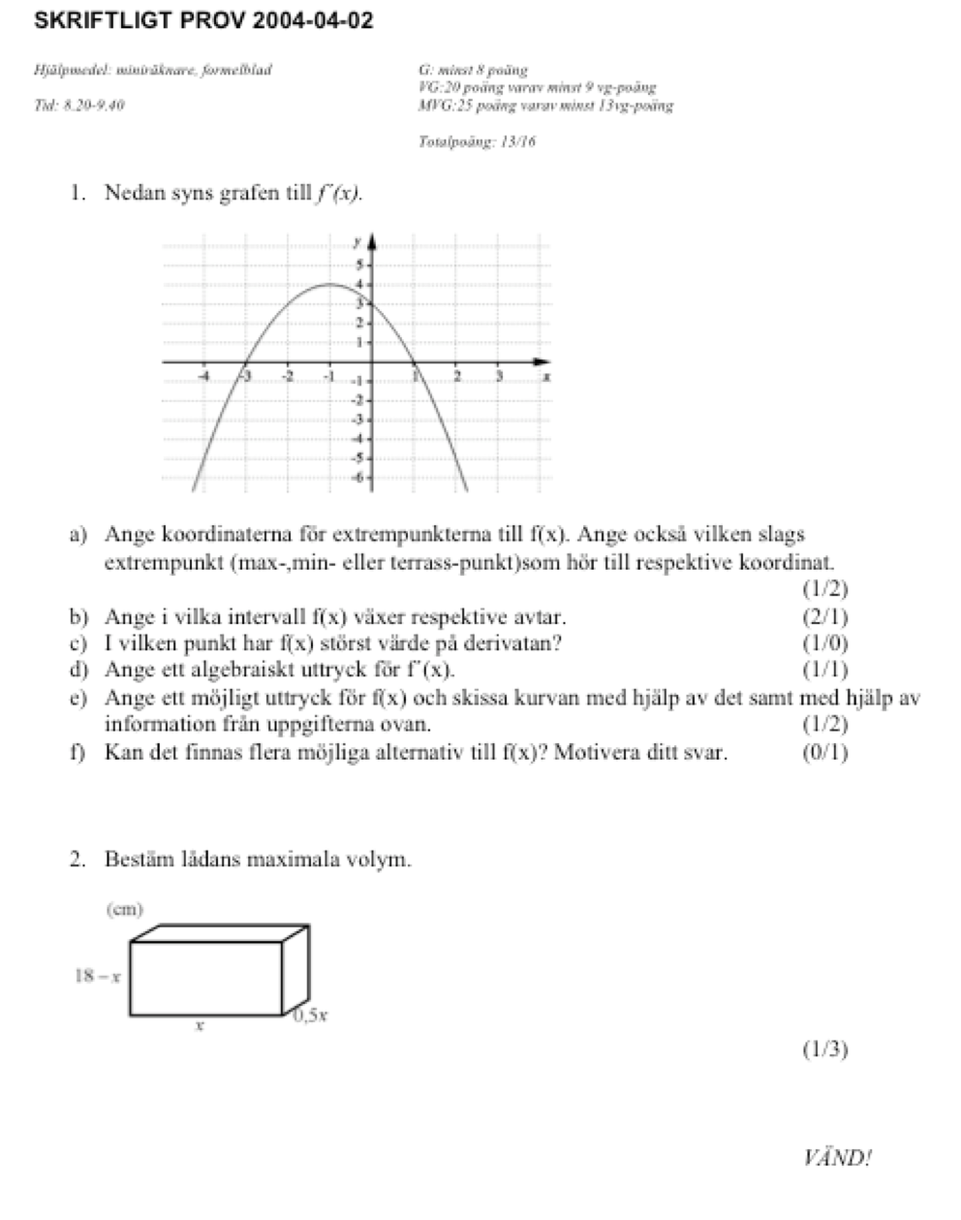
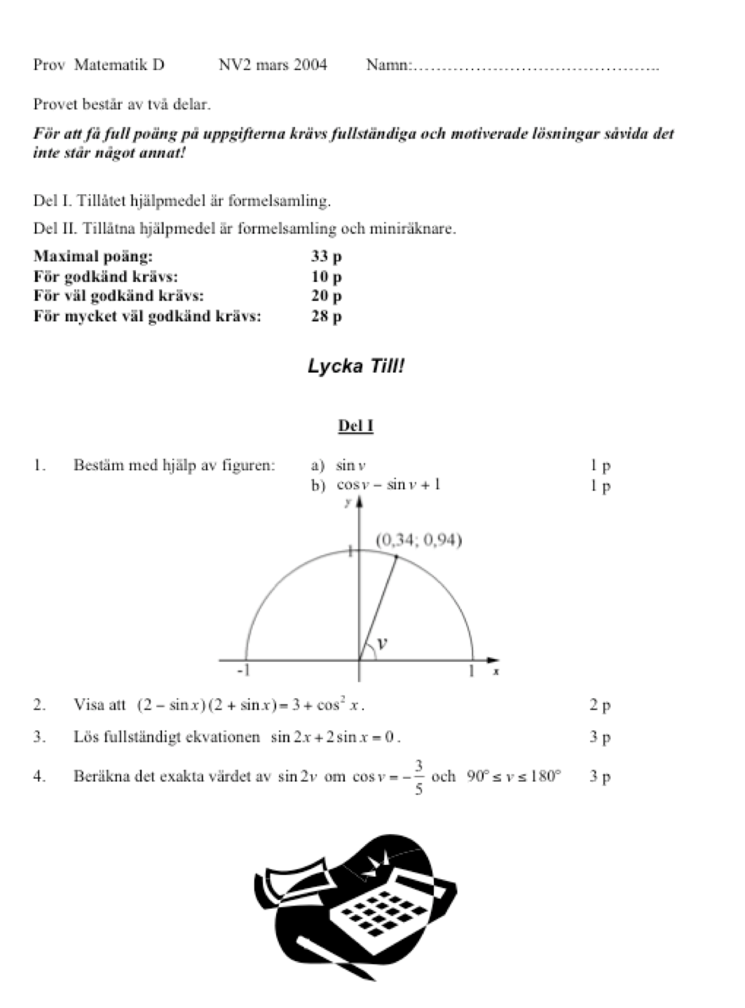
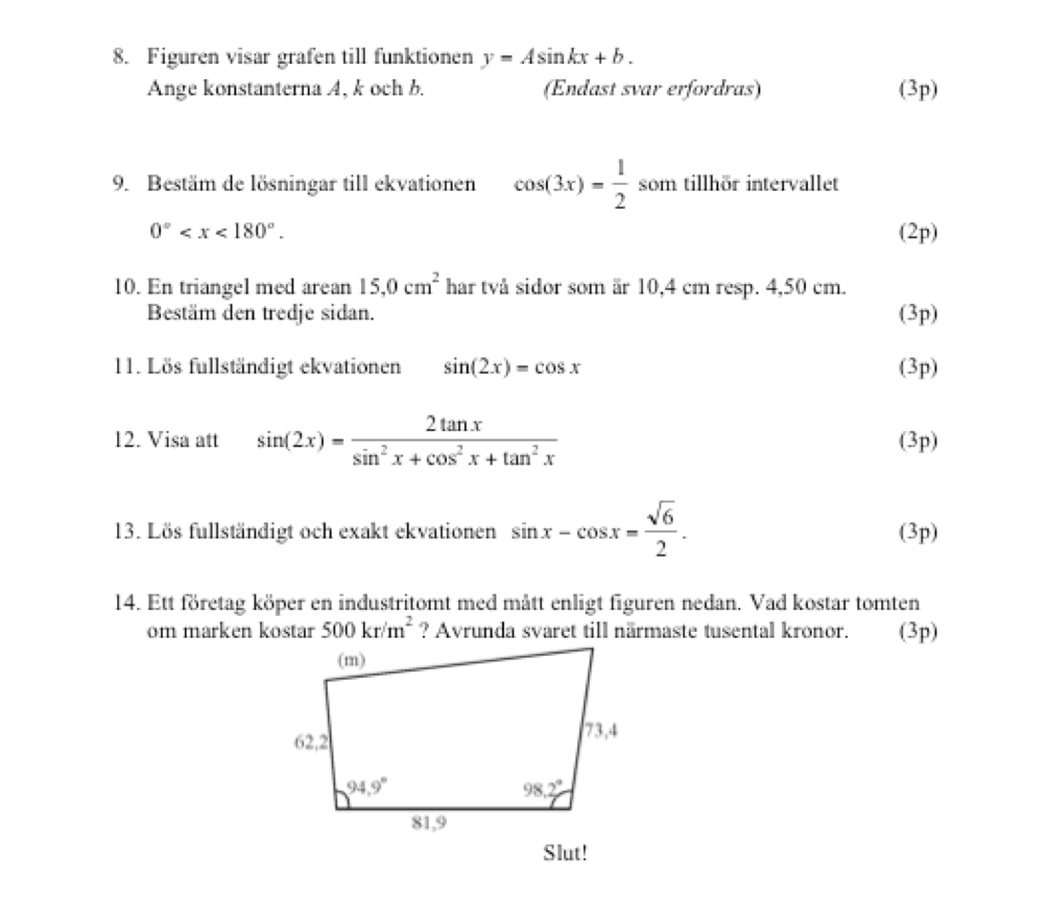
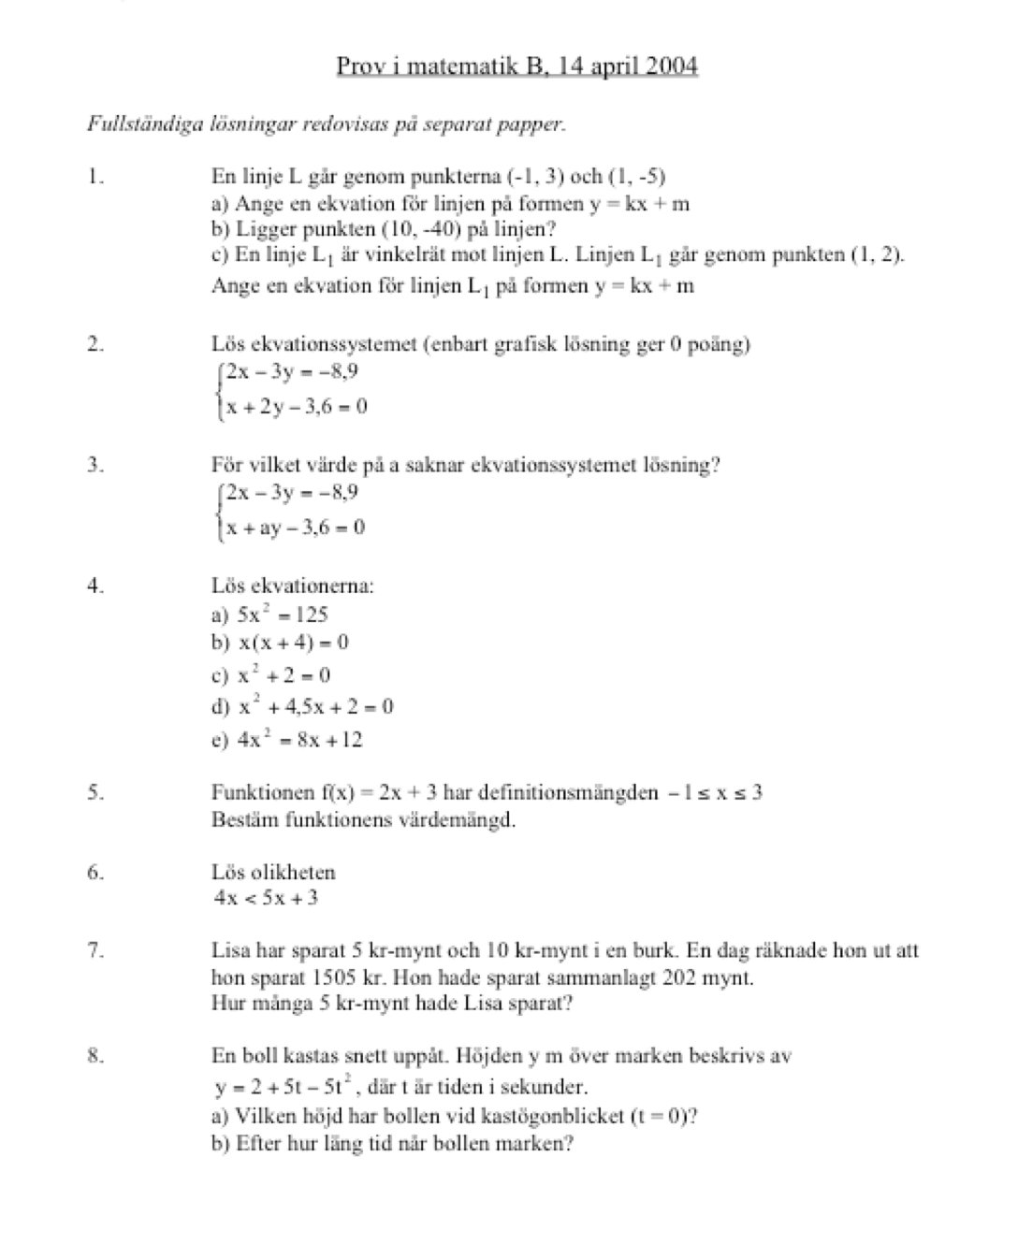
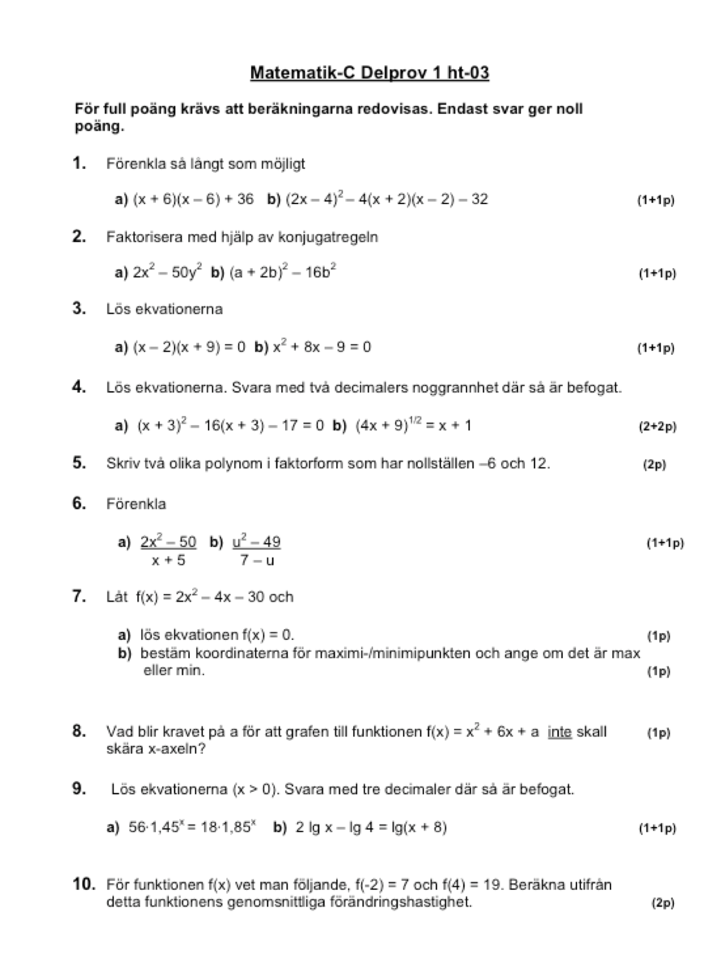
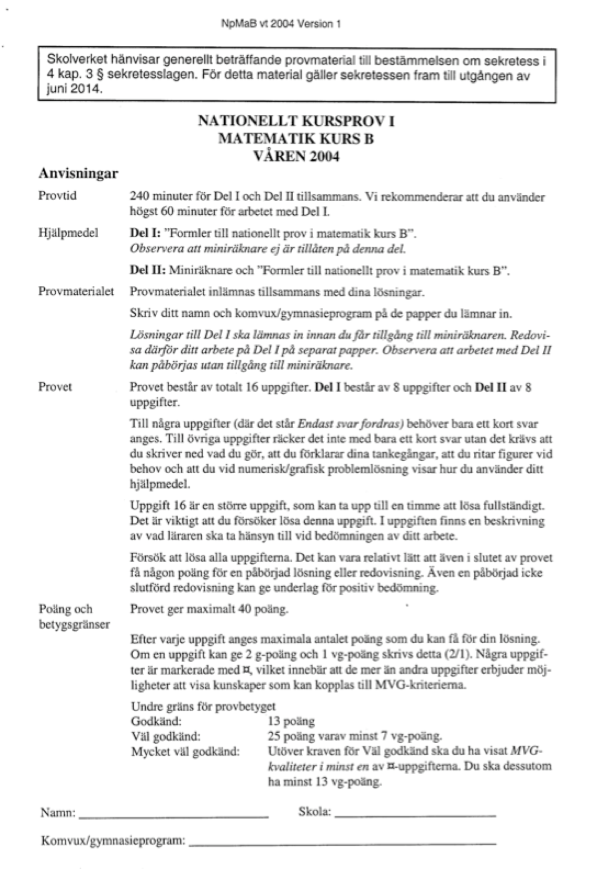
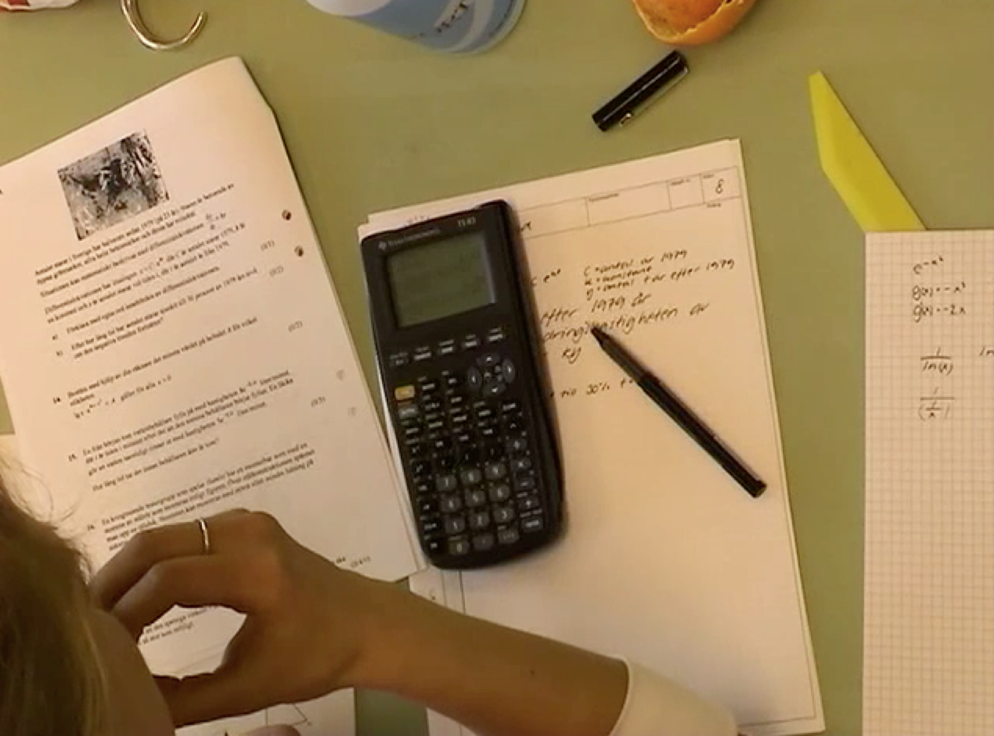
Methods
Classification of tasks
Math reasoning, Competencies
Article I, II, IV
Analyses of students´solutions
Math reasoning
Article II
Teacher interviews:
Math reasoning, Competencies, connected to teachers own tests
Article III, IV

Slide 7
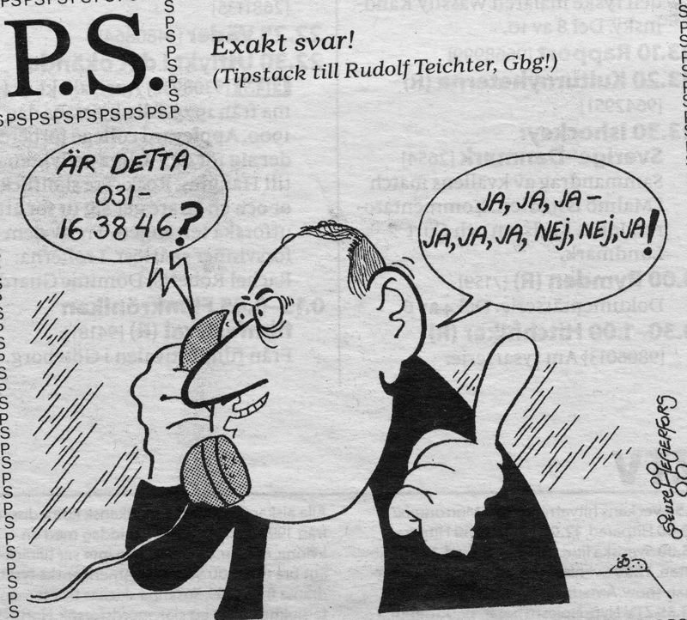

Slide 8
Mathematical reasoning
Reasoning in this thesis is the line of thought, the way of thinking, adopted to produce assertions and reach conclusions. It is not necessarily based on formal deductive logic and may even be incorrect as long as there are some kind of sensible (to the reasoner) reasons that guides the thinking.

Slide 9
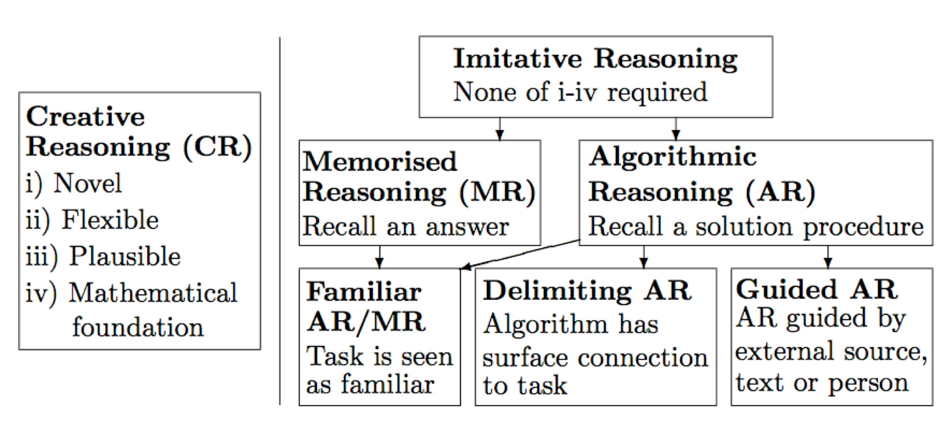
Types of reasoning:

Slide 10
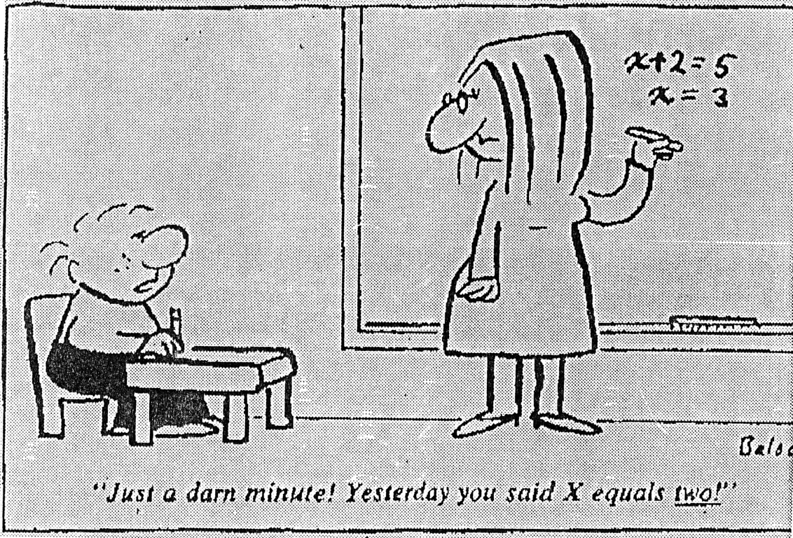
Example MR

Slide 11
Consistent:
At Konsum, a large soft drink costs 15 SEK. At ICA
the soft drink costs 2 SEK more.
How much does soft drink cost at ICA?
15+2=17
Inconsistent:
At Konsum, a large soft drink costs SEK 15 SEK. That is 2 SEK less than what the soft drink costs at ICA. How much does soft drink cost at ICA?
15-2=13

Slide 12
Example IR
Solved example from textbook:
Of the 80 students who left Vallaskolan, 16 had applied to the natural science program in the upper secondary school. What percentage of the students were there?
Percentage of applicants: 16/80 = 0.20 = 20%
Answer: 20% of the students applied for the science program.
Task from the same textbook:
During a police check outside a school, it was found that 84 cars out of 400 were driving too fast. What percentage were speeding?

Slide 13
CR:
x
x
5
x
3
8
⋅
=
x⋅x⋅x⋅x⋅x
x⋅x⋅x
=
⋅
AR:
x
5
⋅
3
5+3
x
=
x

Slide 14
Example AR
Determine the volume of the rectangle.
(cm)
3
3,5
6,4

Slide 15
Example (global)
You will build a glass aquarium of approx. 160 litres.
Suggest suitable measurements.
Describe how you arrived at these measurements and draw a sketch of the aquarium with the measurements indicated.
Investigate how isosceles triangles that have an angle of 70° can look like.
Determine the other angles in the triangles you find.

Slide 16
Example CR Local
A car's value, y SEK, can be described with
the formula
x
y=120000⋅0,85
where x is the time in years after the purchase.
a) How much did the car cost when it was new?
b) How much is the car worth after 3 years?

Slide 17
Mathematical Competencies
Problem solving Competence
Algorithmic Comptence
Concept Competence
Explicit connection to curricula
Modelling Competence
Reasoning Competence
Communication Competence

Slide 18
Results Article I:
 | HP A | SP A | SP B | SP TOT | NV A | NV B | NV C | NP D | NV TOT | NP A | NP B | NP C | NP D | NP TOT
MR/AR/IS | 70 | 88 | 74 | 80 | 78 | 73 | 60 | 58 | 67 | 27 | 42 | 49 | 26 | 36
LCR | 14 | 6 | 12 | 9 | 13 | 15 | 16 | 22 | 16 | 19 | 11 | 7 | 18 | 14
GCR | 16 | 7 | 15 | 11 | 8 | 12 | 24 | 20 | 16 | 54 | 47 | 44 | 56 | 50
CR (L+G) | 30 | 12 | 26 | 20 | 22 | 27 | 40 | 42 | 33 | 73 | 58 | 51 | 74 | 64

Slide 19
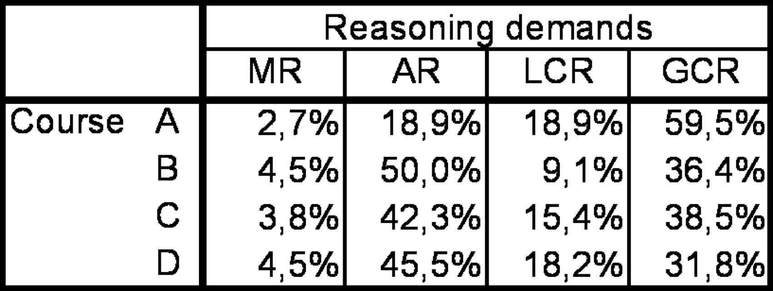
Results Article II:
High consistency between requirements and reasoning used.
Higher proportion of both requirements and used CR in the A course compared to the other courses.

Slide 20
Results Article III:
Why such a high focus on MR/AR in teacher-constructed tests?
Low awareness of CR.
Different types of perceptions of AR/CR. Four different types. a) Easy vs hard, b) Geometry vs algebra, c) “Something special”, d) discern CR
'Not all students can learn CR.’ Takes time to develop CR tasks, difficult to do so,
The desire to get as many students as possible approved.

Slide 21
Results article IV:
Impact?
NCT
TMT?
Regarding tested competencies

Slide 22
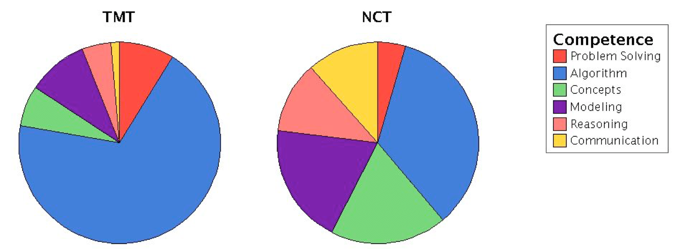
Results article IV:

Slide 23
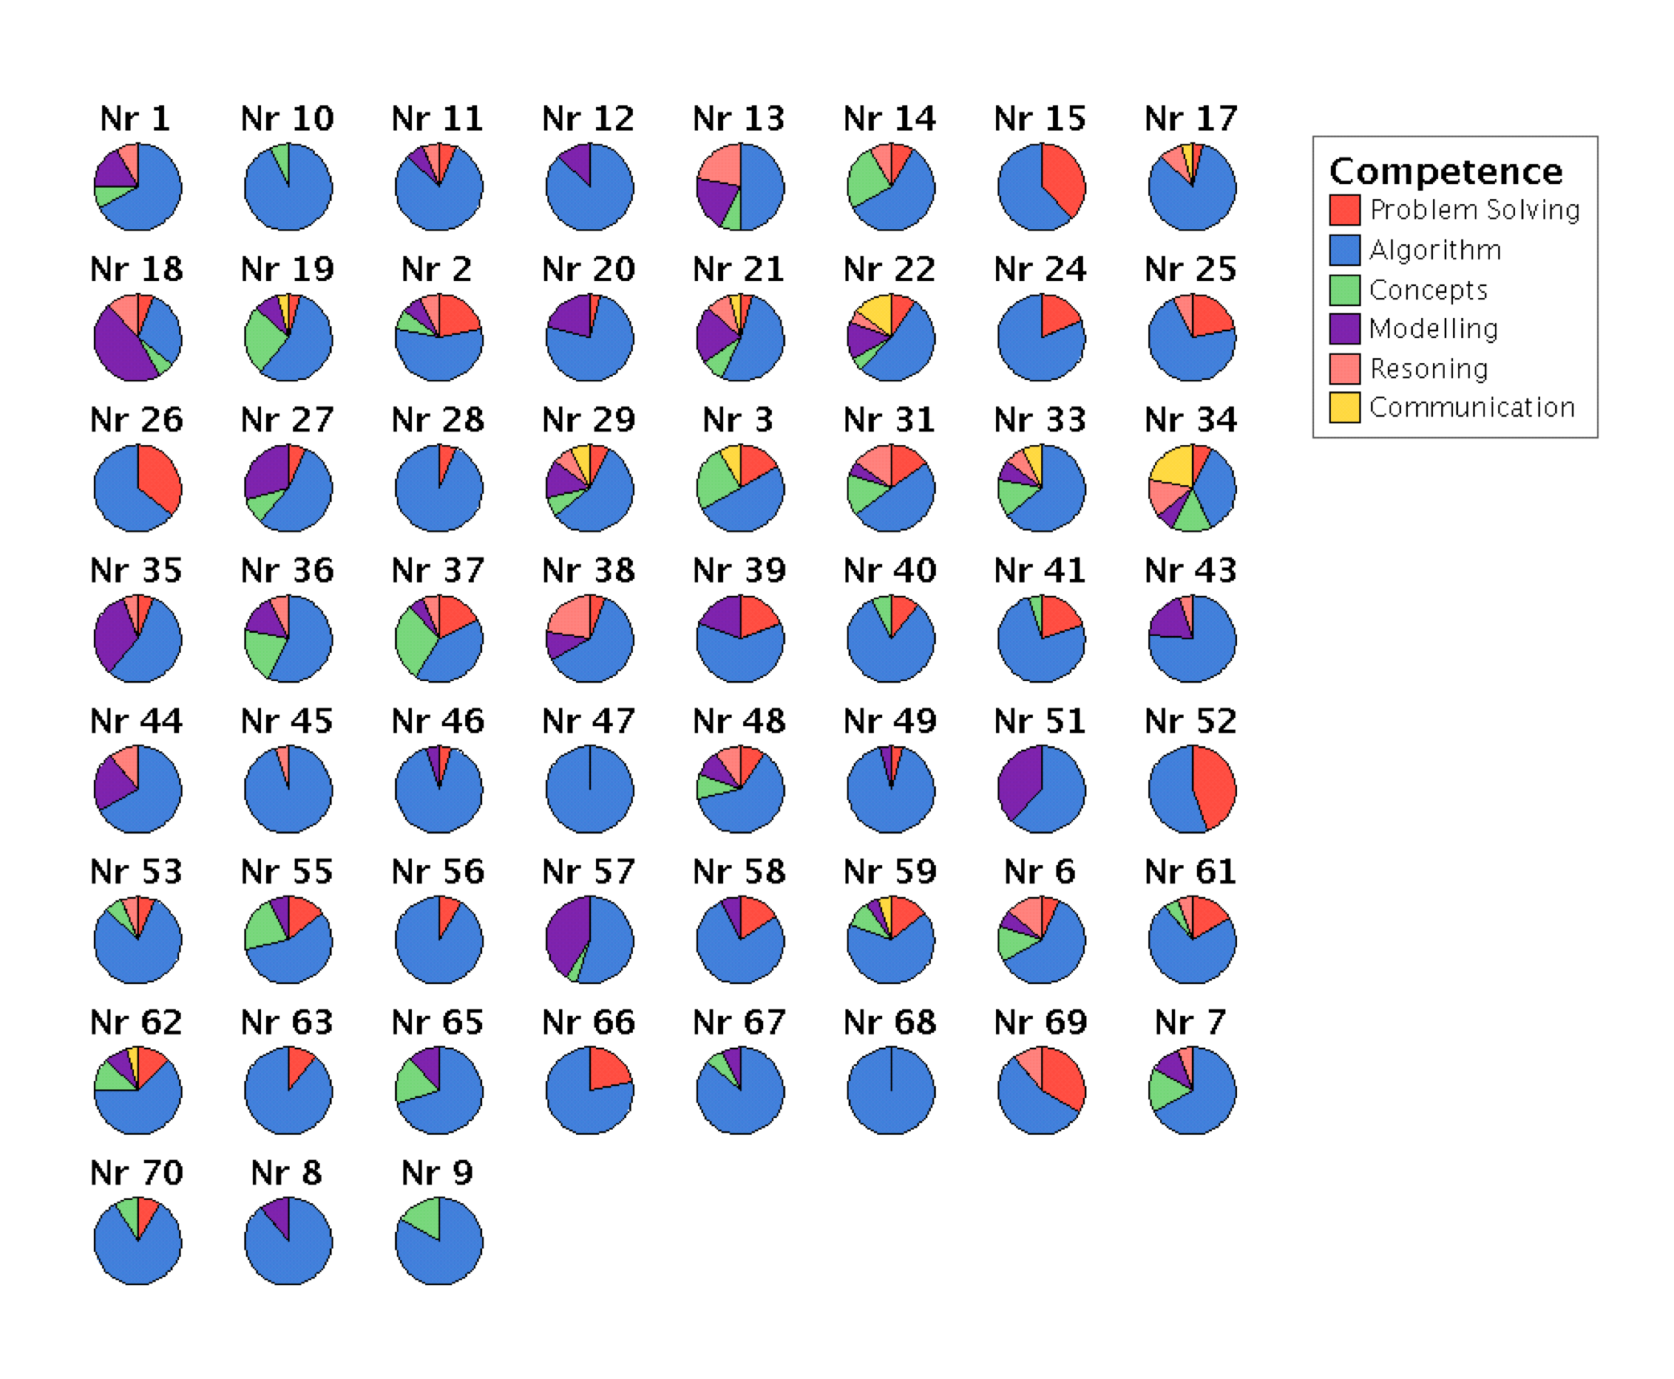
Results article IV:

Slide 24
Results article IV:
Impact?
NCTs
TMTs
Interviews with teachers. Two groups.
Teachers with tests simalar to the NCTs,
Teachers with tests not simalar to NCTs.
Both groups had similar views of the NCTs
Delibarate choices to mimics the NCTs

Slide 25
Conclusions:
Teacher-made tests mainly focus on tasks that can be solved without having to consider intrinsic mathematical properties.
National tests focus to much higher degree on tasks which cannot be solved without having to consider intrinsic mathematical properties.
In the case where a test requires creative mathematically founded reasoning, as in the national tests, students also use non-imitative solution strategies to a much higher extent.
A very content-dense curriculum may hamper the development of creative mathematically founded reasoning and conceptual understanding.

Slide 26
Conclusions:
The focus on tasks possible to solve by imitative reasoning in
teacher-made tests seems explainable by teachers limited awareness about creative mathematically founded reasoning and their wish to get as many students as possible to reach the grade level Passed as possible, which was believed difficult to do when requiring high quality reasoning from weaker students.
Impact of the national course tests on teachers’ development of tests, in terms of tested competences, seem to be fairly modest.
The impact of the national course tests has however been proved to exist and partly shown how to operate, on some teachers test development. I.e. a causal relationship has been shown (cf. request from Mehrens (2002)).

Slide 27
Conclusions:
The frameworks and analysis procedures used throughout this thesis have shown to be useful as research tools and can be used to further evaluate and develop tests.

Slide 28
Discussion
Generally, in Sweden, there´s a big gap between test results and grades, how to explain that?
Whats the nature of your own tests?
Are you, influenced by your National Tests?
What is a good distrubution of AR(IR) and CR? In learnings situations? Why?

Slide 29
末端
[The end]

