Slide 1
IO11 Scaffolding
Christina Pichler-Koban, Klagenfurt University

Slide 2
General overview and aim
In this module future teachers in initial teacher education are introduced to support their students in dealing with complex environmental socio-scientific issues (SSI) by providing a scaffolding framework. Educational research has shown that students often struggle with open problems. Meta-knowledge about the process to be followed can support students in dealing with these tasks and in deciding which step they should perform next.
The intention of this module is to strengthen future teachers’ competences in how to use scaffolding and meta-knowledge frameworks to deal with environmental SSI and to develop a deeper understanding of the benefits for their students through meta-knowledge approaches.
Teacher students learn about scaffolding frameworks by using the topics “forests” and “climate change” as examples of an SSIs with multiple references to life experiences of future science teachers and their future students at school.

Slide 3
Flowchart and Module plan
Introduction to the topic of the forest
Introducing of scaffolding using the example of the SSI forest
Implementation of scaffolding and forest related SSI in classroom
Activity 1.1 Pictures of forests/forest quiz
Activity 2.1: Forest and site
Activity 2.3: Forest and climate change
Activity 3.1: Analysis of forest lessons
Activity 2.2: Forests in change
Activity 3.2: Development of SSI lessons based on forest issues
Activity 1.2 Mapping Fields of interest
Activity 1.3 Connecting forests to curricula

Slide 4
Guidelines for Methods
Immersive:
Emotionally, by linking up with personal experiences, taking on different roles and perspectives
Subject-related, through broad immersion in methods and findings of interdisciplinary multi-perspective mobility research
Prioritizing students’ active learning:
As little direct input from the teacher educators as possible
Discursive Formats
Own experience
Creative elements
Reflective practices

Slide 5
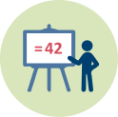
1. Introduction to the topic of the forest
Activity 1.1 Pictures of forests and forest quiz
 | Duration: 30 min + 30 min
This is a “warm up” activity. This activity aims to draw attention to the different dimensions of forest. For example, from the perspective of Education for Sustainable Development, the forest has at least the following dimensions: ecological, economical, societal, cultural. The trainer shows a selection of pictures with different forests. Each participant chooses a picture of their favourite forest and tells a story about it. The intention is to explore students’ previous knowledge, beliefs, experiences, and attitudes related to the topic. If the trainer wants to draw more attention on the forest dimensions, he/she can include the optional activity “forest quiz”, where students must guess terms relating to forest.

Slide 6
1. Introduction to the topic of the forest
Activity 1.2: Mapping fields of interest
 | Duration: 30 min + 60 min
These activities intend to give students an idea of the wide range of topics that are related to forests in the broadest sense. Who knows about forest? Students try to give correct definitions for terms related to forest. Forest tales: The students are given the task of collecting information on the topic of forests (newspaper articles, photos, headlines, studies). In small groups they discuss what was decisive for them to choose articles, which of the materials seem credible, which seem interesting for teaching. The topics addressed are collected and topic clusters are formed to form a pool for further tasks.

Slide 7
1. Introduction to the topic of the forest
Activity 1.3: Connecting forests to curricula
 | Duration: 30 min
The teacher trainer gives an example how to identify aspects in forest topics that relate to maths and science education. The example given in the outline refers to Austrian curriculum. Following this example groups of two teacher students identify aspects in forest topics that relate to maths and science education according to their national curricula for one subject and grade on their own.

Slide 8
2. Introduction of scaffolding using the example of the SSI forest
Activity 2.1: Forest and site
 | Duration: 60 min
What does a forest need to grow, and which elements determine its appearance? The intention of this activity is to work out the connection between forest and site. A forest tree is first used to work out what it needs for its growth. In a next step, the class looks into the question of how different plant species cope with different offers of light, water and nutrients and which species thrive where. In pairs, students create social media profiles of different forest trees.

Slide 9
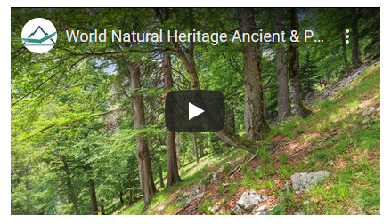
2. Introduction of scaffolding using the example of the SSI forest
Activity 2.2: Forests in change
 | Duration: 90 min
The students compare distributions of forests at different times in earth history using maps and tables. They calculate changes in forest areas during the last century, they discuss causes and consequences of these changes.

Slide 10
2. Introduction of scaffolding using the example of the SSI forest
Activity 2.3: Forests and climate change
 | Duration: 230 min
This activity consists of six exercises. First the trainer gives a short input on the influence of the forest on the regional climate, the students explore this by measuring temperature and humidity at different sites. The students receive data on a site and have to make a choice on the appropriate tree species. The following exercises add economical, legal, environmental and social dimensions, that play a role in such decisions using different techniques like group work, role play, discussions.

Slide 11
Implementation of scaffolding and forest related SSIs in classroom
Activity 3.1: Analysis of forest and climate change lesson
 | Duration: 45 min
The Teacher Trainer introduces a range of scaffolding techniques to the students. The students analyse the previous lessons on the topic of the forest and try to identify the scaffolding elements.

Slide 12
Implementation of scaffolding and forest related SSIs in classroom
3.2: Development of SSI lessons based on forest issues
 | Duration: 180 min
The teacher students choose a topic from the topic pool resulting from Activity 1.2 and give a vote for their preferred topic. For the topic that gets the most votes, the students should work out a scaffold in groups of two. First, they need to consider where suitable data material for the content to be taught could be found. The research and preparation of the data material should be done by the students as homework. The teacher trainer selects three curriculum objectives that match the content. He presents them to the students in the following practice session. Each group chooses a curriculum objective and thinks about how the chosen topic and the curriculum objective can be linked and how the scaffold should be built up. Using the data material prepared in the homework assignment, the students now plan their lesson. Each group tests the lesson setting of another group and provides feedback.

Slide 13
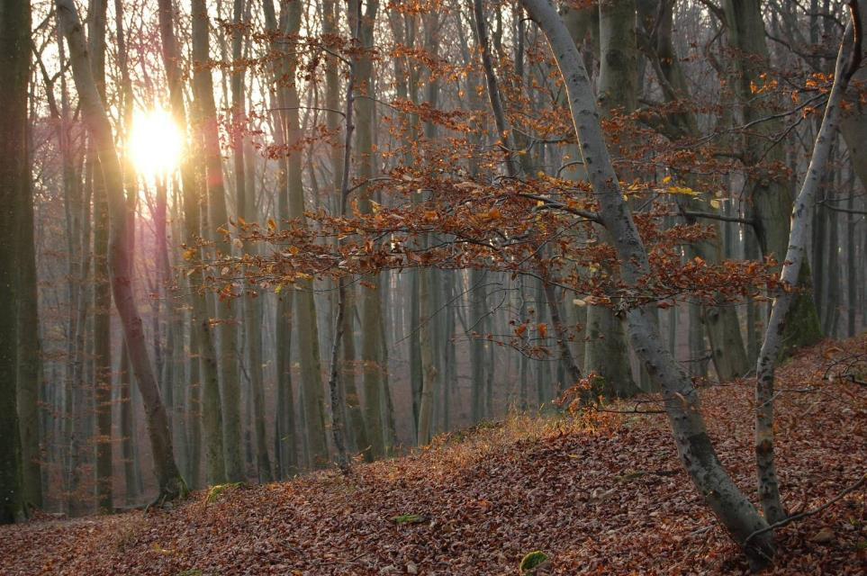
Activity 1.1: Pictures of forests
European beech forest (Photo: Hanns Kirchmeir)
Notes:
Image from Pixabay: It is not necessary to quote the source

Slide 14
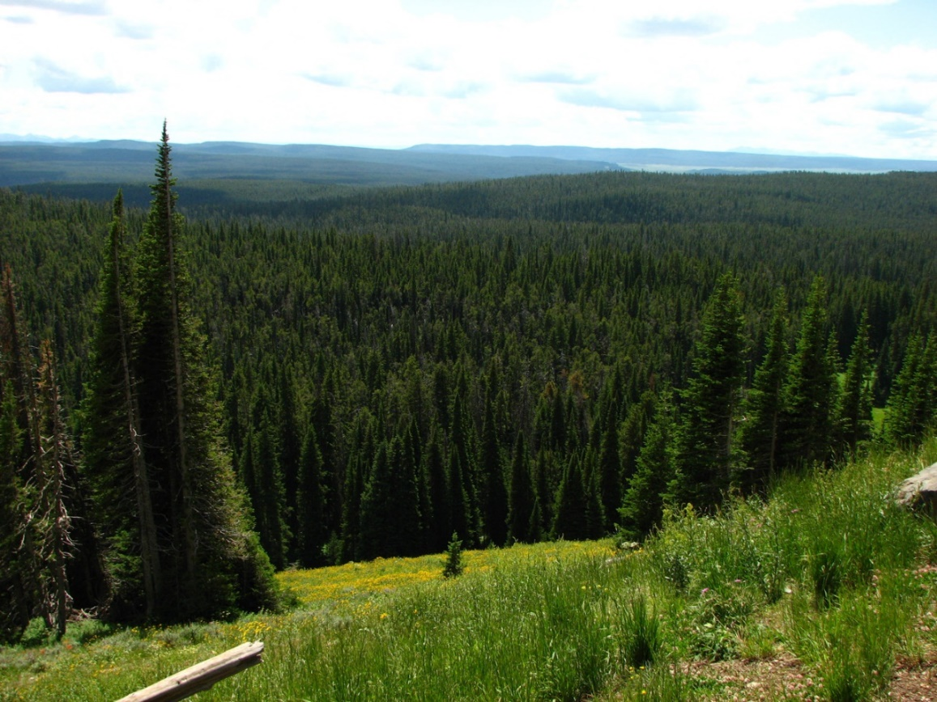
Activity 1.1: Pictures of forests
Coniferous forest (Photo: Michael Huber)
Notes:
Image from Pixabay: It is not necessary to quote the source

Slide 15
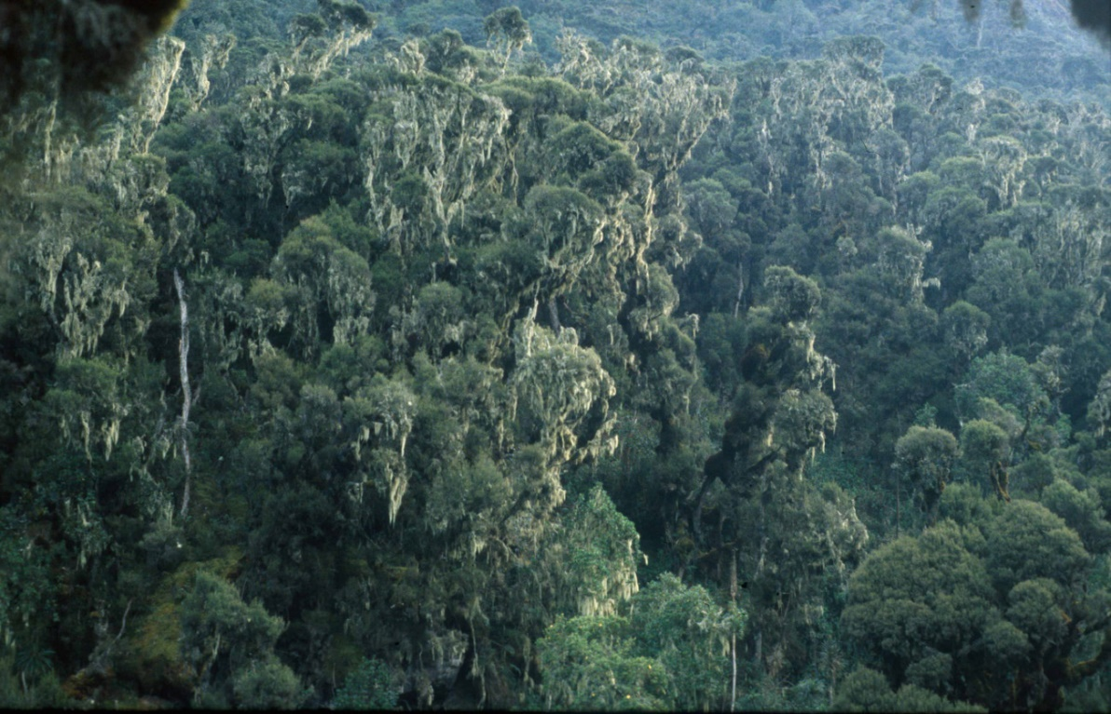
Activity 1.1: Pictures of forests
Cloud forest, Uganda (Photo: Hanns Kirchmeir)
Notes:
Image from Pixabay: It is not necessary to quote the source

Slide 16
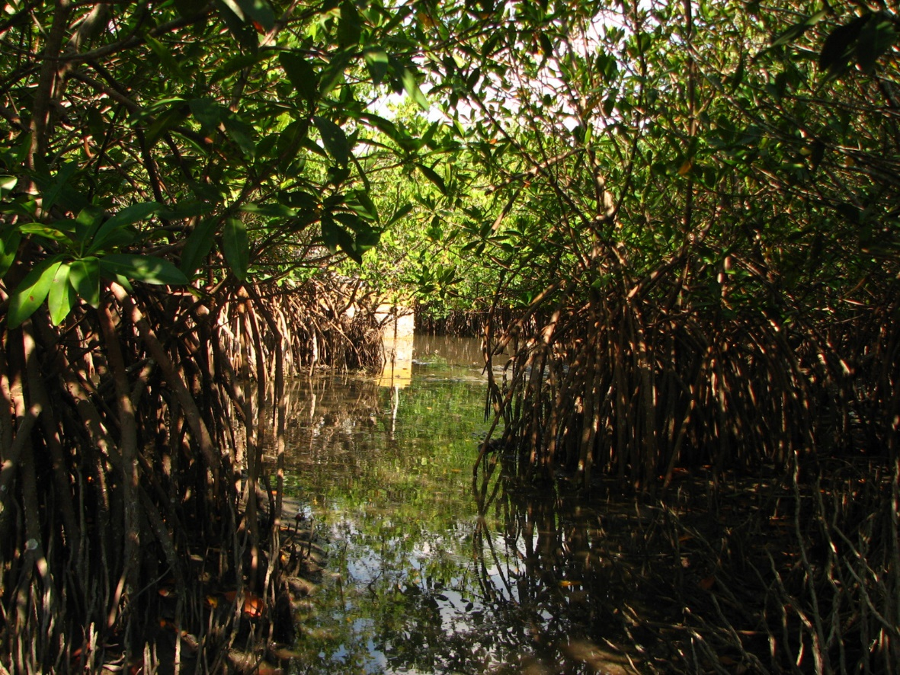
Activity 1.1: Pictures of forests
Mangroves, La Mancha/Mexico (Photo: Michael Huber)
Notes:
Image from Pixabay: It is not necessary to quote the source

Slide 17
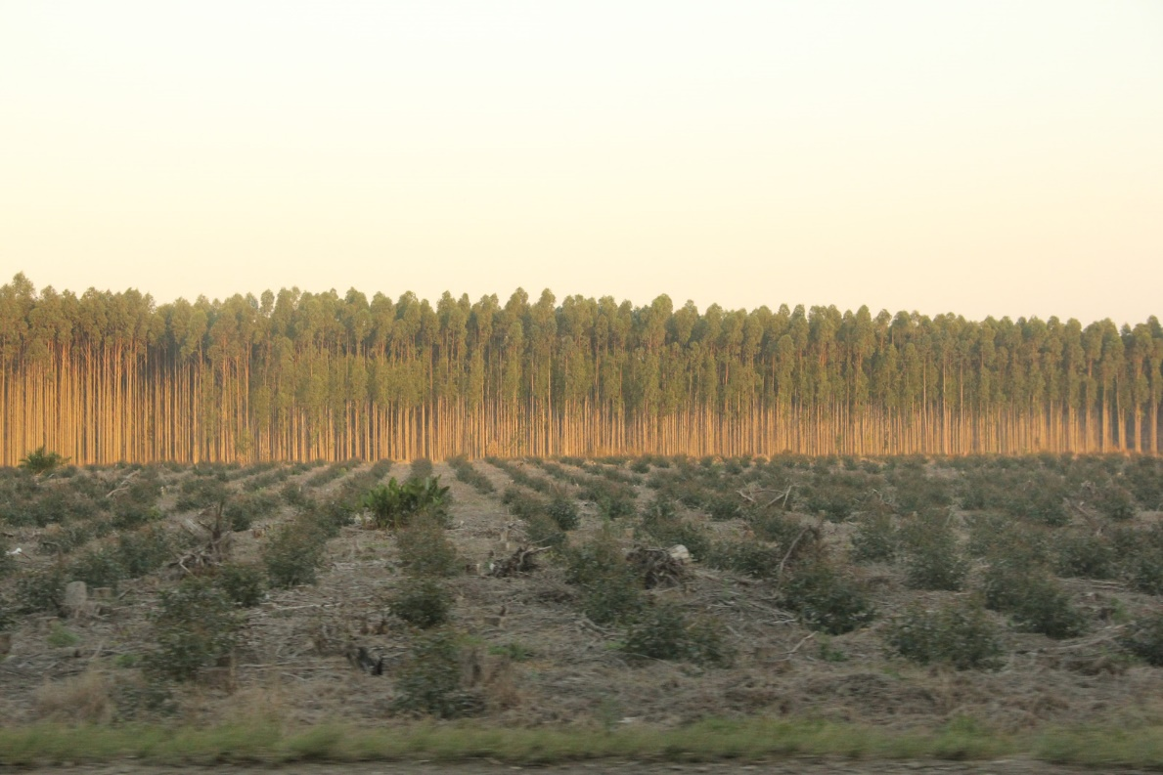
Activity 1.1: Pictures of forests
Eukalyptus plantation, South Africa (Photo: Hanns Kirchmeir)
Notes:
Image from Pixabay: It is not necessary to quote the source

Slide 18
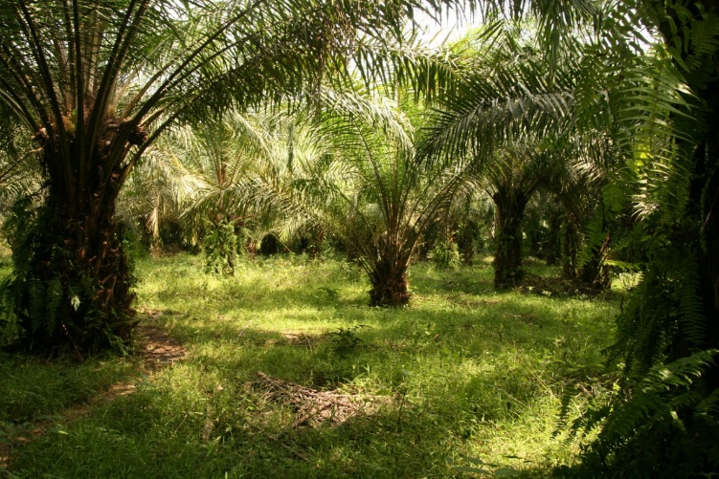
Activity 1.1: Pictures of forests
Oil palms (Photo: Hanna Kirchmeir)
Notes:
Image from Pixabay: It is not necessary to quote the source

Slide 19
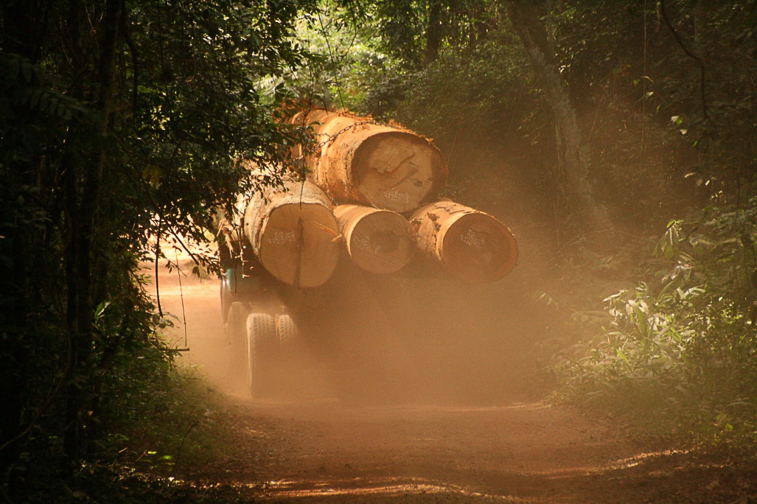
Activity 1.1: Pictures of forests
Timber transport, Ghana (Photo: Hanna Kirchmeir)
Notes:
Image from Pixabay: It is not necessary to quote the source

Slide 20
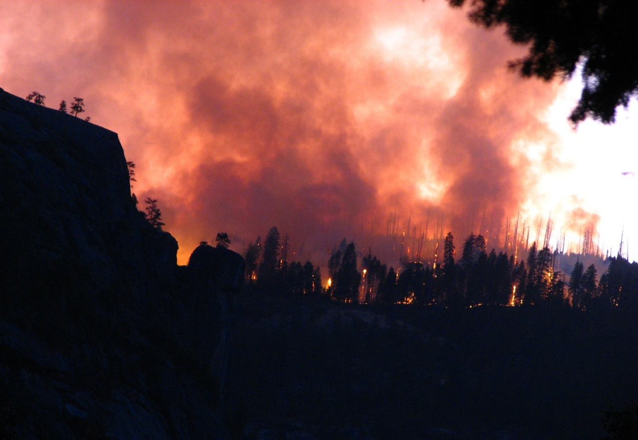
Activity 1.1: Pictures of forests
Wildfire (Photo: Michael Huber)
Notes:
Image from Pixabay: It is not necessary to quote the source

Slide 21
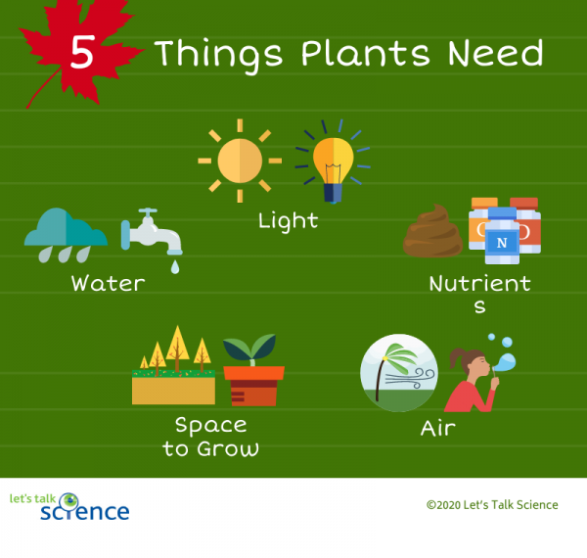
Activity 2.1: Forest and site – plant growth
Notes:
Image from Pixabay: It is not necessary to quote the source

Slide 22
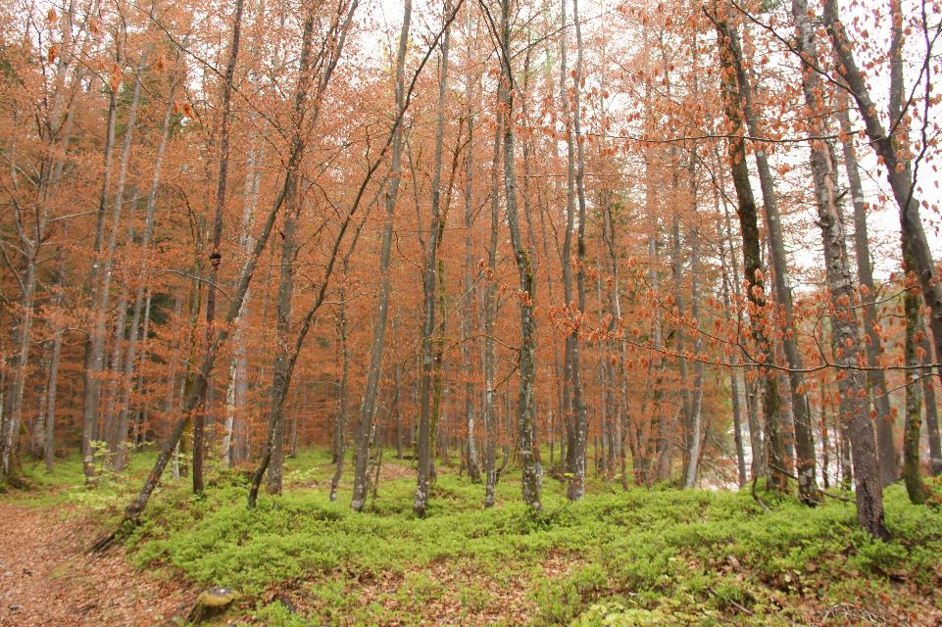
Activity 2.1: Forest and site – forests on earth
Notes:
Image from Pixabay: It is not necessary to quote the source

Slide 23
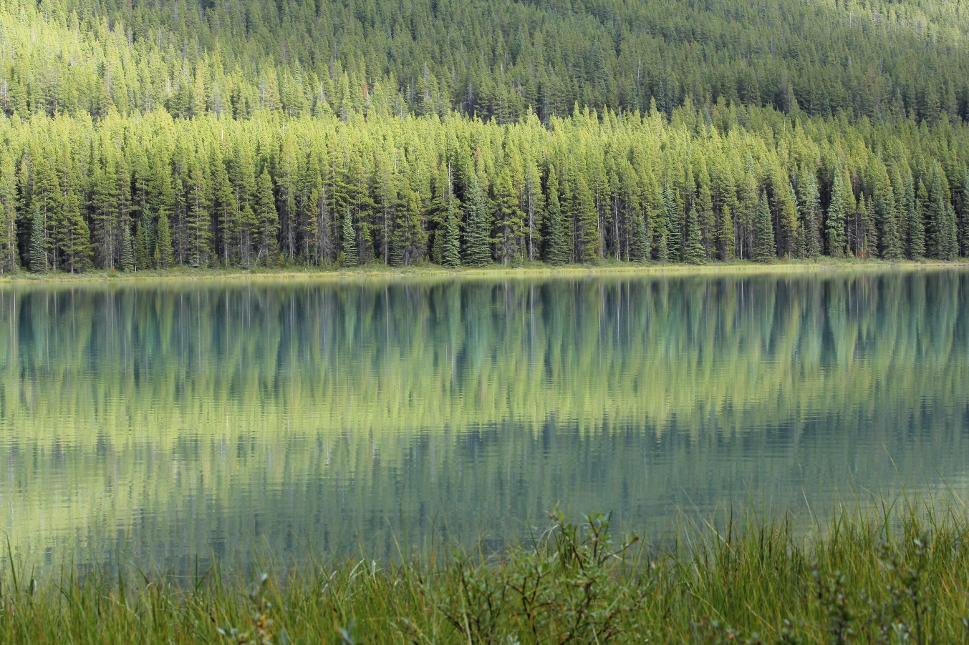
Activity 2.1: Forest and site – forests on earth
Notes:
Image from Pixabay: It is not necessary to quote the source

Slide 24
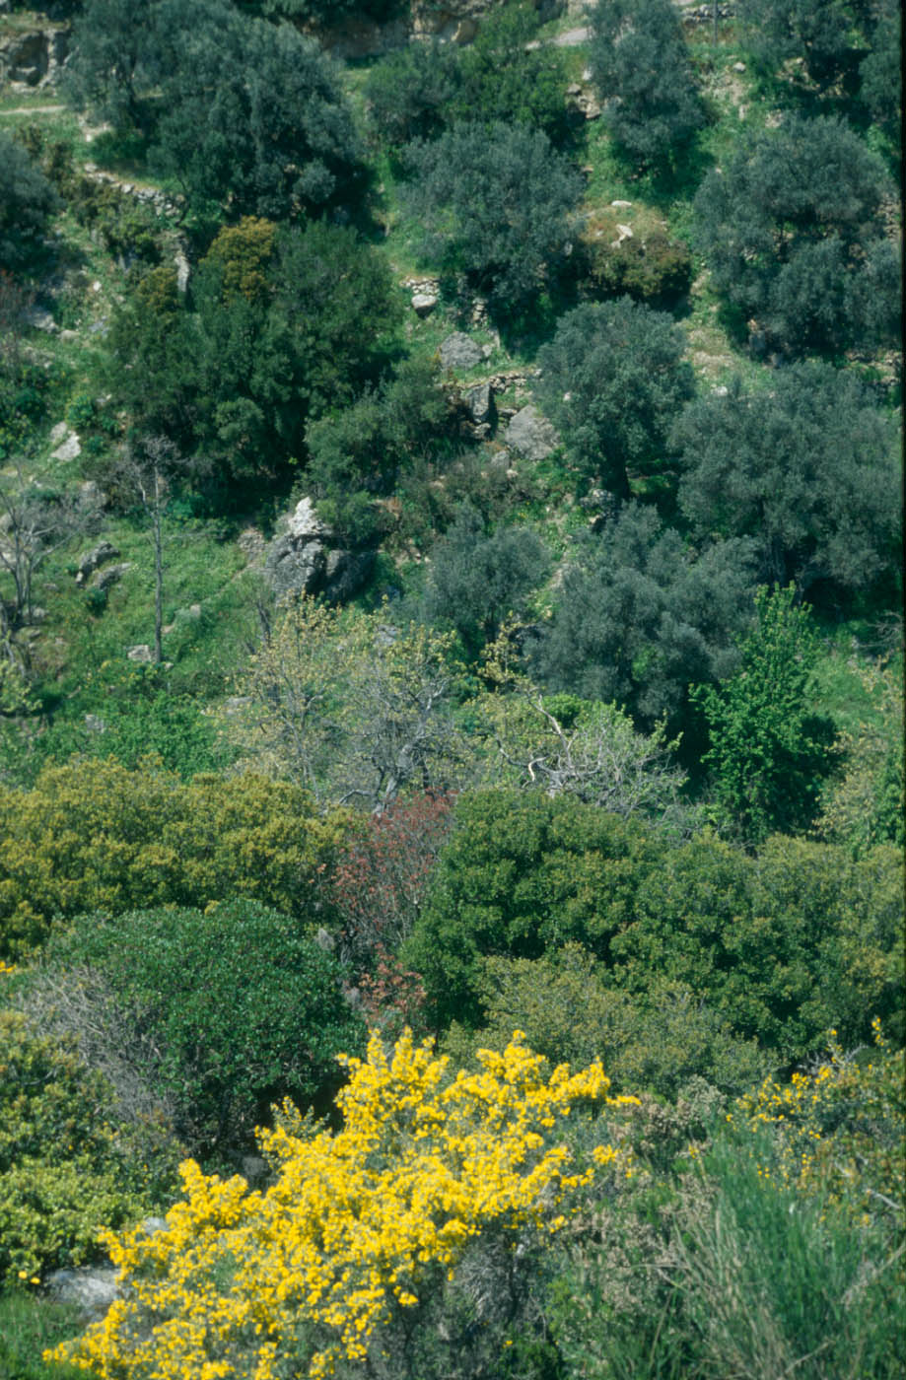
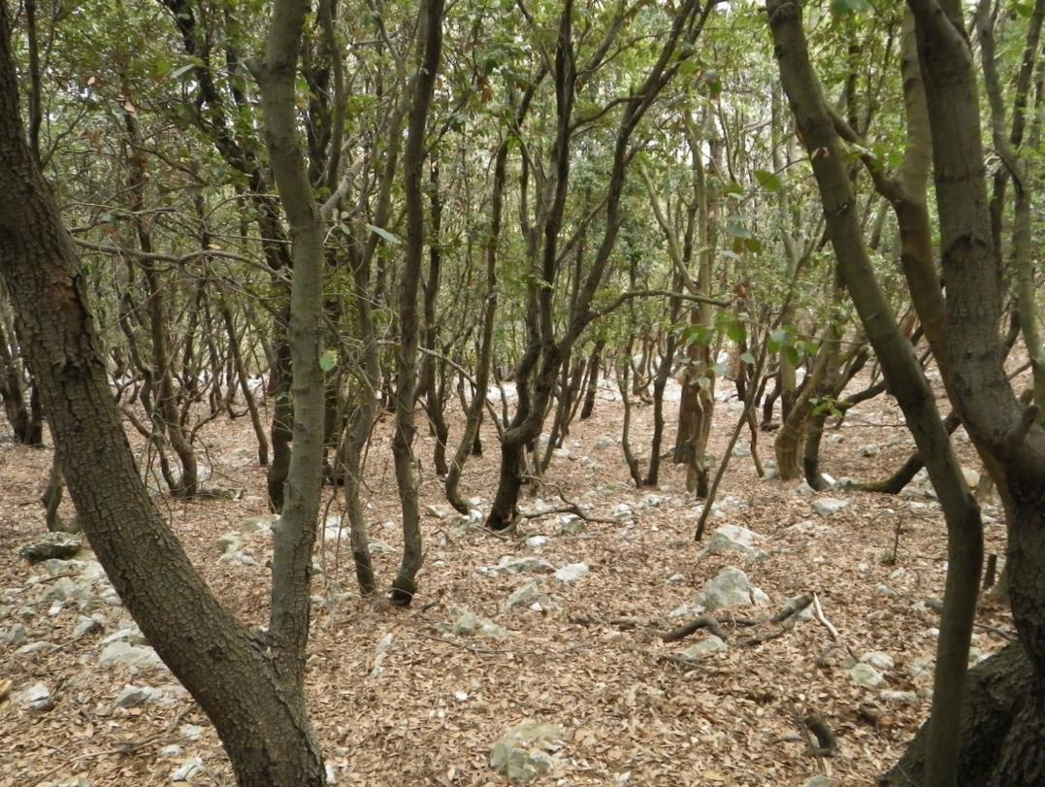
Activity 2.1: Forest and site – forests on earth
Notes:
Image from Pixabay: It is not necessary to quote the source

Slide 25
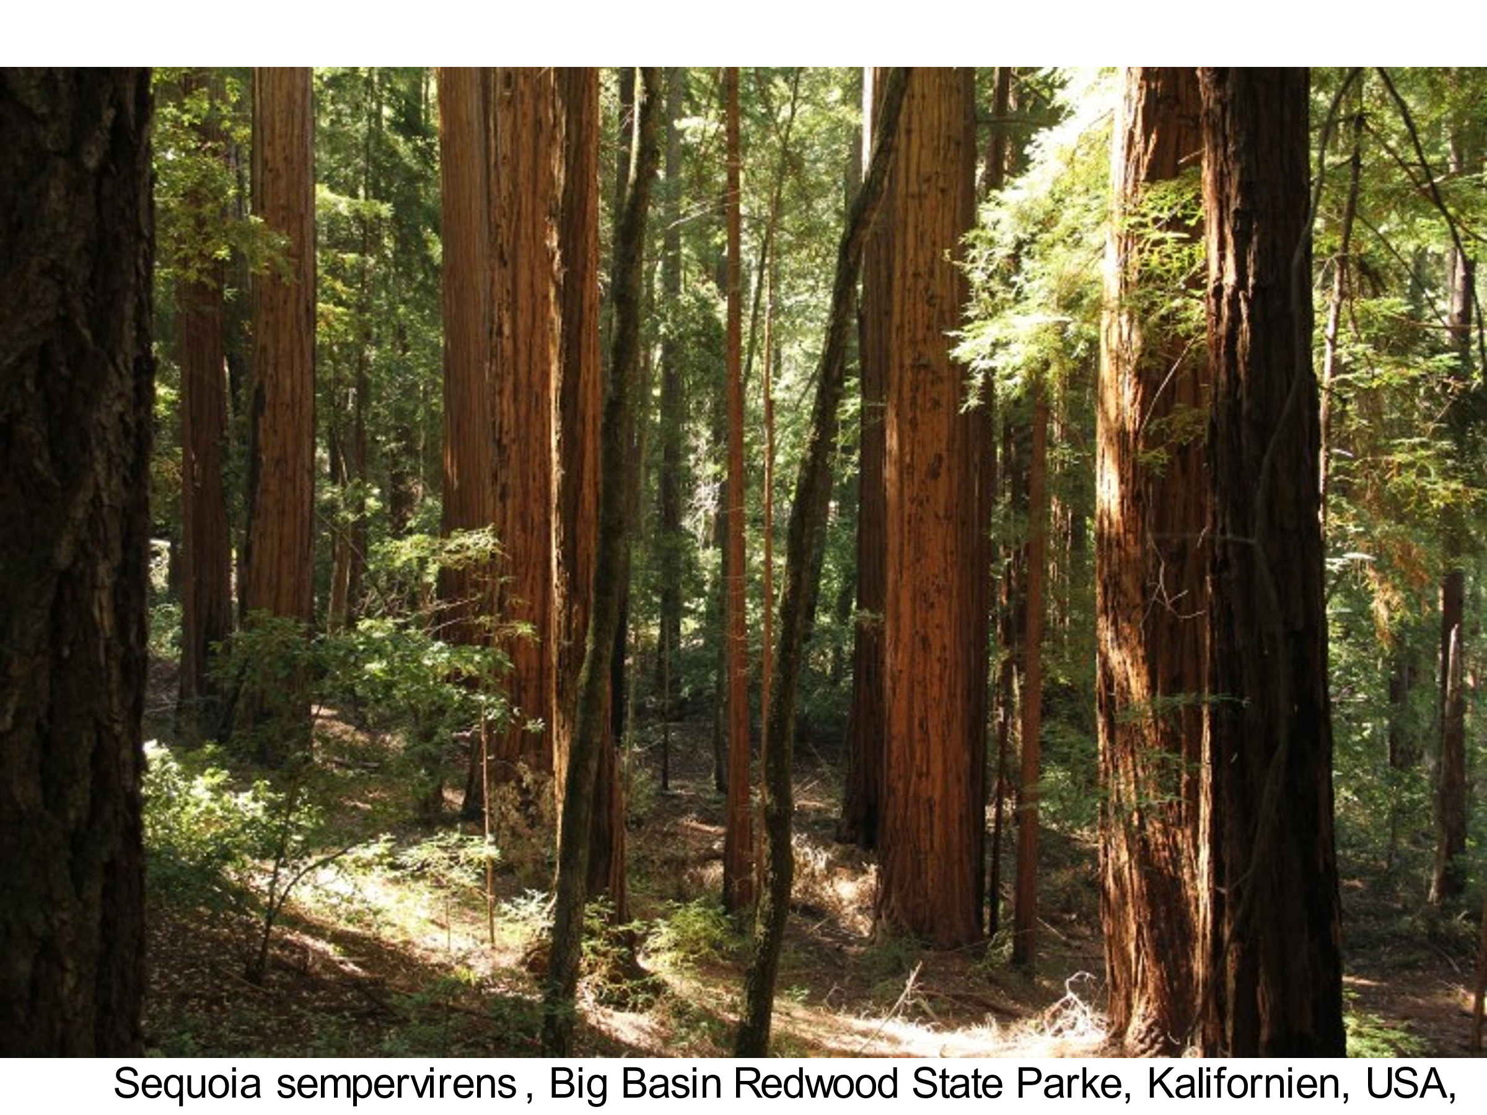
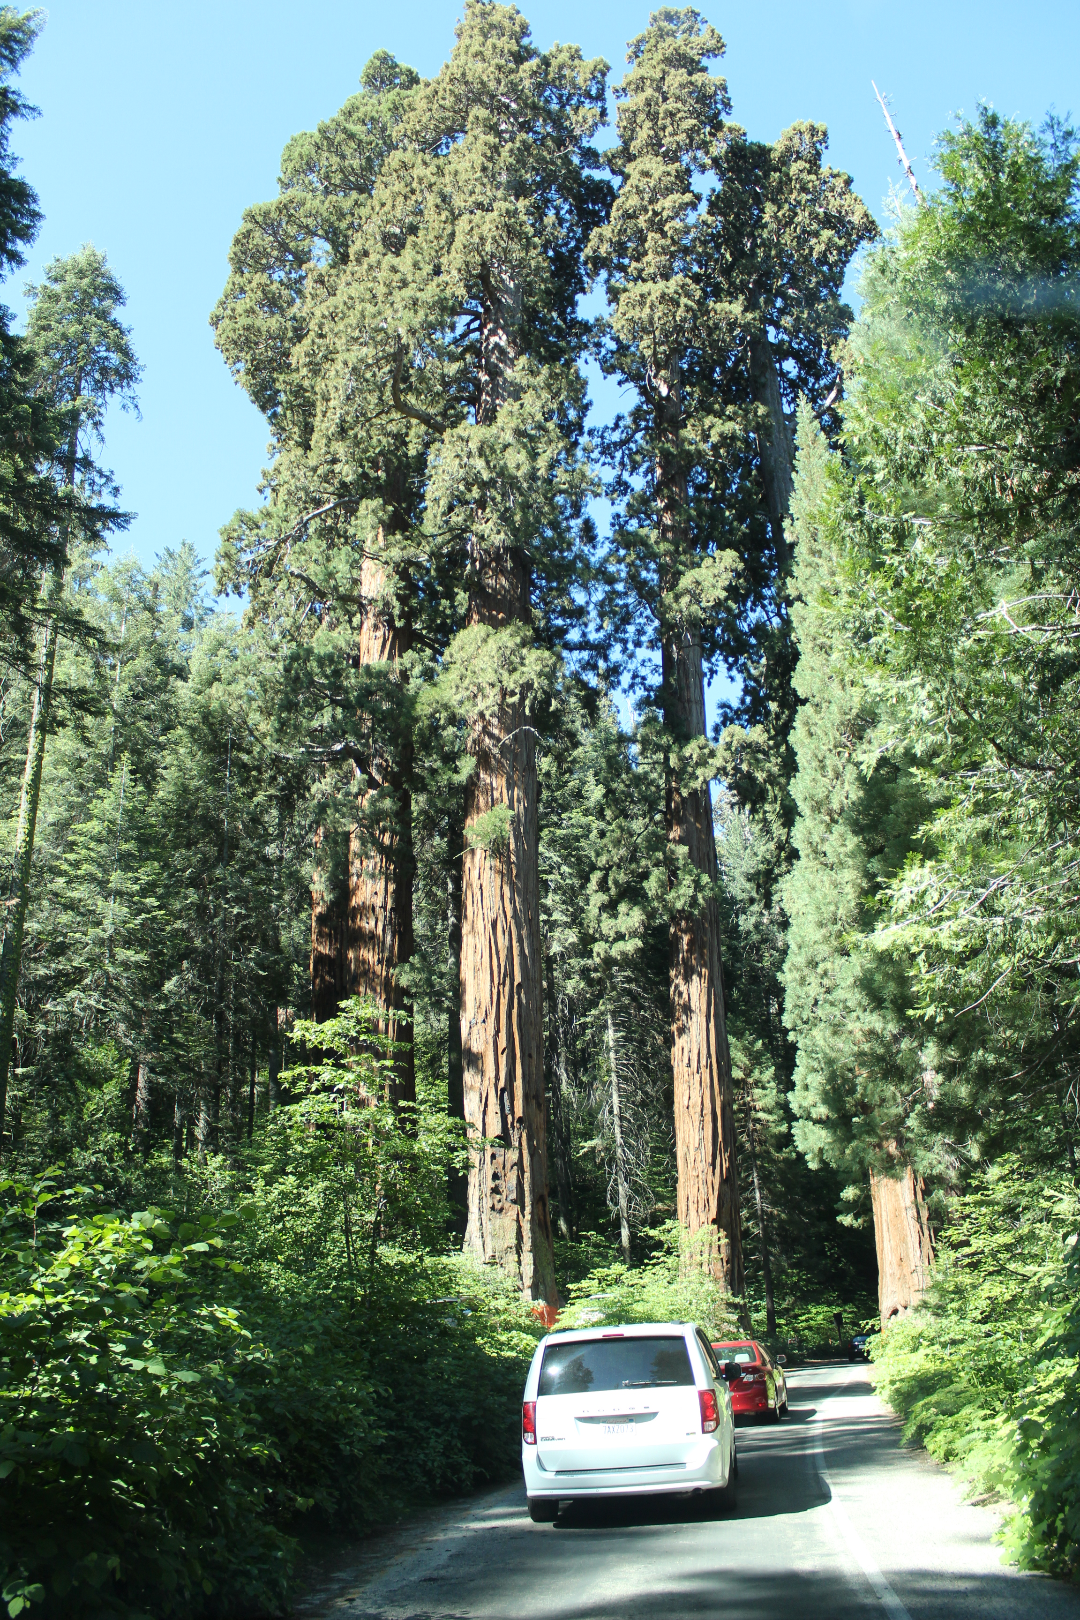
Activity 2.1: Forest and site – forests on earth
Notes:
Image from Pixabay: It is not necessary to quote the source

Slide 26
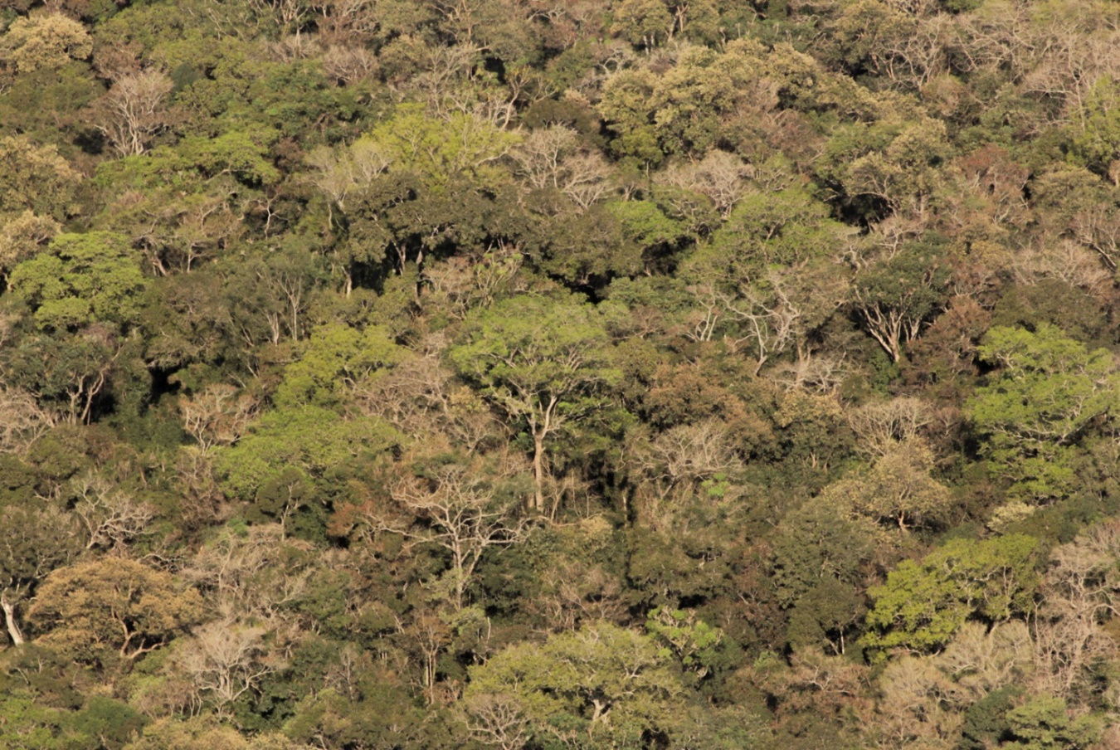
Activity 2.1: Forest and site – forests on earth
Notes:
Image from Pixabay: It is not necessary to quote the source

Slide 27
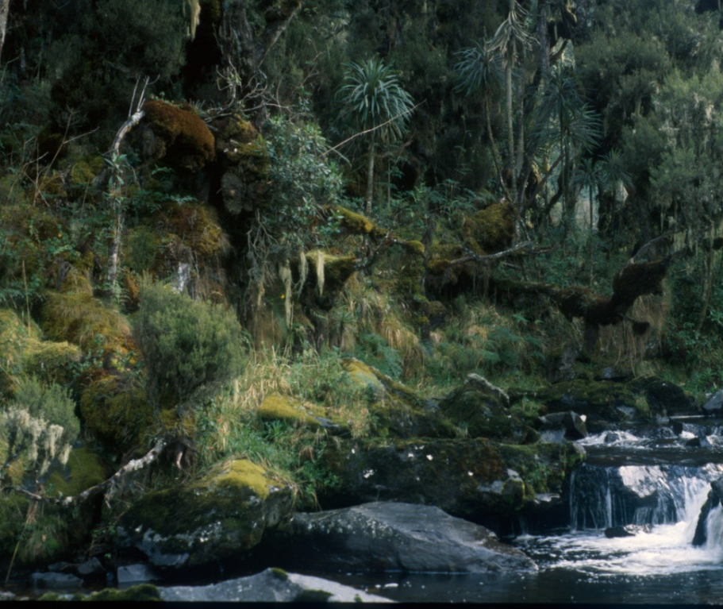
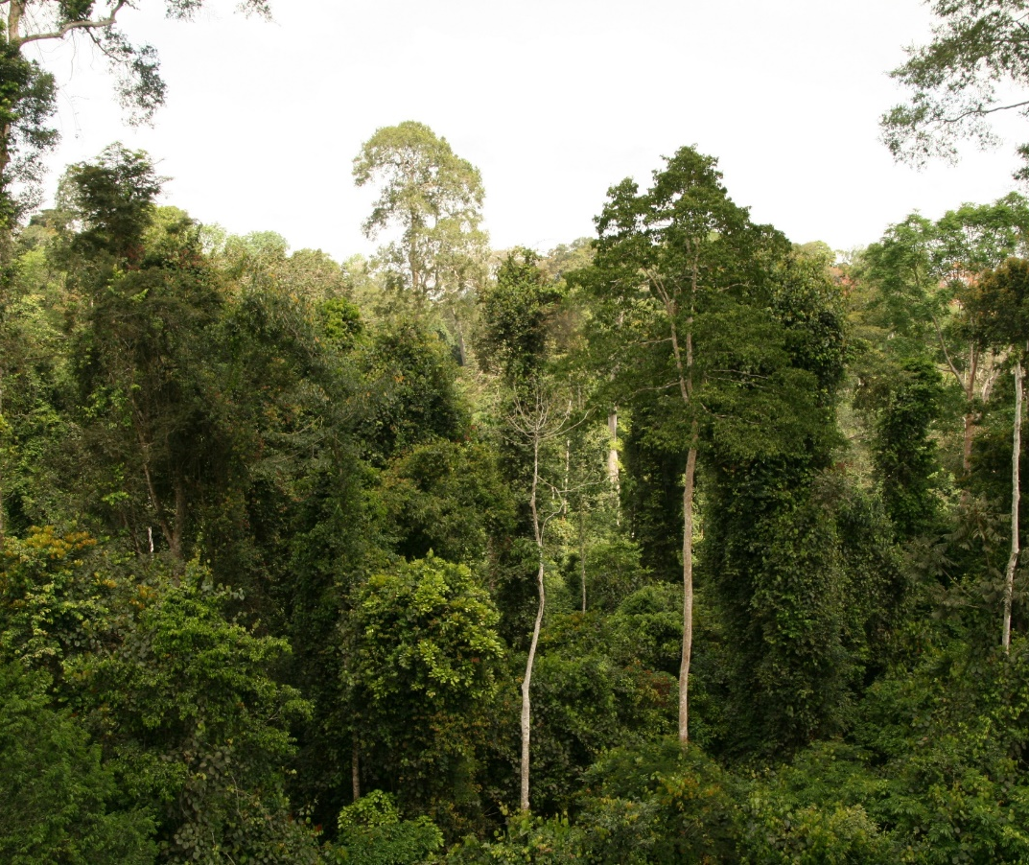
Activity 2.1: Forest and site – forests on earth
Notes:
Image from Pixabay: It is not necessary to quote the source

Slide 28
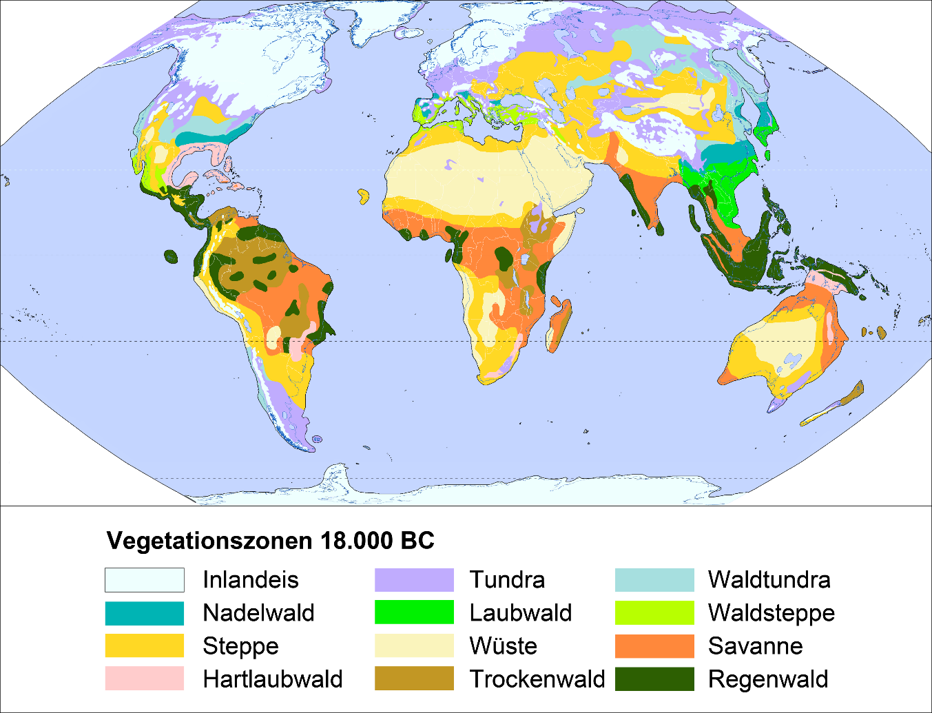
Activity 2.2: Forests in change
Vegetation zones 18,000 BC
Inland ice
Tundra
Forest tundra
Coniferous forest
Decid. forest forest
Forest steppe
Steppe
Desert
Savannah
Hard-leaf forest
Dry forest
Rain forest
Notes:
Image from Pixabay: It is not necessary to quote the source

Slide 29
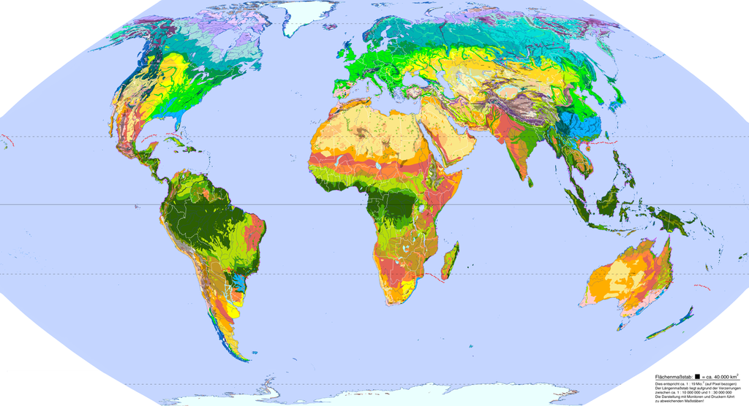
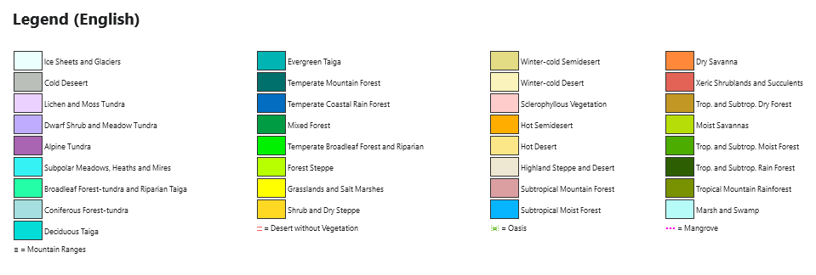
Activity 2.2: Forests in change
Notes:
Image from Pixabay: It is not necessary to quote the source

Slide 30
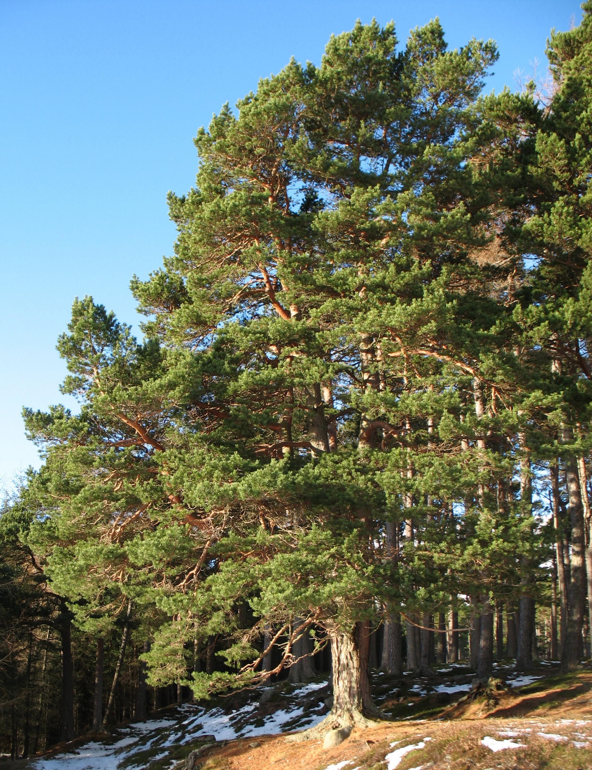
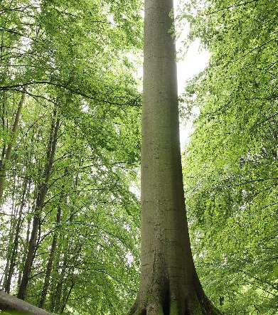
Activity 2.3: Forests & climate change
Beech (Fagus sylvatica)
Pine (Pinus sylvestris)
Which tree species is better suited for this location? Decide and reason your decision!
Site
Zone: Central Europe
Altitude: 700m ASL
Mean annual temperature: 7°C
Annual precipitation: 1100 mm/year
Soil: gravel materials of mixed sources, medium acidity, sandy loam
Soil moisture: fresh
Distribution: in Central Europe 300-1000 m ASL
Mean annual temperature: 4-12°C
Annual precipitation: 450-2000 mm/year
Soil: nutrient-rich, slightly acidic to calcareous, cohesive sandy to loamy
Soil moisture: moderate moisture
Special feature: young trees tolerate shade; old trees are very competitive in the fight for light and therefore often displace other tree species
Distribution: in Central Europe up to 2000 m ASL
Mean temperature: summer 9-20°C, winter -20-0°C
Annual precipitation: ≥ 400 mm/year
Soil: no special demands
Soil moisture: dry or wet
Special feature: undemanding tree species, tolerates many soils and climates, weak competition at good sites

Slide 31
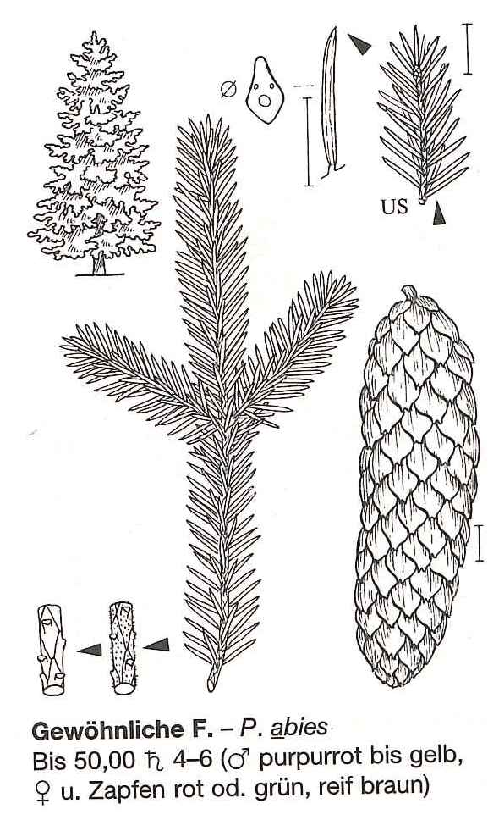
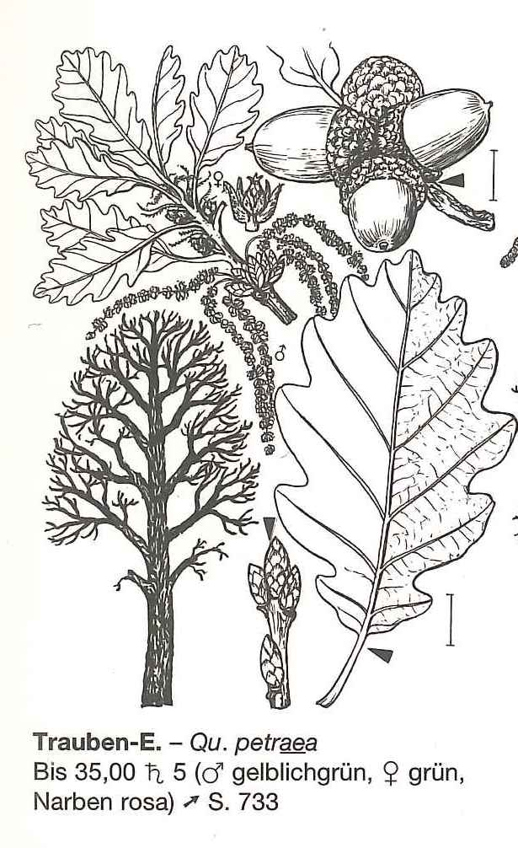
Activity 2.3: Forests & climate change
Spruce (Picea Abies)
Oak (Quercus petrae)
A forest owner hands over his estate to his daughter, a trained forester. Some areas are to be reforested. Which tree species should she choose for the new plantings?
Site
Alpine foothills, Burgenland, Austria
Altitude: 300m ASL
Mean temperature: 9°C
Annual precipitation: 800 mm/year
Soil: loam
Yearly yield: 11 m³/ha/year
Plan age for harvesting: 80 years
Average price per m³: 95 €
Risk: High risk caused by bark beetle, windthrow (loamy soils with low oxygen content leads to very flat root systems near to surface)
Yearly yield: 6 m³/ha/year
Plan age for harvesting: 120 years
Average price per m³: 115 €
Risk: low risk of windthrow (deep rooting system), low risk of bark beetle, medium risk of other insects

Slide 32
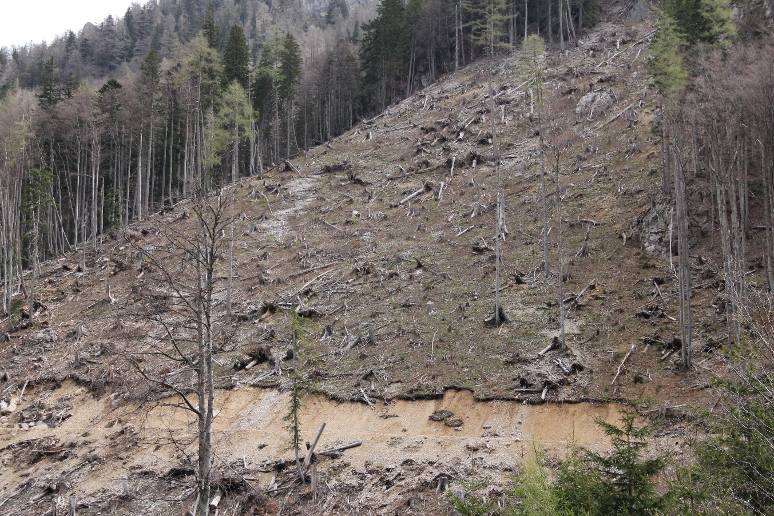
Activity 2.3: Forests & climate change
A heavy storm knocked down large parts of the forest. Since this is a protective forest, it must be reforested as quickly as possible.
Discuss in groups which aspects you need to consider to make a good decision: site conditions, legal and economic aspects …
Kosiak, Austria (Photo: Hanns Kirchmeir)

Slide 33
Christina.Pichler-Koban@aau.at

