Slide 1
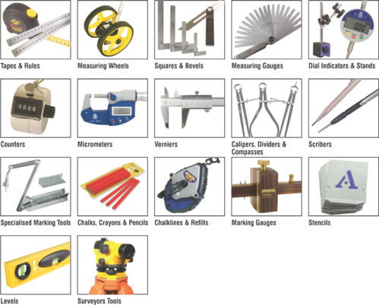
IO3 Measurement (Mathematics) Michiel Doorman, Monica Wijers & Vincent Jonker Utrecht University – Netherlands
Key competences for measurement &
The innovative role of IT measurement skills
Notes:
Check alignment with IO1 (we didn’t exchange anything earlier).

Slide 2
competences for measurement
Initial ideas about measurement competences (knowledge, skills & attitude)
Generating and using (personal) reference points for measurement
Schematizing situations (visualizing relations between units of measurement for the same quantity as well as between quantities) [in contrast with staircase representations to memorize adding/subtracting zeros – one of the learning boundaries/obstacles for this domain]
Measuring (selection of relevant quantity & appropriate measuring tool, reading & interpreting results)
Using appropriate language

Slide 3
Structure of our module
Describing the dimensions of each competence
Activities – own competence & teaching the competence
How many floor tiles? The floor area of your room is 4 x 5m. You want to cover it with tiles of 30 x 60cm. (own competence) How many tiles do you need to order? Find at least two strategies to solve the problem. (teaching the competence) How can this problem be used to promote students’ understanding and reasoning about area?

