Slide 1
De geschiedenis van de deling
Nationale Wiskunde Dagen 2014
Natascha Ralki & Sien Gielen

Slide 2
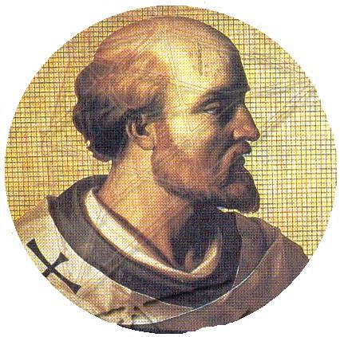
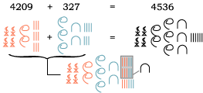
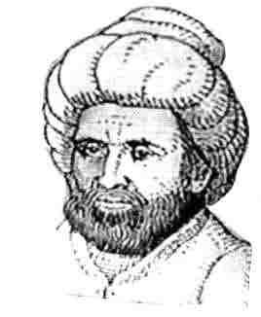
Egyptische deling
Gerbert
Ontbinden in factoren
De staart-deling
2000
v. Chr.
825 980
1400 1600 1800 2000
De galei-methode
De korte deling
De lange deling

Slide 3
Verklaring Egyptische deling

Slide 4
19 = 8 x 2 + 3
19 : 8
3 = 2 + 1
3 = 8 : 2 : 2 + 8 : 2 : 2 : 2
= 8 x + 8 x
19 = 8 x 2 + 8 x + 8 x
19 = 8 x ( 2 x + )

Slide 5
Verklaring Galeimethode

Slide 6
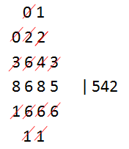
8 685 : 16
8 685 = (5  1 000) + 3 685
= (5  1 000) + (5  600) + 685
= 5  (1000 + 600) + 685
= 5  (1600) + 685
= 5  (1600) + [(4  100) + 285]
= 5  (1600) + [(4  100) + (4  60) + 45]
= 5  (1600) + [4  (100 + 60) + 45]
= 5  (1600) + (4  160) + 45
= 5  (1600) + (4  160) + [(2  10) + 25]
= 5  (1600) + (4  160) + [(2  10) + (2  6) + 13]
= 5  (1600) + (4  160) + [2  (10 + 6) + 13]
= 5  (1600) + (4  160) + (2  16) + 13]

Slide 7
Verklaring Gerbert

Slide 8
904 : 8
904 = 900 + 4 = 10 x 90
= (10 – 2) x 90 + 2 x 90 + 4
= (10 – 2)  90 + 180 + 4
= (10 – 2)  90 + (10 – 2)  18 + 2  18 + 4
= (10 – 2)  90 + (10 – 2)  18 + 40
= (10 – 2)  90 + (10 – 2)  18 + (10 – 2)  4 + 2  4
= (10 – 2)  90 + (10 – 2)  18 + (10 – 2)  4 + 8
= (10 – 2)  (90 + 18 + 4) + 8
= 8  (90 + 18 + 4 + 1)
= 8  113

Slide 9
Doorschuiven

Slide 10
Doorschuiven: eerste keer
1 → 2
2 → 3
3 → 1
4 → 5
5 → 6
6 → 4

Slide 11
Doorschuiven: tweede keer
1 → 3
2 → 1
3 → 2
4 → 6
5 → 4
6 → 5

