Slide 1
Science problem of the month
A problem of hearing
© 2014 Centre for Research In Mathematics Education University of Nottingham, mascil project (G.A. no. 320693); CC-NC-SA 4.0 license granted. The project mascil has received funding from the European Union’s Seventh Framework Programme (FP7/2007-2013).

Slide 2
Overview
Aims:
To design and use a simple hearing test;
To critically compare designs with others;
To understand the work of an audiologist;
We will:
Work as a group to design a simple hearing test;
Learn about different types of hearing loss and how they are diagnosed;
Act in the role of an audiologist to diagnose common hearing problems from audiograms.
© 2014 Centre for Research In Mathematics Education University of Nottingham, mascil project (G.A. no. 320693); CC-NC-SA 4.0 license granted. The project mascil has received funding from the European Union’s Seventh Framework Programme (FP7/2007-2013).

Slide 3
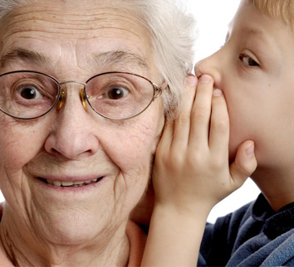
Discussion
It has been estimated that in the population:
1 in 6 people have some form of hearing loss;
1 in 30 wear hearing aids;
1 in 10 would benefit from a hearing aid.
There are many degrees of hearing loss between hearing well and hearing nothing but there is natural deterioration with age.
© 2014 Centre for Research In Mathematics Education University of Nottingham, mascil project (G.A. no. 320693); CC-NC-SA 4.0 license granted. The project mascil has received funding from the European Union’s Seventh Framework Programme (FP7/2007-2013).

Slide 4
A social problem
Hearing impairment can result in the following social problems:
Difficulty participating in conversations;
Difficulty hearing in a group situation, particularly with background noise;
Finding men’s voices easier to hear than women’s;
Needing the TV louder than other family members;
Misunderstanding what is being said;
Hearing better from one side than the other;
Missing parts of conversations;
Avoiding social situations.
(Source: Chime Social Enterprises, 2014)
© 2014 Centre for Research In Mathematics Education University of Nottingham, mascil project (G.A. no. 320693); CC-NC-SA 4.0 license granted. The project mascil has received funding from the European Union’s Seventh Framework Programme (FP7/2007-2013).

Slide 5
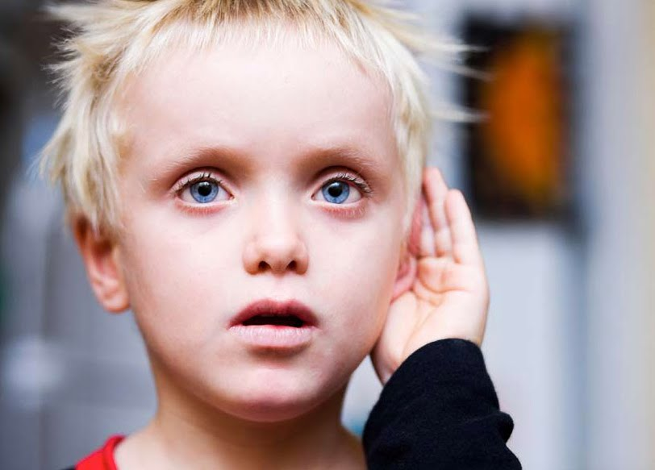
Designing a hearing test
Design a short hearing test that you can use to measure hearing ranges and construct a definition of what is ‘normal’ hearing.
© 2014 Centre for Research In Mathematics Education University of Nottingham, mascil project (G.A. no. 320693); CC-NC-SA 4.0 license granted. The project mascil has received funding from the European Union’s Seventh Framework Programme (FP7/2007-2013).

Slide 6
Design features
Features to consider:
What are the key variables?
How can sample sounds be generated easily and replicated consistently?
What sample of people will be tested?
Should hearing be tested for both ears independently or is the combined hearing most appropriate?
Is the predicted answer of ‘normal’ hearing going to be a single measurement or a range?
In what form might the results be best displayed?
What health and safety controls are needed?
© 2014 Centre for Research In Mathematics Education University of Nottingham, mascil project (G.A. no. 320693); CC-NC-SA 4.0 license granted. The project mascil has received funding from the European Union’s Seventh Framework Programme (FP7/2007-2013).

Slide 7
Audiology
Watch the video https://www.youtube.com/watch?v=9u9Ja4wyUaU
and use Handout 1 to understand more about:
The work of an audiologist;
Different types of hearing test;
Different types of hearing problem;
How audiograms are used in diagnosis.
© 2014 Centre for Research In Mathematics Education University of Nottingham, mascil project (G.A. no. 320693); CC-NC-SA 4.0 license granted. The project mascil has received funding from the European Union’s Seventh Framework Programme (FP7/2007-2013).

Slide 8
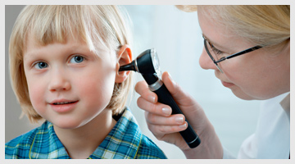
Final questions
What skills, knowledge and personal qualities are needed by an audiologist?
© 2014 Centre for Research In Mathematics Education University of Nottingham, mascil project (G.A. no. 320693); CC-NC-SA 4.0 license granted. The project mascil has received funding from the European Union’s Seventh Framework Programme (FP7/2007-2013).

