Slide 1
Mascil Mathematics and Science in Life
31 januari 2014
Monica Wijers, Vincent Jonker
Freudenthal Instituut
Notes:
Workshop on conference for math teachers – 40+ participants

Slide 2
Outline
15:30 – 15:45 : MasCil project
15:45 – 16:05 : Activity 1 - a mascil task
16:05 – 16:15 : Reflection
16:15 – 16:40 : Activity 2 - redesigning problems
16:40 – 16:50 : Reflection
16:50 – 17:00 : Filling in Questionnaire

Slide 3
The project
1

Slide 4
Mascil
“Mathematics and Science for Life”
European FP7-project: “supporting action on innovation in the classroom”
4 years (1-1-2013 tot 31-12-2016)
Professionial development of teachers: Enriching teaching repertoire, towards
Inquiry based scinece teaching (IBST)
Connecting math and science to world of work (WoW)

Slide 5
Aims
Promoting IBST in (primary and) secondary education
Making connections with the World of Work

Slide 6
How?
Collecting best practices - collection of ‘proven’ teaching materials
Setting up learning communities of teachers and representatives from industry and vocational education
Design and implement a professional development program for pre-service and inservice teacher education

Slide 7
Two quotes
World of work (Authenticity, etc.). Quote 1
Inquiry Learning. Quote 2

Slide 8
Quote 1 (Abrahamson et al. 2006)
About Authenticity: The authenticity of 'authentic inquiry' may depend more on engagement and reasoning it enables than on specific content

Slide 9
Quote 2 (Ainley et al, 2006)
Purpose:
Materials must have an explicit end product that the pupils care about.
Materials involve making something for another audience to use.

Slide 10
Connected projects
EU
inGenious
Primas
Establish
Parrise
Local
……
.....….
Notes:
Add local initiatives for

Slide 11
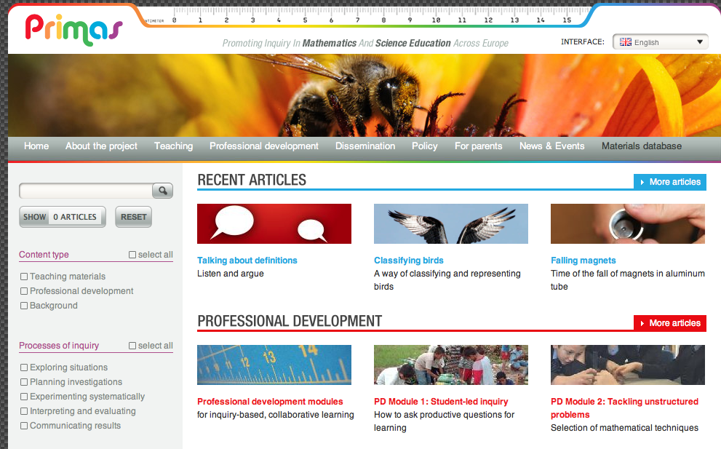

Slide 13
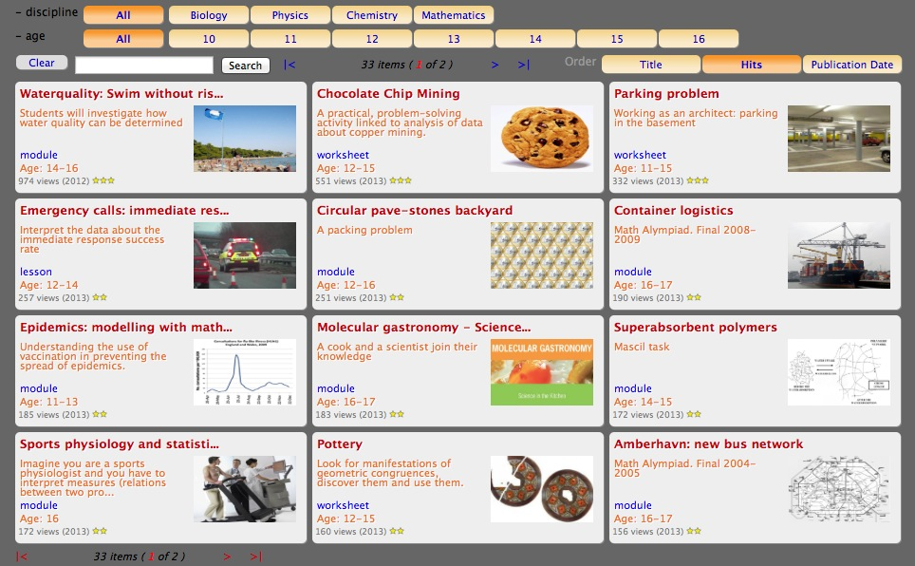

Slide 14
Activity: a mascil task
2

Slide 15
Drug concentration
See: http://www.mascil-project.eu/teaching-material.html
Or use direct url
http://www.fisme.science.uu.nl/toepassingen/28001/
Notes:
This is a Mascil Math example, replace by science example if needed

Slide 16
Instructions – smal groupd
Read the task
Get to know the task (as a student)
In your opinion: Is this an IBL task? What makes it IBL or non-IBL?
In your opinion: is this task connected to the World of Work? If, so how?

Slide 17
IBL characteristics named
……..
Notes:
Take notes of group reports

Slide 18
Connections to WoW found
……..
Notes:
Take notes of reports from groups.
Optional: present info on related professions (in this case farmaco-kinetics)

Slide 19
Mascil Framework
For IBL and WoW

Slide 20
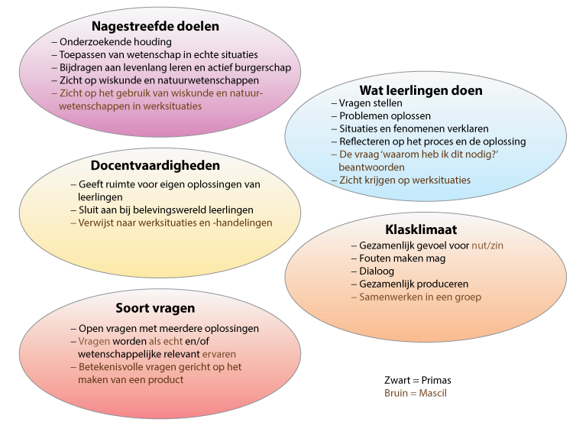

Slide 21
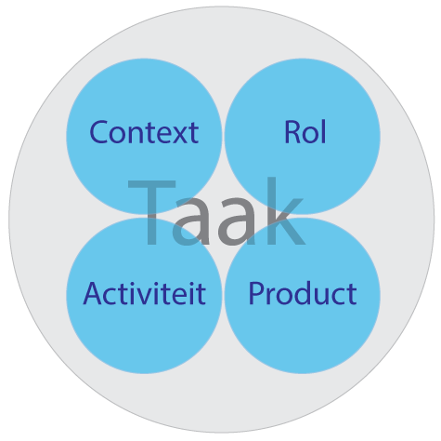

Slide 22
Redesigning textbook problems
3
Notes:
Or: designing Mascil tasks.

Slide 23
Mascil task
Textbook version
What is different? The same?
How to come from textbook problem to Mascil task?

Slide 24
Activity 2
Small groups
Read through the textbook problems
Select one and make it more ‘Mascil’

Slide 25
Reflection
Report briefly:
Which problem did you choose?
How did you make of it?
What did you do to change it?
Notes:
Mainly focus on what teachers did to change the problem (do not discuss the problems itself)

Slide 26
Guidelines for design

Slide 27
Guide-lines (IBL)
Remove structure from problems
Open up questions
Stimulate collaboration and communication

Slide 28
Guidelines (WoW)
Add a rich vocational context (or use rich vocational context as a start for design)
Give students a professional role
Build in workplace activities (similar to actions, processes or procedures used in workplaces)
Aim at products connected to the World of Work with a purpose for an audience

Slide 29
end
4

