Slide 1
Embodied approach in education: Understand mathematics as you learn to cycle
Anna Shvarts
a.y.shvarts@uu.nl
Summer School - 22 august 2022

Slide 2
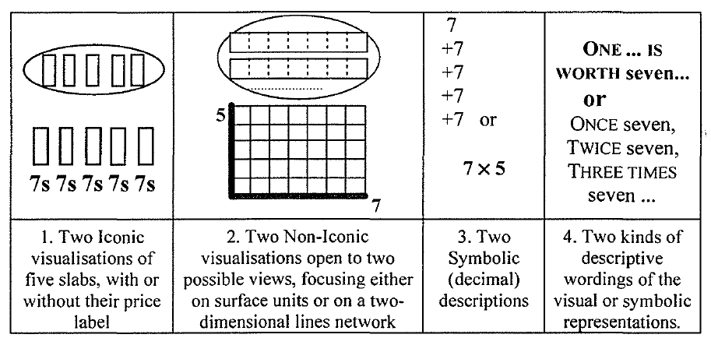
Multiple representations
A.Paivio (1971, 1986) Dual coding theory
Visual and verbal (propositional) information co-exist in cognition
R.Duval (2006, 2008) Multiple representations
Each mathematical concept is represented as a visual, algebraiс, verbal and other registers
Semiotic register is a representation and the rules how to read it

Slide 3
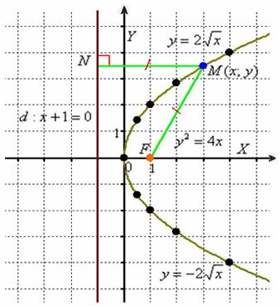
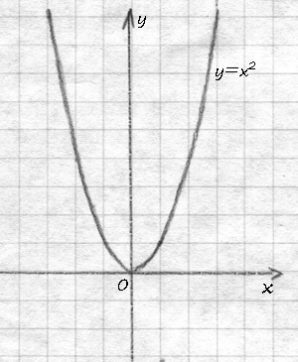
The problem of representation
One of the types of signs according to C. Peirce is the iconic sign which is “similar” to the object. But what does this “similarity” mean for mathematical visual models?

Slide 4
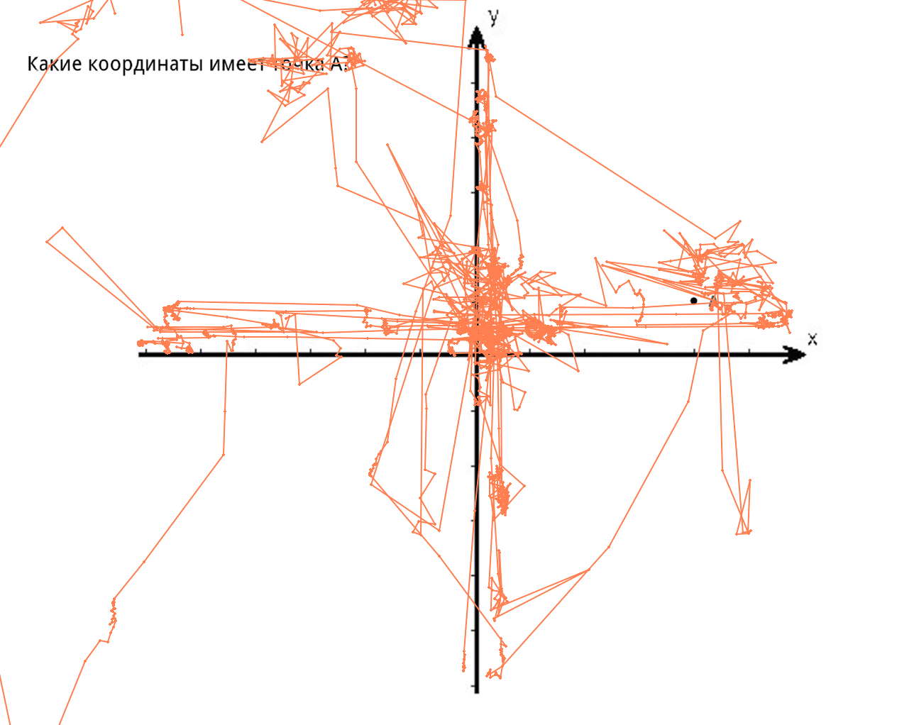
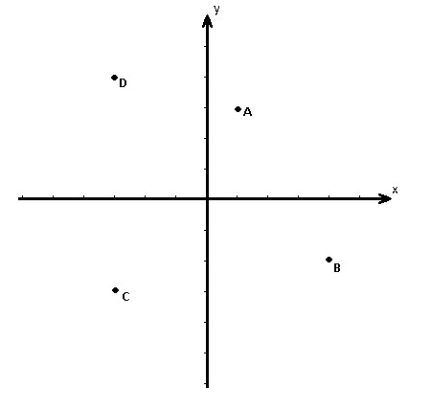
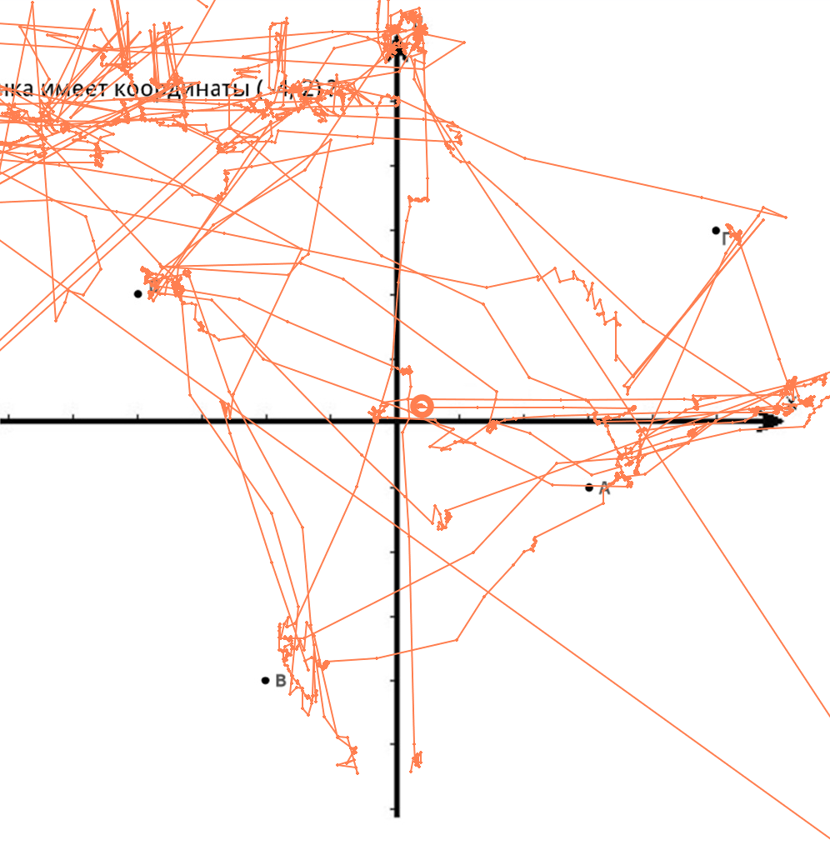
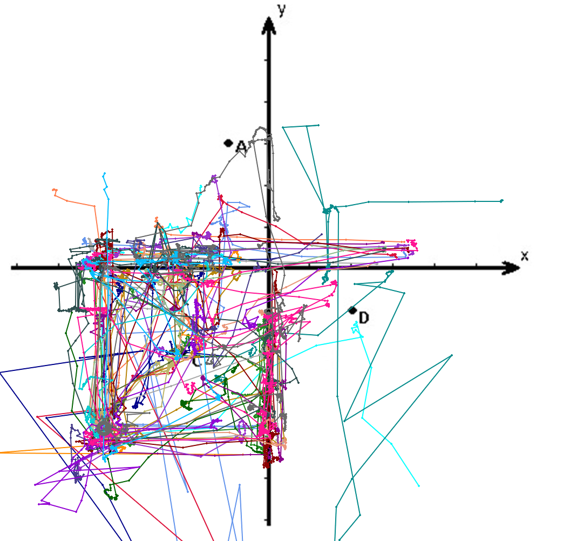
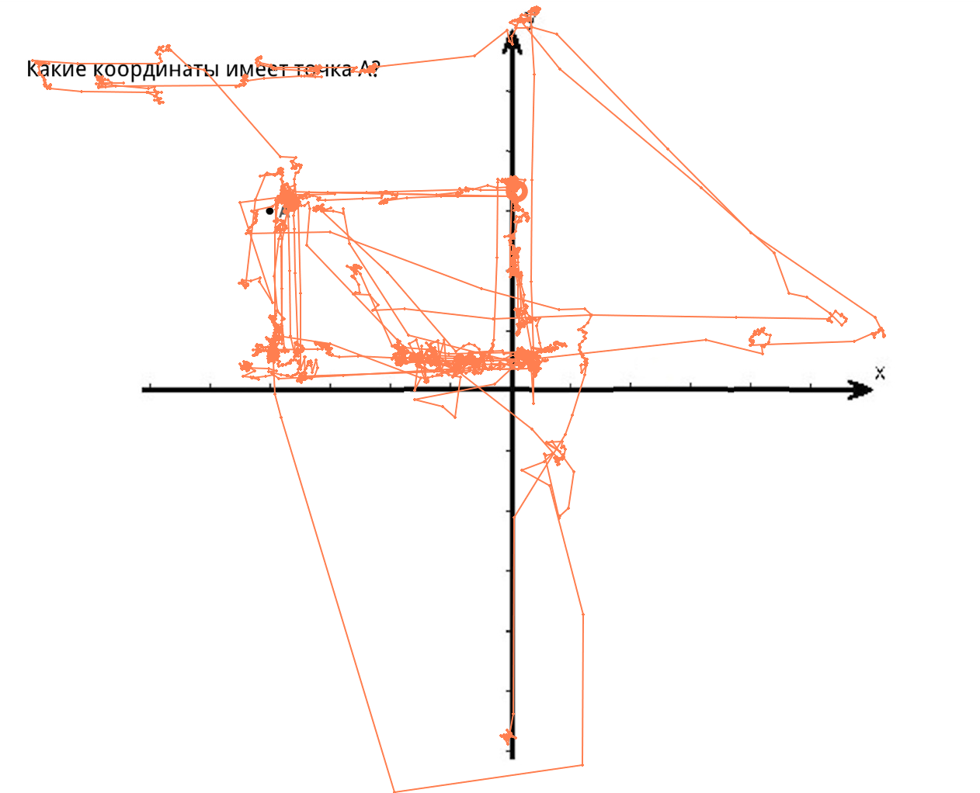
Theoretical perception: seeing meaningful structures
Which point has coordinates
(-3, -3)?
Eye-movements during adult’s explanation: new for of perception
Students
First grader
(Krichevets, Shvarts & Chumachenko, 2015; Shvarts, 2018)

Slide 5
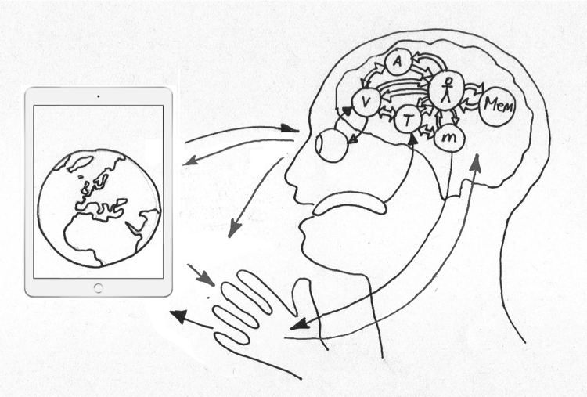
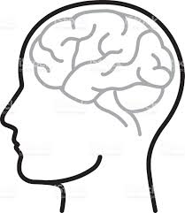
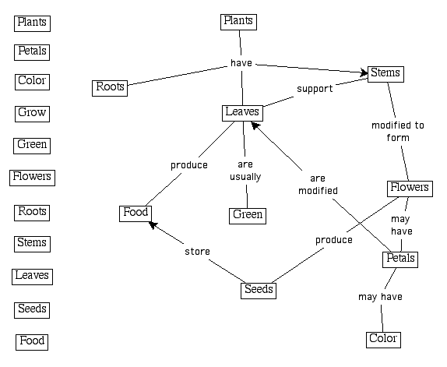
"Embodied turn” in cognitive science
✕
4E perspective: Embodied, embedded, enactive, extended cognition: 1990 – 2000 – now
(Barsalow, Rosch, Turvey, Kelso, Varela...)
from linear information processing and propositional perspective to knowledge
to organism-environment interaction and non-representative knowledge distributed between a person and an environment
Abstract
concepts
Rosa Alberto’s graphics

Slide 6
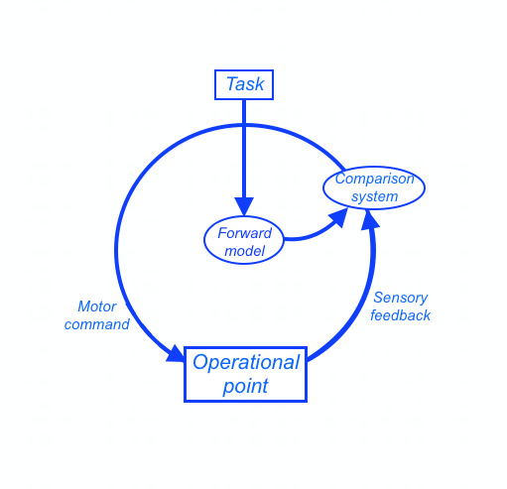
Organism-environment interaction:
multilevel system
Adopted from Bernstein, 1967 and Schubotz, 2007
Iterative constitution of the solution to a (motor) problem
Perception-action loops: perception focuses on the relevant for action aspects
Continuous adjustment on the basis of forward model and feedback
Multi-level systems: change of regulation level with automatization: attention to bigger units
Explore yourself!
Draw:

Slide 7
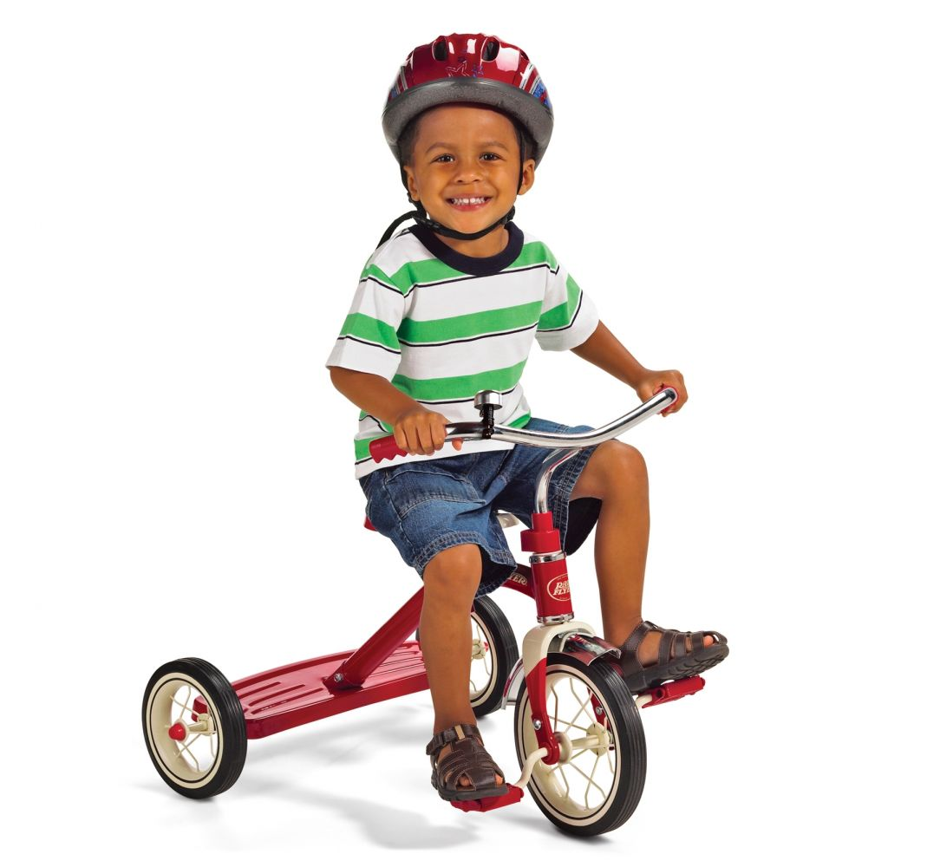
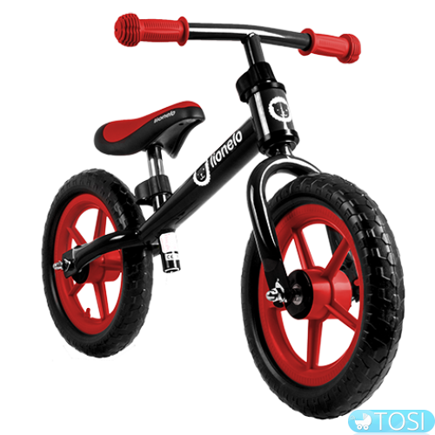
Who do we learn cycling?
Pedaling
Mathematical notations
Sensory-motor coordinations
Balance

Slide 8
Non-linear pedagogy: Embodied action-based design
Dor
Abrahamson
While the task is always given, the strategies to resolve the task are diverse and emerge through the practice in complex and dynamic environment. (Newell,Ranganathan, 2010; Chow, Atenchio, 2014; Abrahamson & Sanchez-Garcia, 2016)
presents a motor problem and provokes goal-oriented motor actions
provides continuous sensory feedback
postpones mathematical notations
Mental Imaginary Trainer for proportions (MITp)
The screen is green when one cursor is two times higher than another one from the bottom of the screen. (Abrahamson, 2014).
Try it yourself!

Slide 9
From embodied experience to mathematics
(See review: Alberto, Shvarts, Bakker, Drijvers, 2021)
Stage 1: Acting. Motor problem.
Find green positions and then maintain screen green
- developing actions and perception
- scaffolding by the system: green feedback
Stage 2: Reflecting. Description problem.
Describe your strategy of maintaining screen green
- developing mathematical discourse
- scaffolding by the tutor

Slide 10
Guess: what is the rule that makes triangle green?

Slide 11
From embodied experience to mathematics
(See review: Alberto, Shvarts, Bakker, Drijvers, 2021)
Stage 1: Acting. Motor problem.
Find green positions and then maintain screen green
- developing actions and perception
- scaffolding by the system: green feedback
Stage 2: Reflecting. Description problem.
Describe your strategy of maintaining screen green
- developing mathematical discourse
- scaffolding by the tutor
Stage 3: Mathematizing. Mathematical problem.
Solve a mathematical problem using the gained experience
Uses mathematical artifacts: grids, graphs
Lead to the development of formal expressions

Slide 12
Mathematizing parabola
(y-1)²+x² = (y+1)²
y=x²/4
(y-1)²+x²
y+1

Slide 13
Practical exercises
Students’ perspective:
Acting: Solve the motor problem
Reflecting: Reflect how you solved it
Mathematizing: Use this experience in solving mathematical problem
Teachers’ perspective:
Think, how you can use these tasks in a classroom.

Slide 14
Non-linear pedagogy
Creating Fields of promoted action:
special environments where a particular action is facilitated by the design of the environment and suggested problems (Reed & Bril, 1996; Abrahamson & Trninic, 2015)
Promoting some actions and letting the body to establish details of performance (Hutto, Sánchez-García, 2014)
Complex dynamic system of learning:
unification on the higher level doesn’t require similarity at the lower level and similar developed path

Slide 15
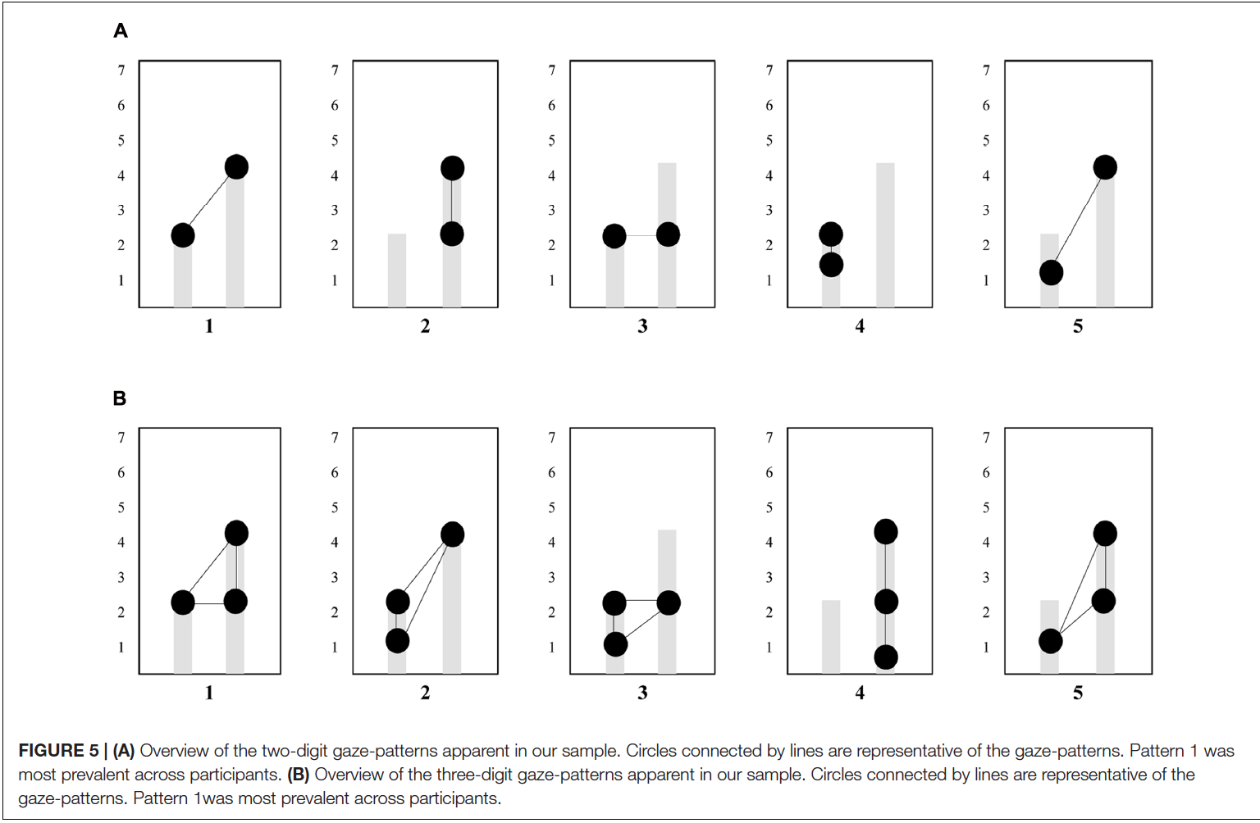
Idiosyncrasy of emergent patterns: the variety of student’s strategies
Duijzer, Shayan, Bakker, Van der Schaaf, & Abrahamson, Frontiers in Psychology, 2017.
The patterns vary from a student to a student
However, each of them might lead to conceptualization of rational relations

Slide 16
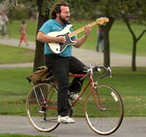
Mathematics understanding as multilevel system
Multiple levels of the system respond to multiple tasks:
Motor problem: Sensory-motor level
Description problem: Verbal level
Formalization problem: Algebraic level
The system of each student is unique,
and, yet, it fits mathematical culture.
(See a paper on body-artifact functional system:
Shvarts, Alberto, Bakker, Doorman, Drijvers, ESM, 2021)

Slide 17
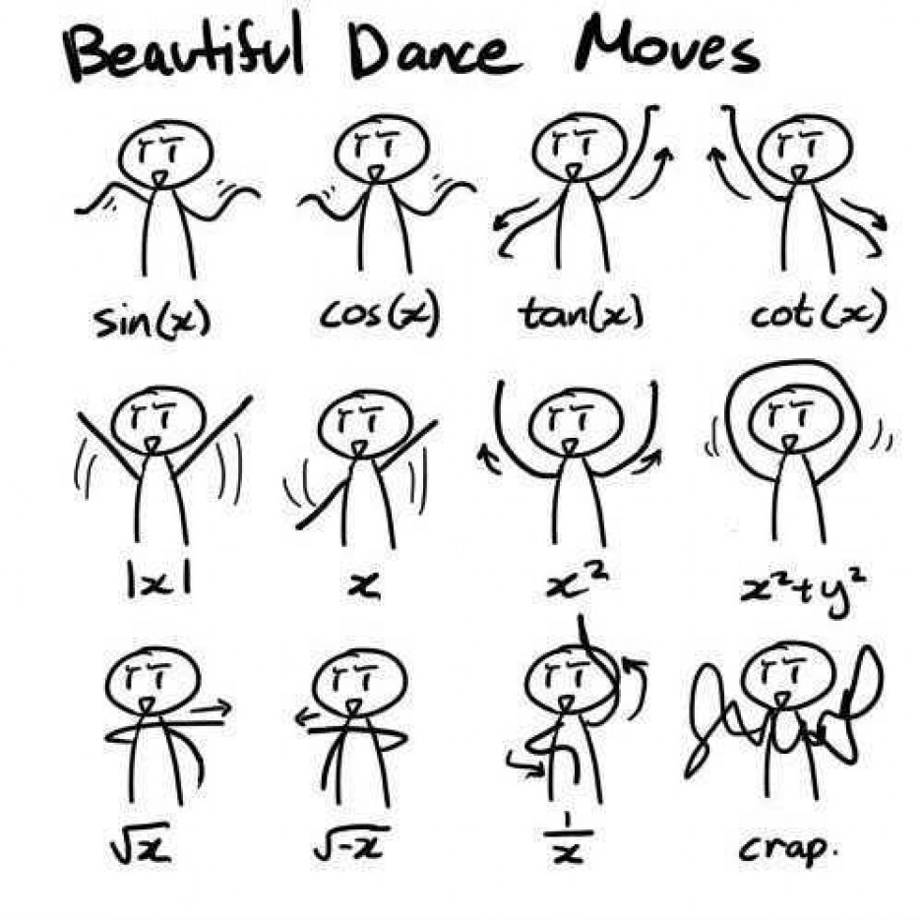
Thank you for your attention!
Questions?

Slide 18
Recommended sources
Embodied cognition in education and beyond:
Wilson, A., & Golonka, S. (2013). Embodied Cognition is Not What you Think it is. Frontiers in Psychology, 4, 58.
Macrine S. & Fugate J. (2022), Movement matters: How embodied cognition informs teaching and learning. MIT Press.
Embodied design:
https://embodieddesign.sites.uu.nl/
Abrahamson, D., Nathan, M. J., Williams-Pierce, C., Walkington, C., Ottmar, E. R., Soto, H., & Alibali, M. W. (2020). The Future of Embodied Design for Mathematics Teaching and Learning. Frontiers in Education, 5, 147.
Alberto, R., Shvarts, A., Drijvers, P., & Bakker, A. (2021). Action-based embodied design for mathematics learning: A decade of variations on a theme. International Journal of Child-Computer Interaction, 100419.

